Slide 1
CSCI – 4135: Spring 2022
Web Application Engineering
Instructor: Sujoy Chakraborty
Lecture Slides – 25

Slide 2
Angular

Slide 3
Outline
Angular CLI
Components
Services
How to build a real-world web application using Angular

Slide 4
Versions: AngularJS to Angular
AngularJS was introduced in 2010
V2 introduced in 2015
V2 final release in 2016
Follows Semantic Versioning
Version 2+ is just called Angular
AngularJS: v1, Angular: V2+

Slide 5
TypeScript
Even though JavaScript is super popular and widely used, it has some drawbacks:
- JavaScript is not strongly typed
- We cannot specify the data type of a variable, or the type of arguments/return type of a function
- Ability to specify type information saves a lot of debugging time (an application wouldn’t compile if the type is used incorrectly)
function multiply(x, y) {
return x * y;
}
multiply(‘bob’, 3); //Syntactically perfectly valid (No way for us to detect such incorrect use).
Solution: Using TypeScript

Slide 6
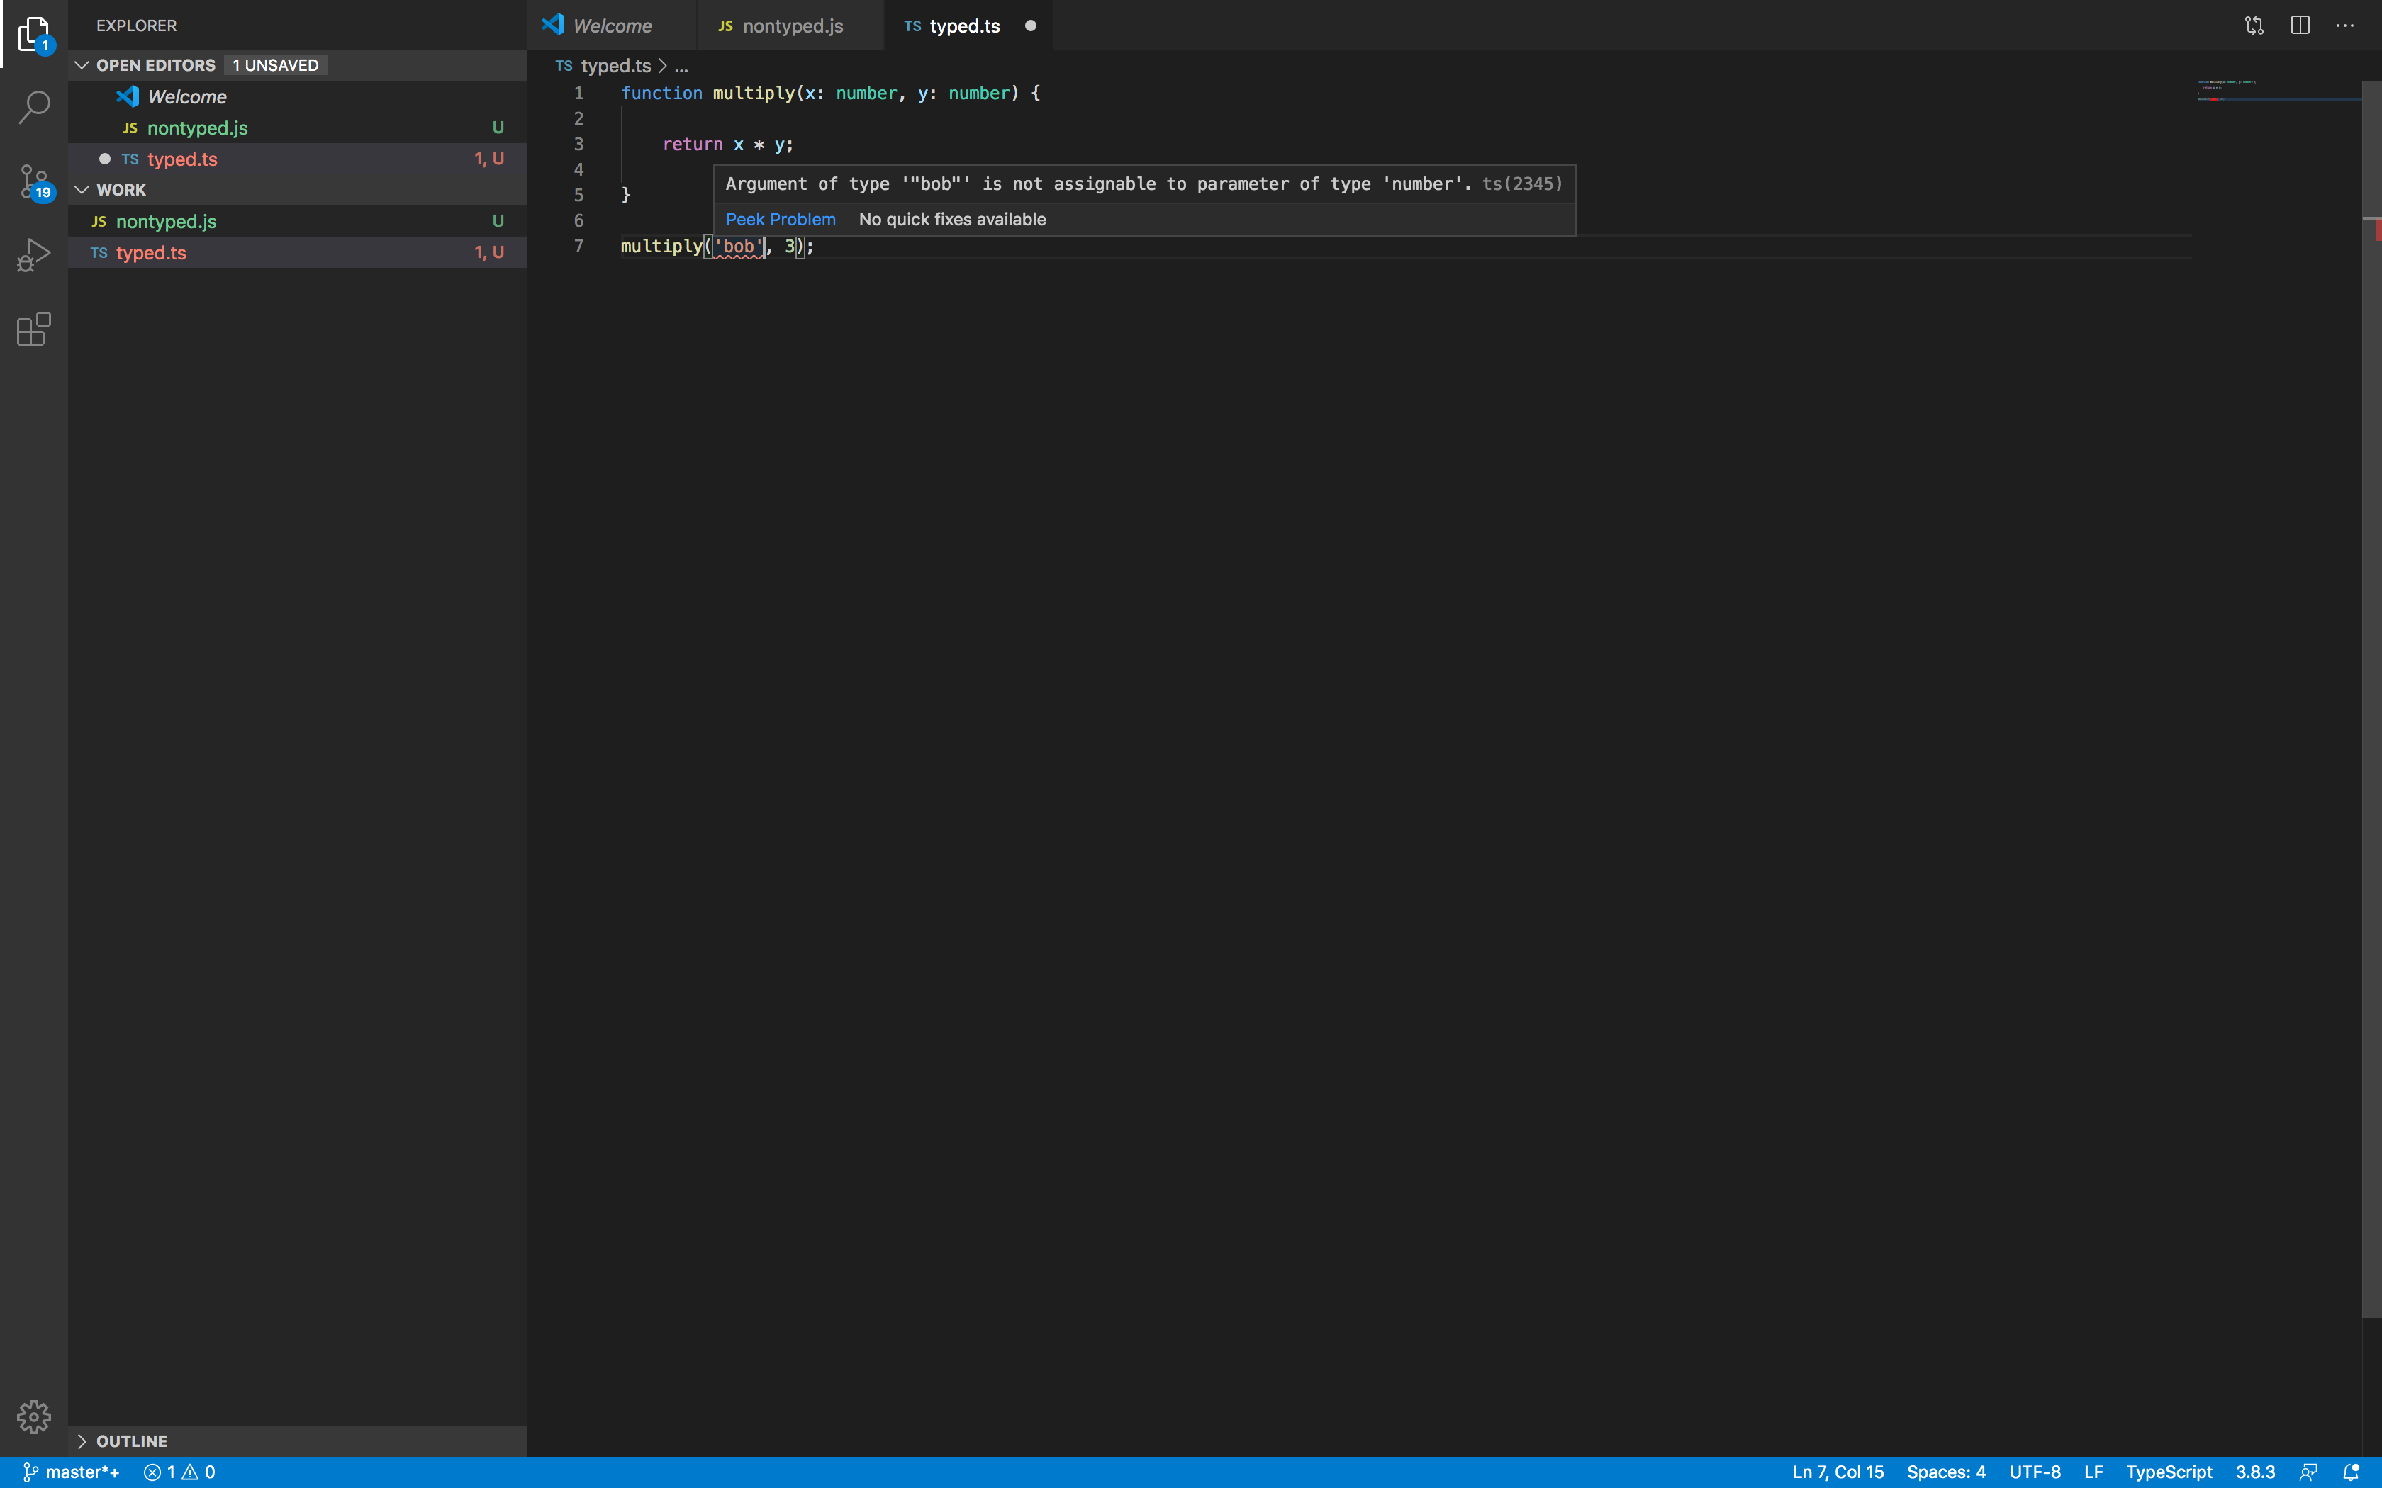
TypeScript – cont.
TypeScript is a language created by Microsoft
Allows us to use type information in JavaScript
TypeScript needs to be converted to regular JavaScript (transpilation) so that it is understood by the browser
function multiply(x: number, y: number) {
return x * y;
}
Multiply(‘bob’, 3) //Gives an error due to incorrect type specification. We can view it on the editor itself.

Slide 7
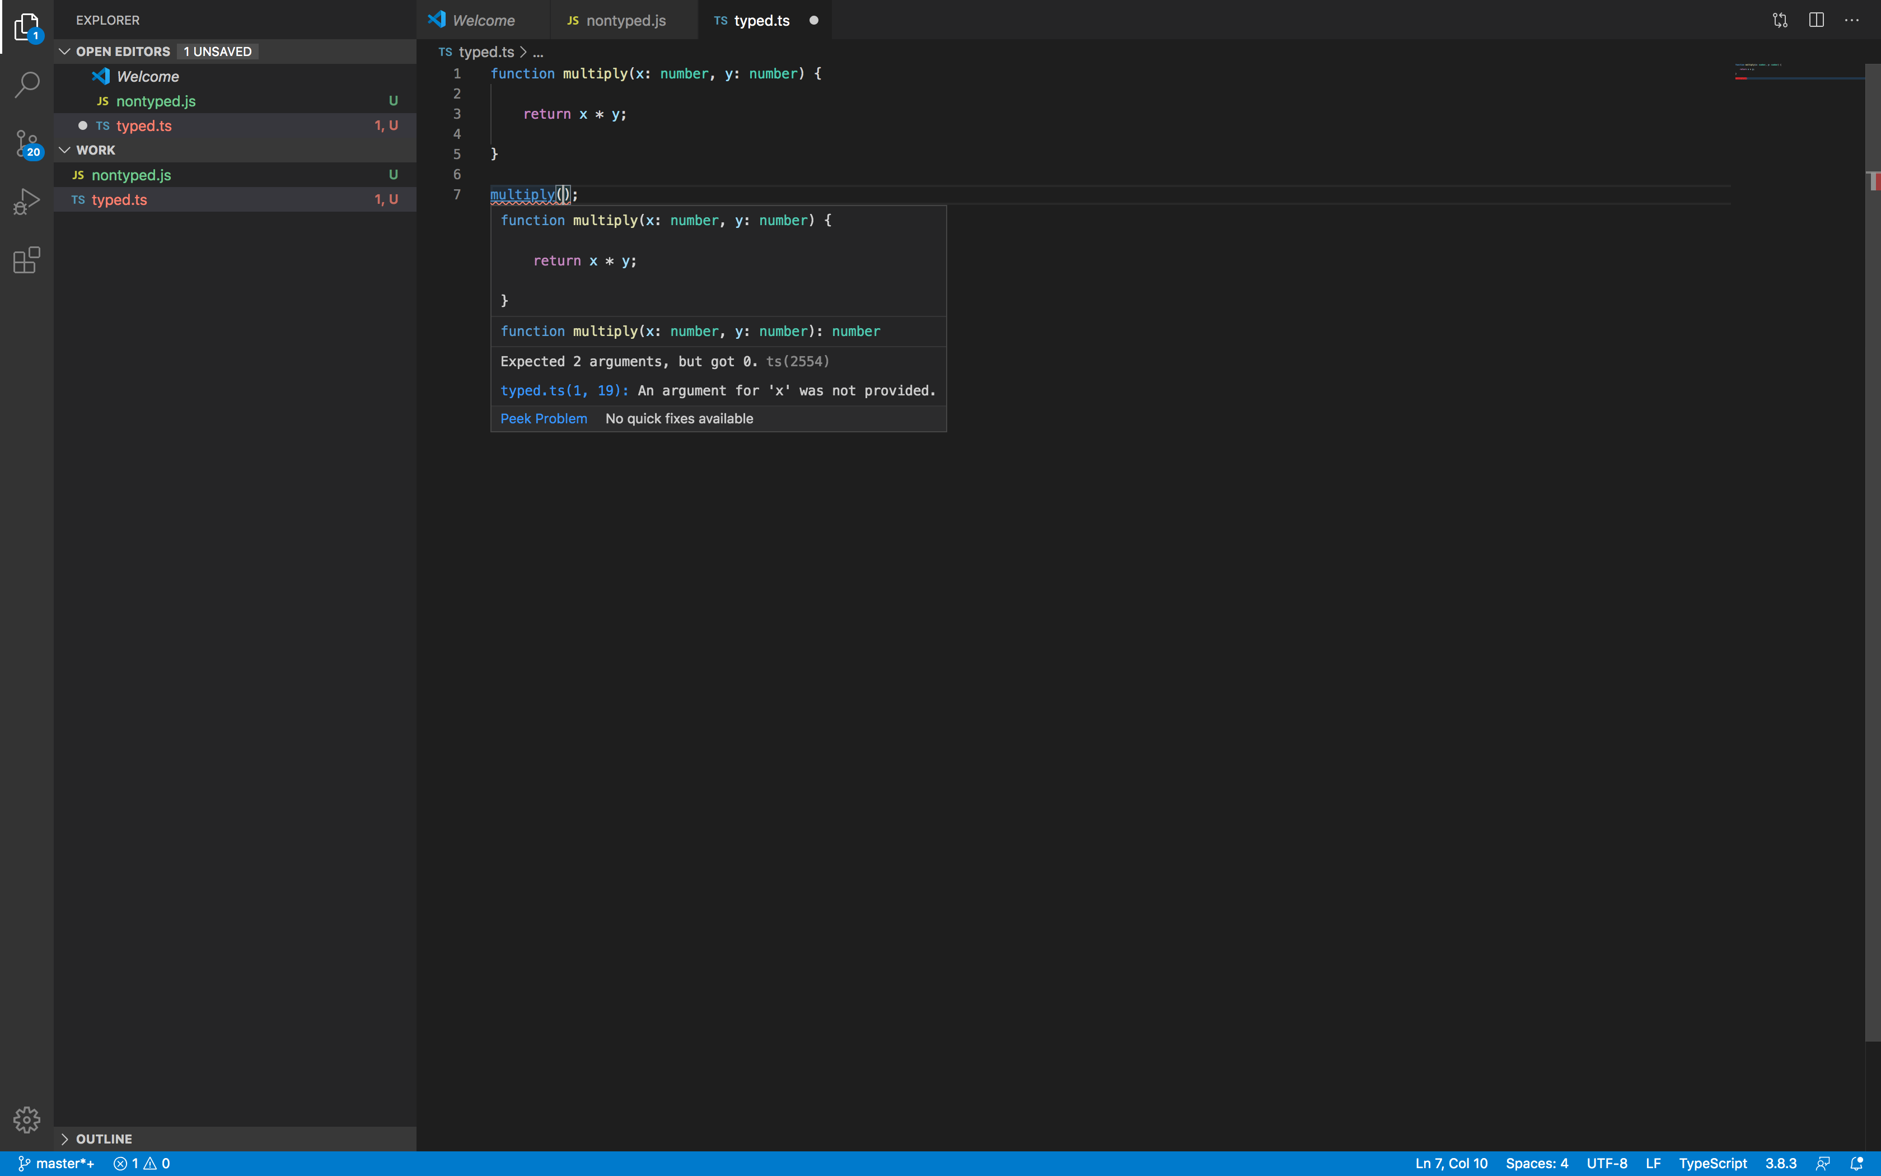
TypeScript – cont.
Advantages:
- Makes the application easier to debug (incorrect usages are detected right away in the editor, before we execute the application on browser.)
- Gives us a lot more information about the usage of a library/function when we create our applications.

Slide 8
Using the Angular CLI
When we write our applications, we will use TypeScript:
- type check that we get is beneficial
- documentation on the Angular website shows everything in TypeScript first
- Many libraries used in Angular applications are written in TypeScript
Web browsers do not understand TypeScript.
It needs some translation into regular JavaScript file: a process known as transpilation.

Slide 9
Using the Angular CLI – cont.
{
"compileOnSave": false,
"compilerOptions": {
"baseUrl": "./",
"outDir": "./dist/out-tsc",
"sourceMap": true,
"declaration": false,
"downlevelIteration": true,
"experimentalDecorators": true,
"module": "esnext",
"moduleResolution": "node",
"importHelpers": true,
"target": "es2015",
"lib": [
"es2018",
"dom"
]
}
Let us consider the following example:
function multiply(x: number, y: number) {
return x * y;
}
multiply(2, 3);
let Name: string;
Name = ‘John’;

Slide 10
Using the Angular CLI – cont.
To convert the TypeScript code to regular JavaScript, use the command: tsc <filename>.ts
Below is the converted code after transpilation:
function multiply(x, y) {
return x * y;
}
multiply(2, 3);
var Name;
Name = ‘John’;
Notice that we have lost the type information after trsanspilation.

Slide 11
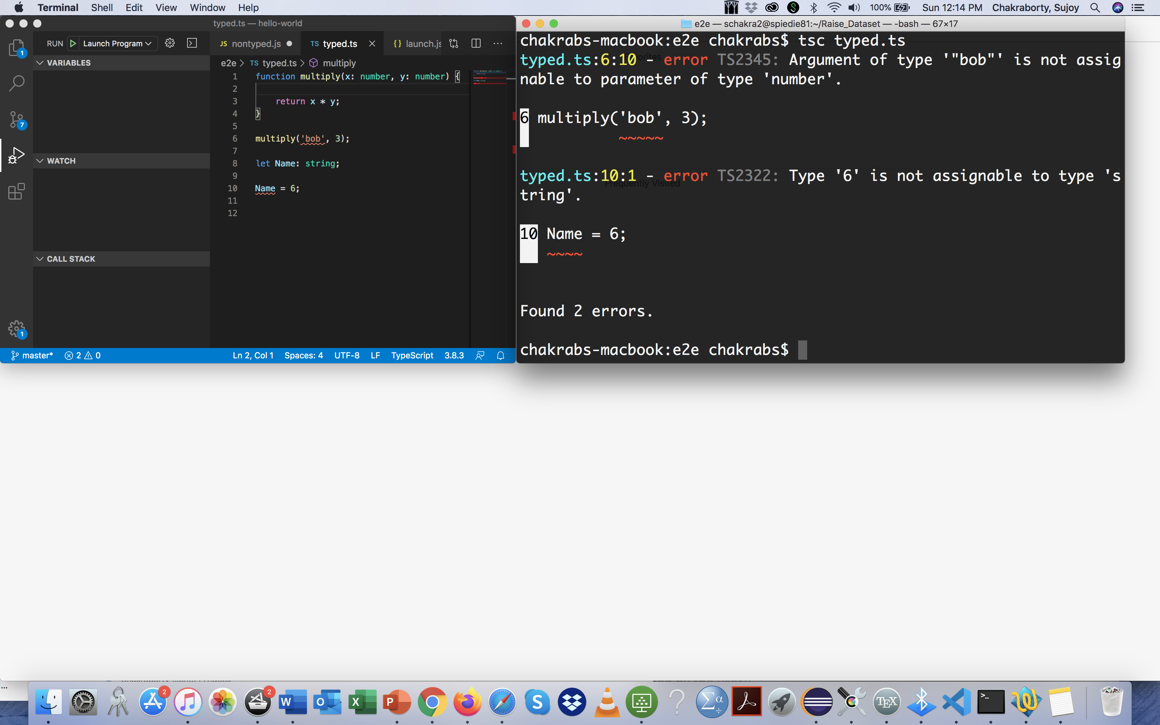
Using the Angular CLI – cont.
So, we might ask what is the point of using TypeScript if it gets converted to JavaScript in the end.
The answer to that is: TypeScript is still useful because it lets us find ahead of time incorrect uses of data:
1) on the editor when we code
2) at the time of transpilation

Slide 12
Using the Angular CLI – cont.
Typically, developing an Angular application is much more involved than just compiling TypeScripts to JavaScripts.
We also need to do module bundling (taking all the code of the angular framework, our application code and other dependencies and put everything together into a module that the browser can understand).
This is typically done with systemJs or webpack.
Setting the configuration for systemJs or Webpack to make sure that everything comes together to work properly can be sometimes tricky.
To facilitate the development and running of applications, we will use Angular CLI (Command Line Interface for Angular).

Slide 13
Using the Angular CLI – cont.
Using Angular CLI, it is very easy to develop and execute an application.
Runs on nojeJs (Refer to the installation guide). Steps to be followed to invoke an angular application:
Installation : npm install -g angular-cli
Usage : ng –help
Generating and Serving a project via development
server : ng new PROJECT-NAME
cd PROJECT-NAME
ng serve
Navigate to http://localhost:4200/. The app automatically reloads when source files are modified.

Slide 14
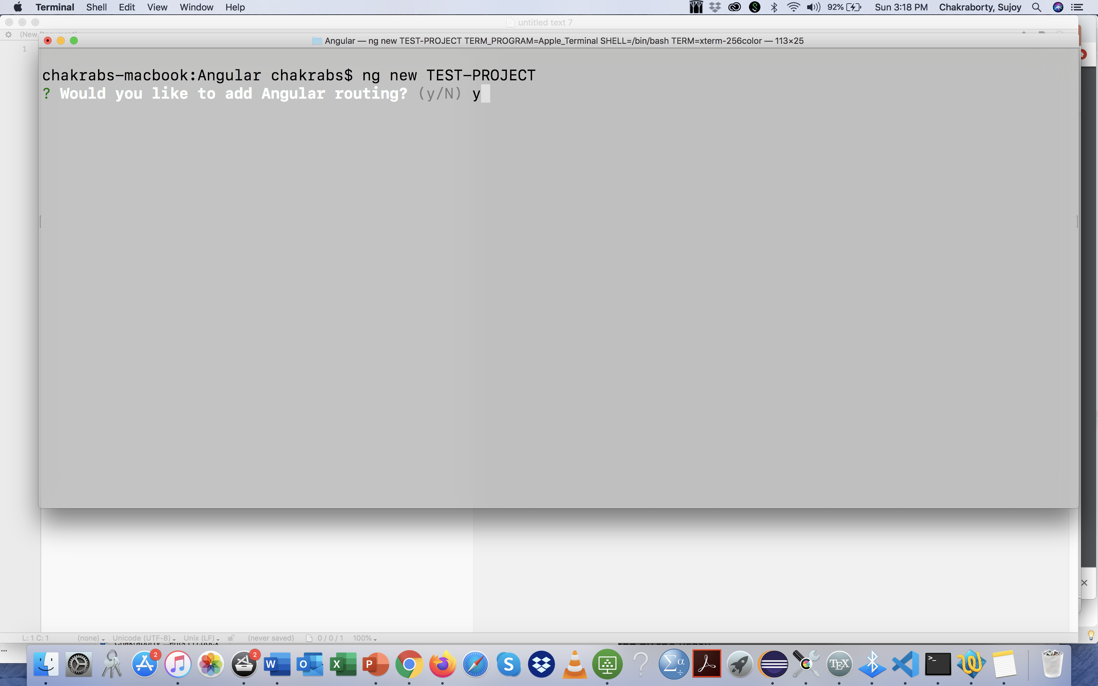
Using the Angular-CLI – cont.

Slide 15
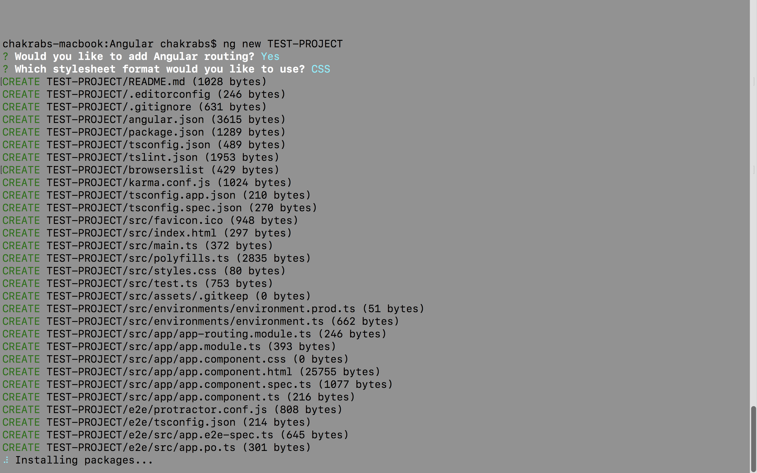
Using the Angular-CLI – cont.

Slide 16
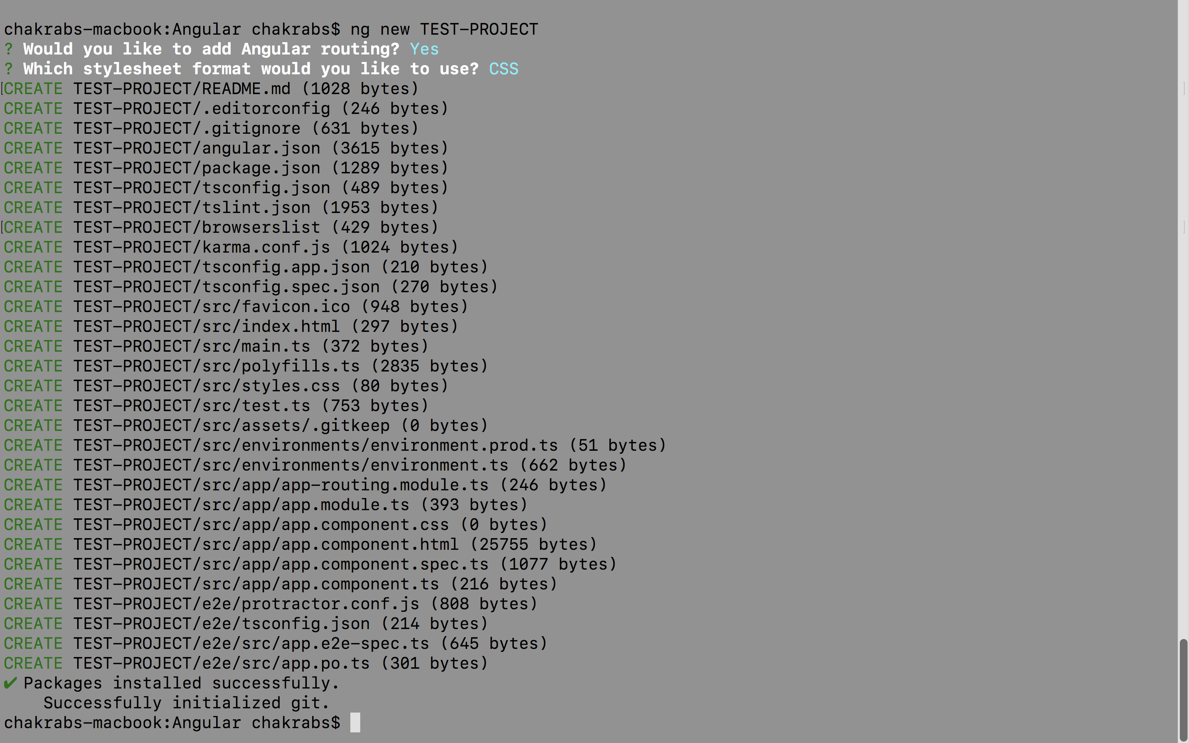
Using the Angular-CLI – cont.

Slide 17
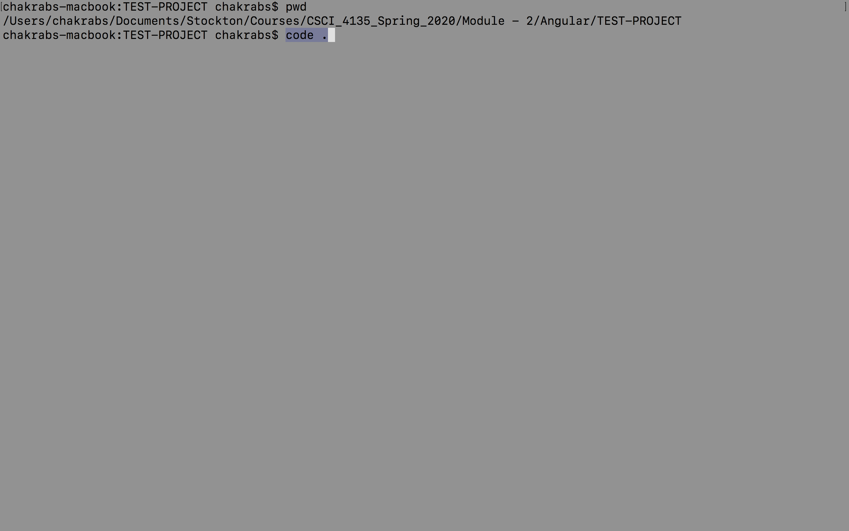
Using the Angular-CLI – cont.

Slide 18
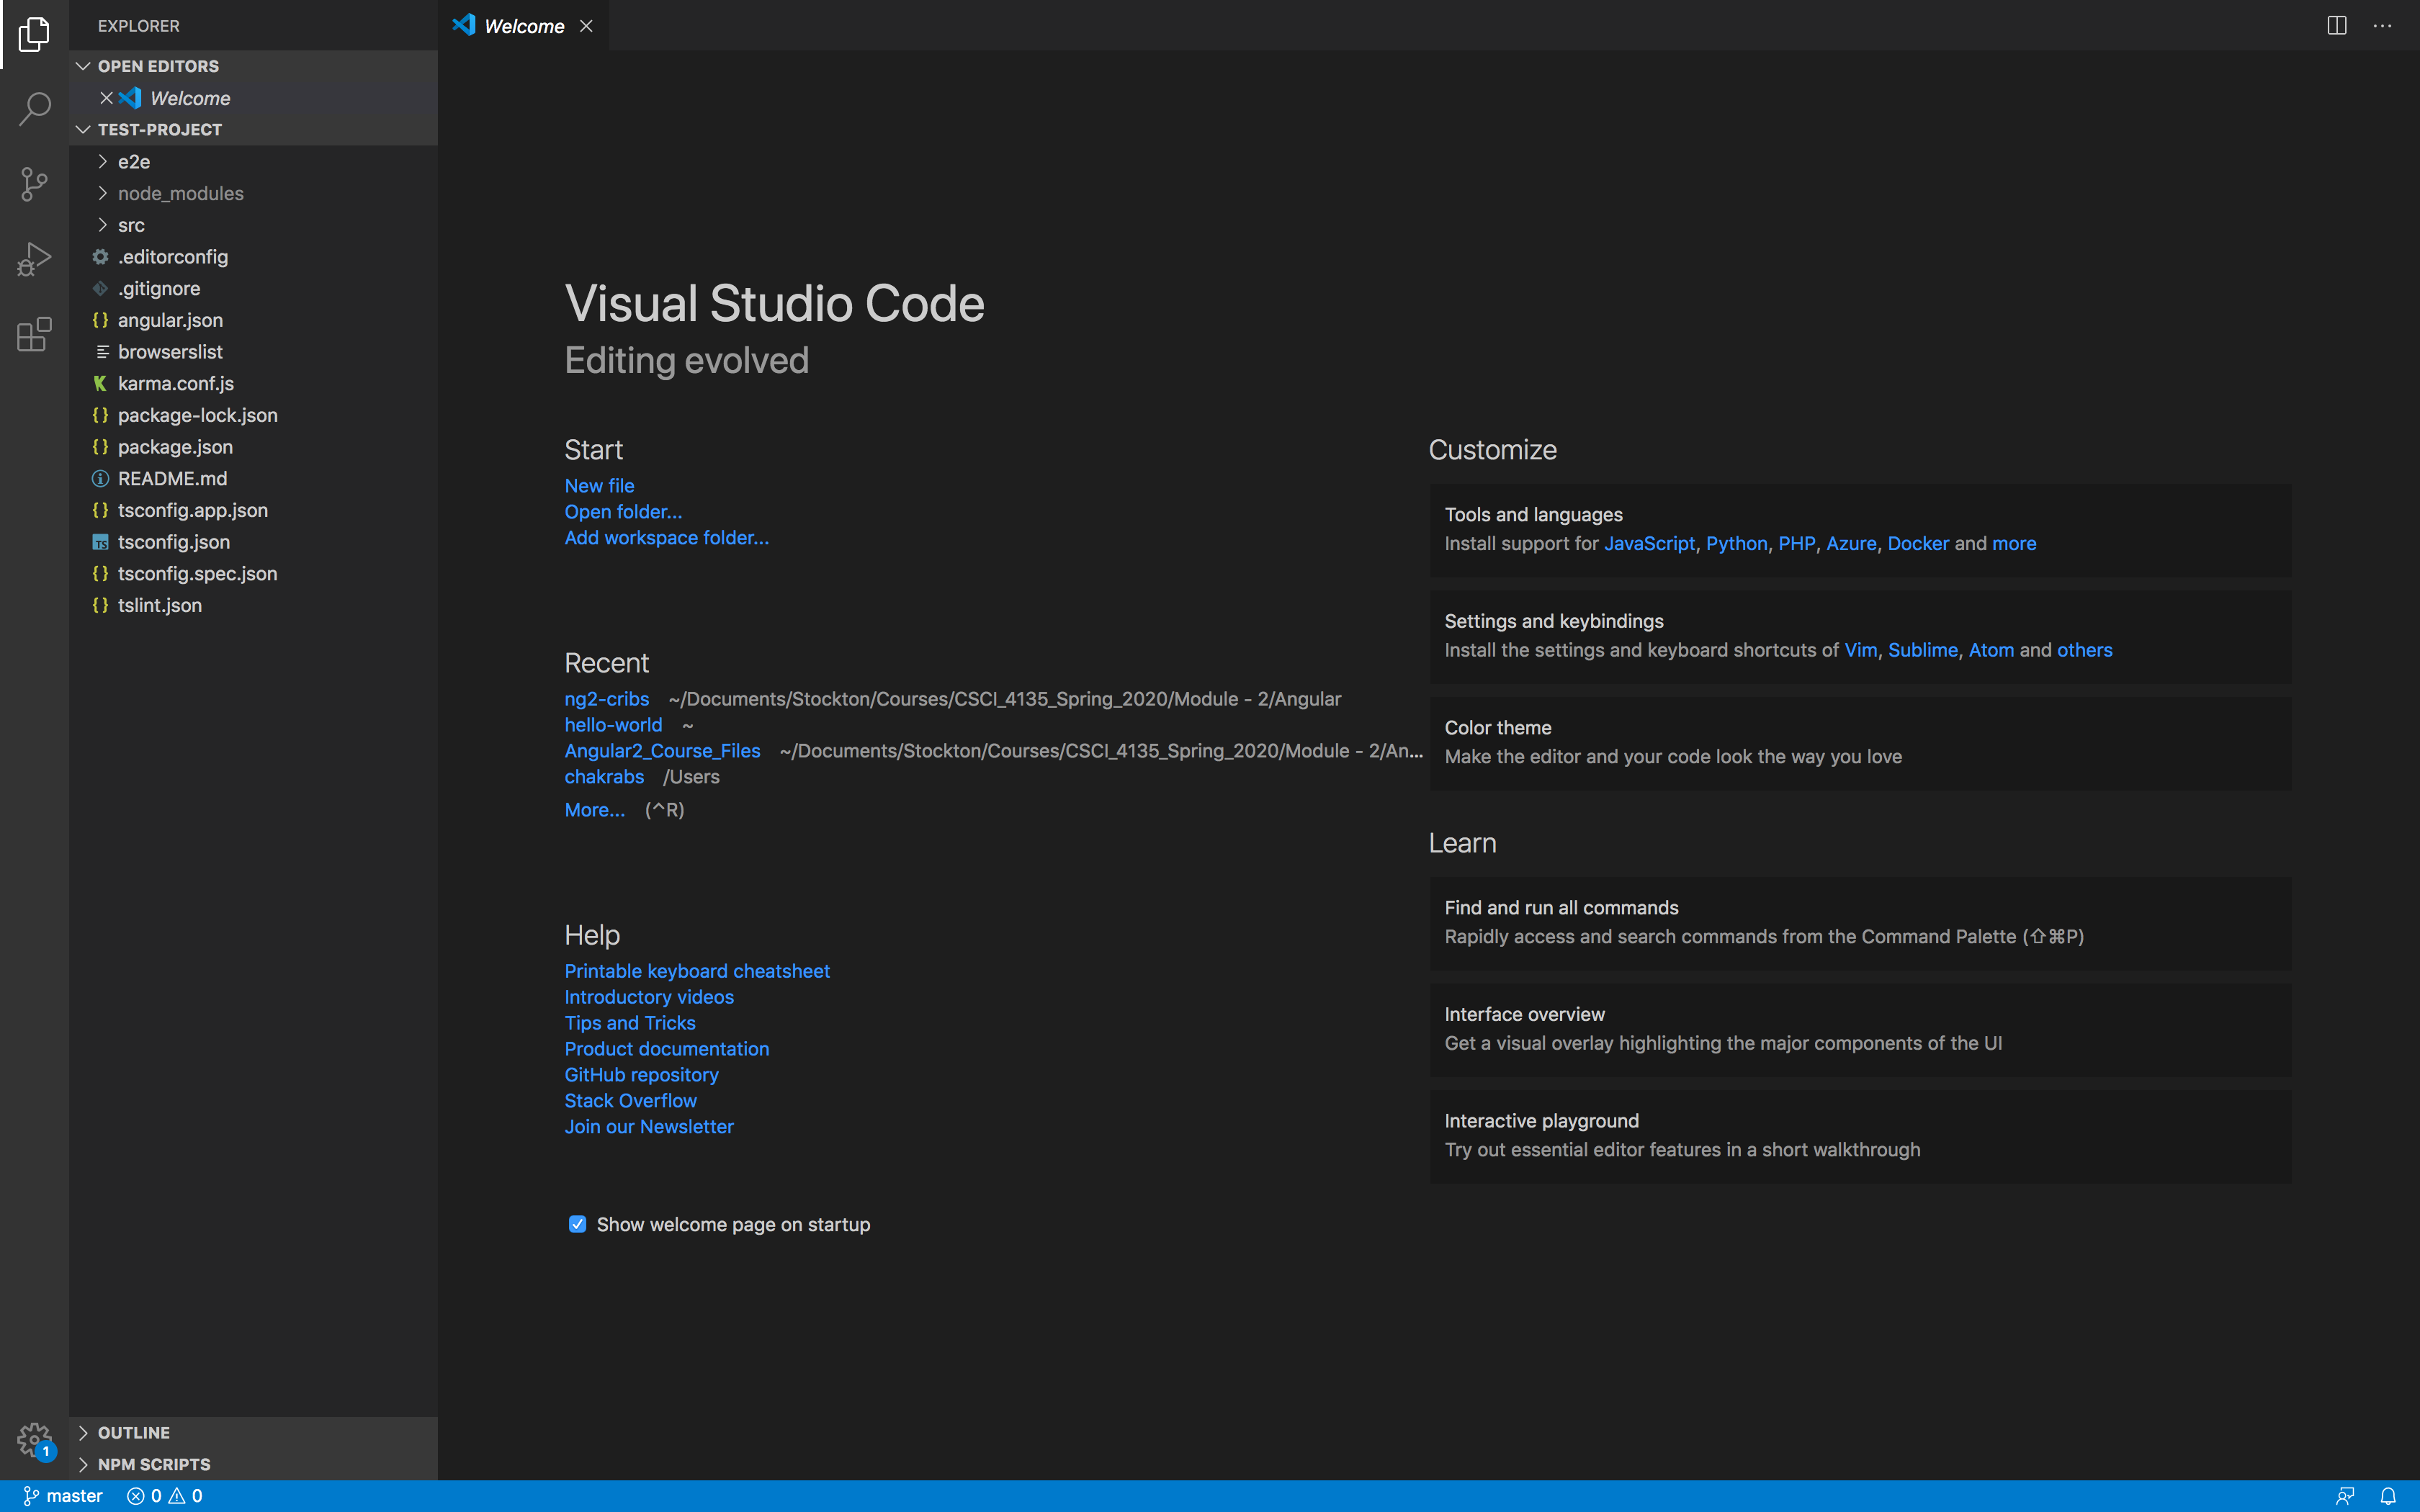
Using the Angular-CLI – cont.

Slide 19
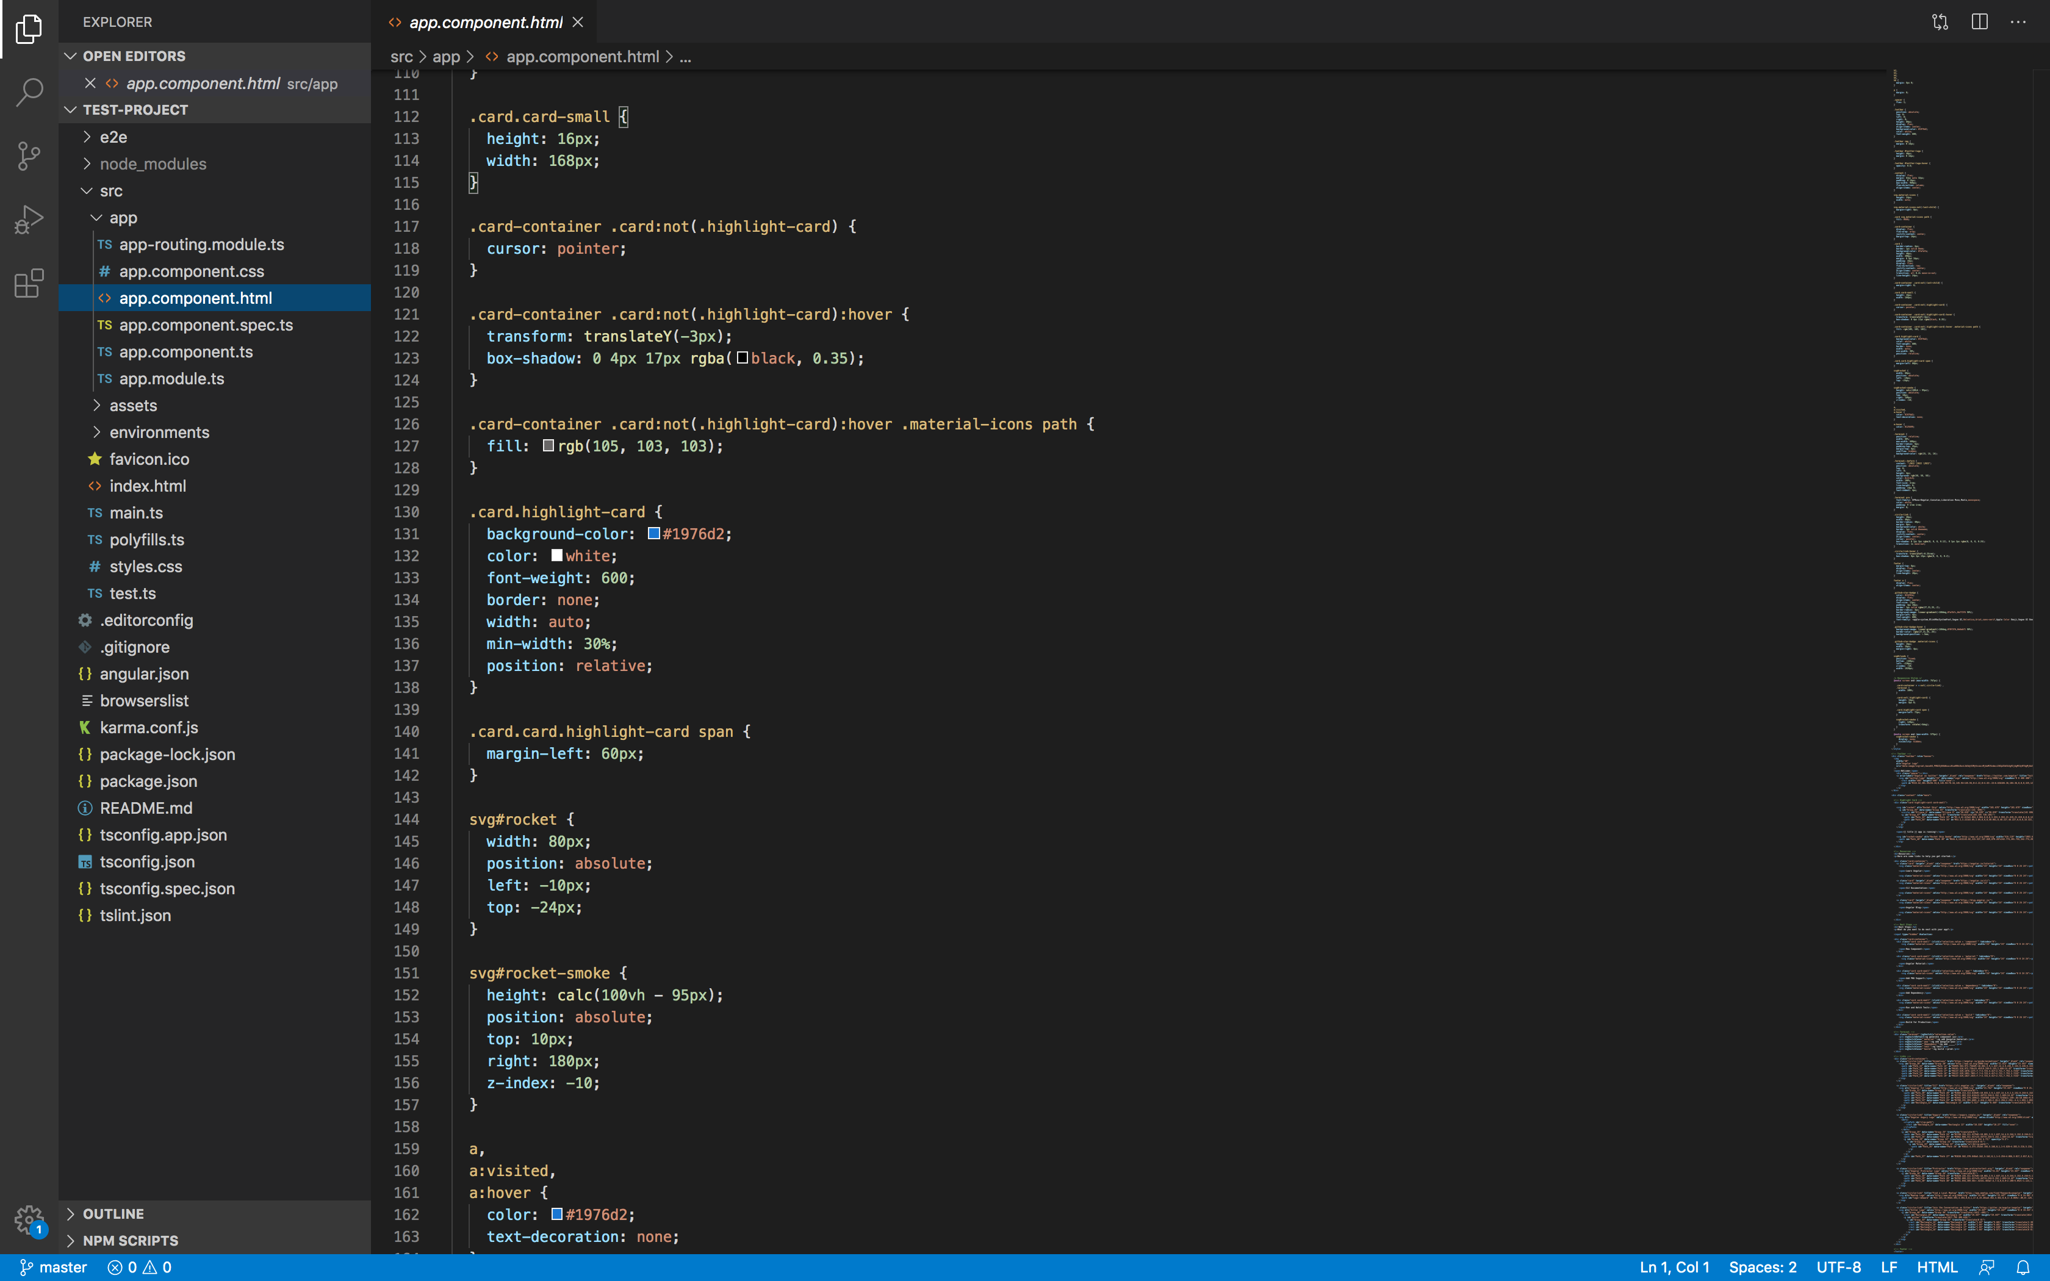
Using the Angular-CLI – cont.

Slide 20
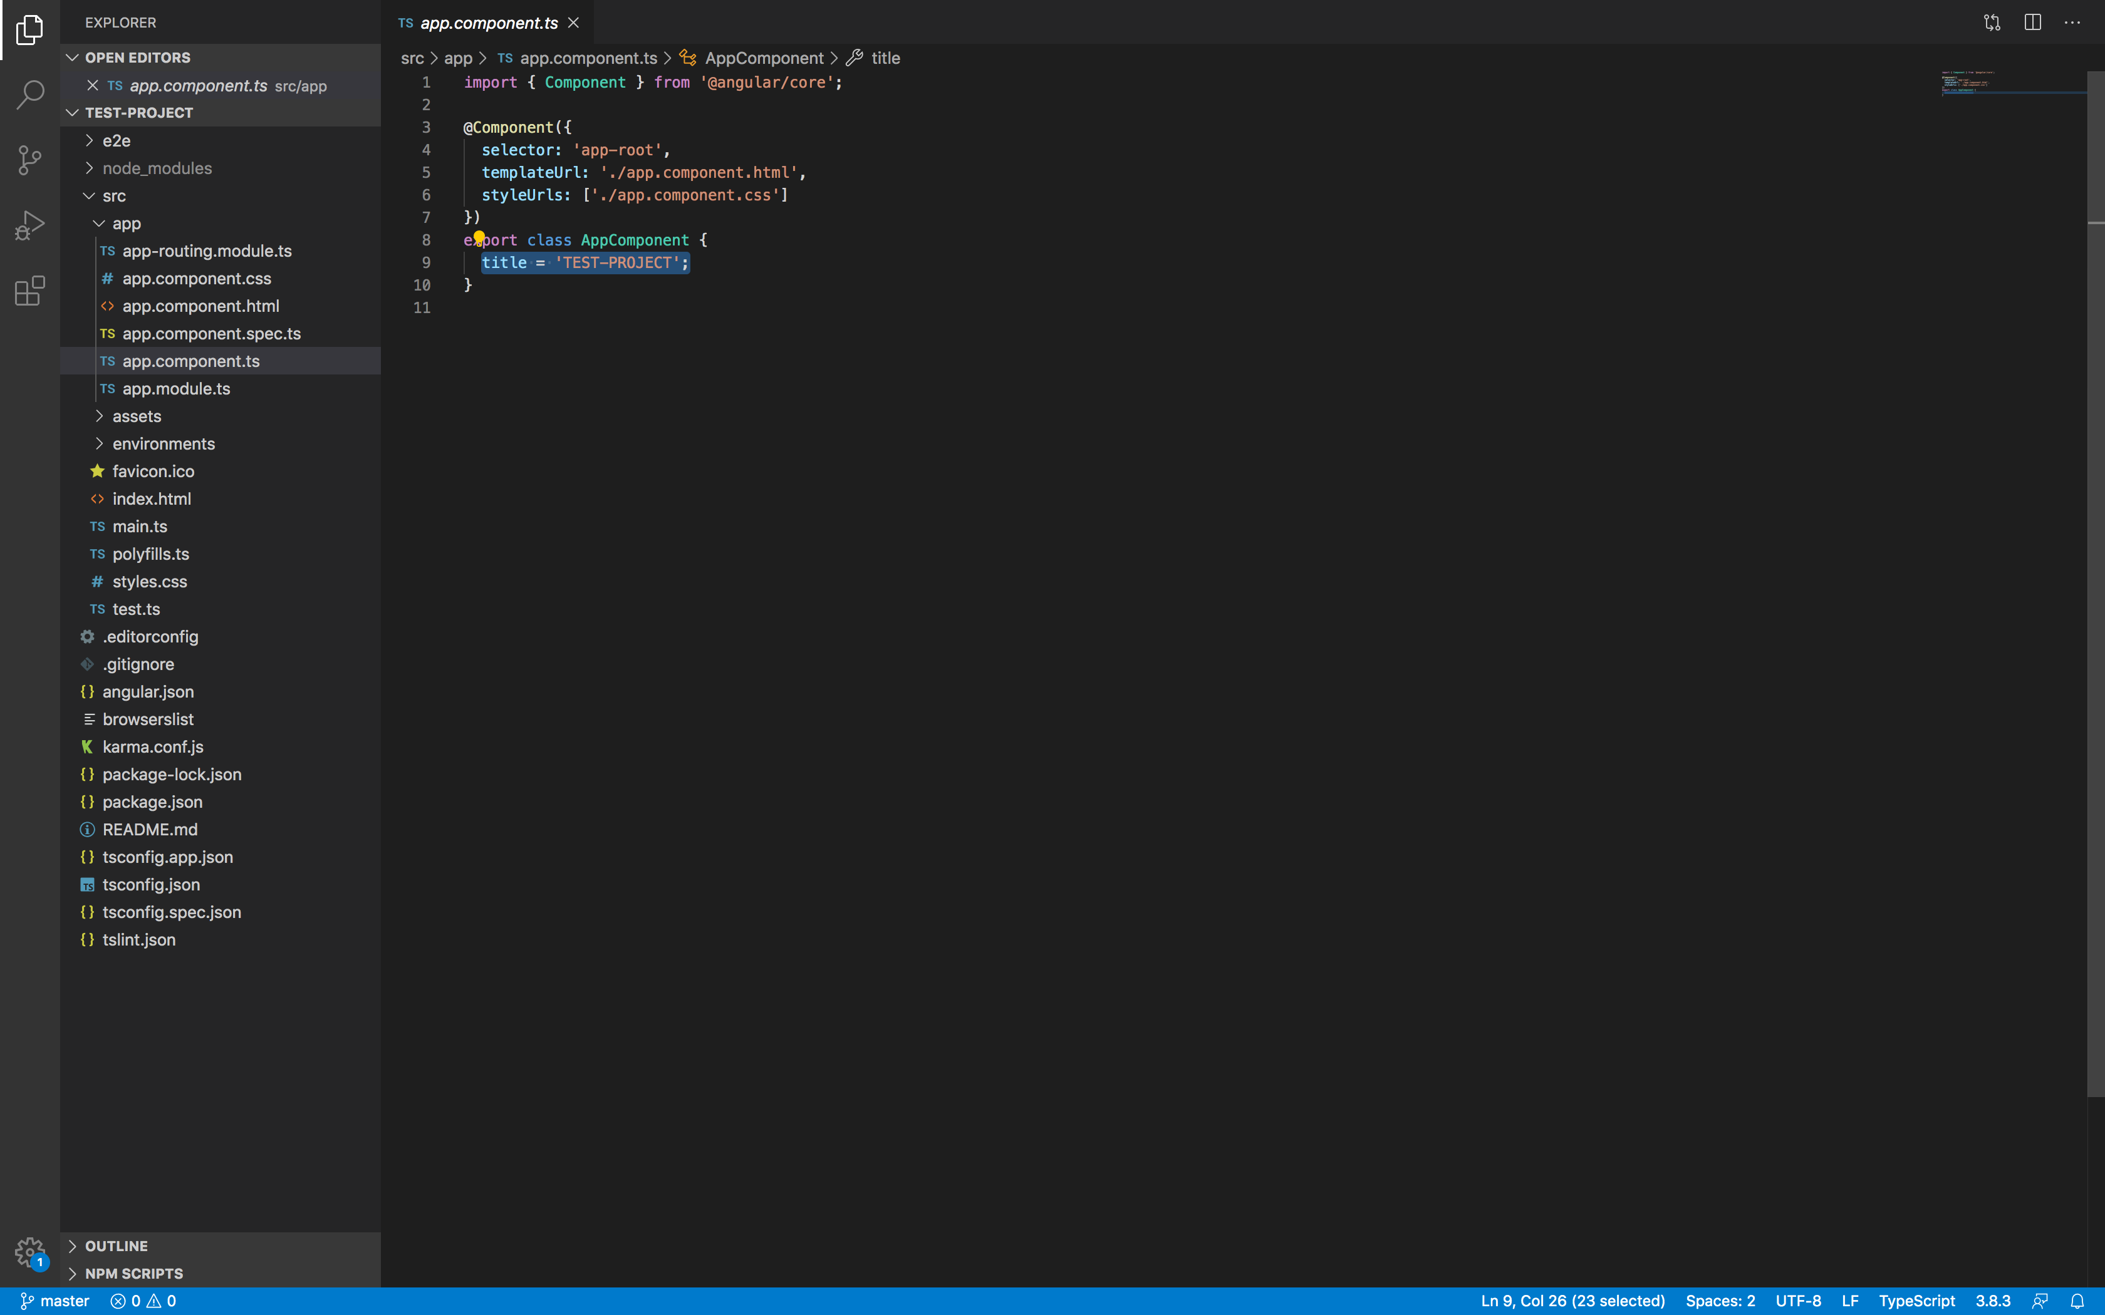
Using the Angular-CLI – cont.

Slide 21
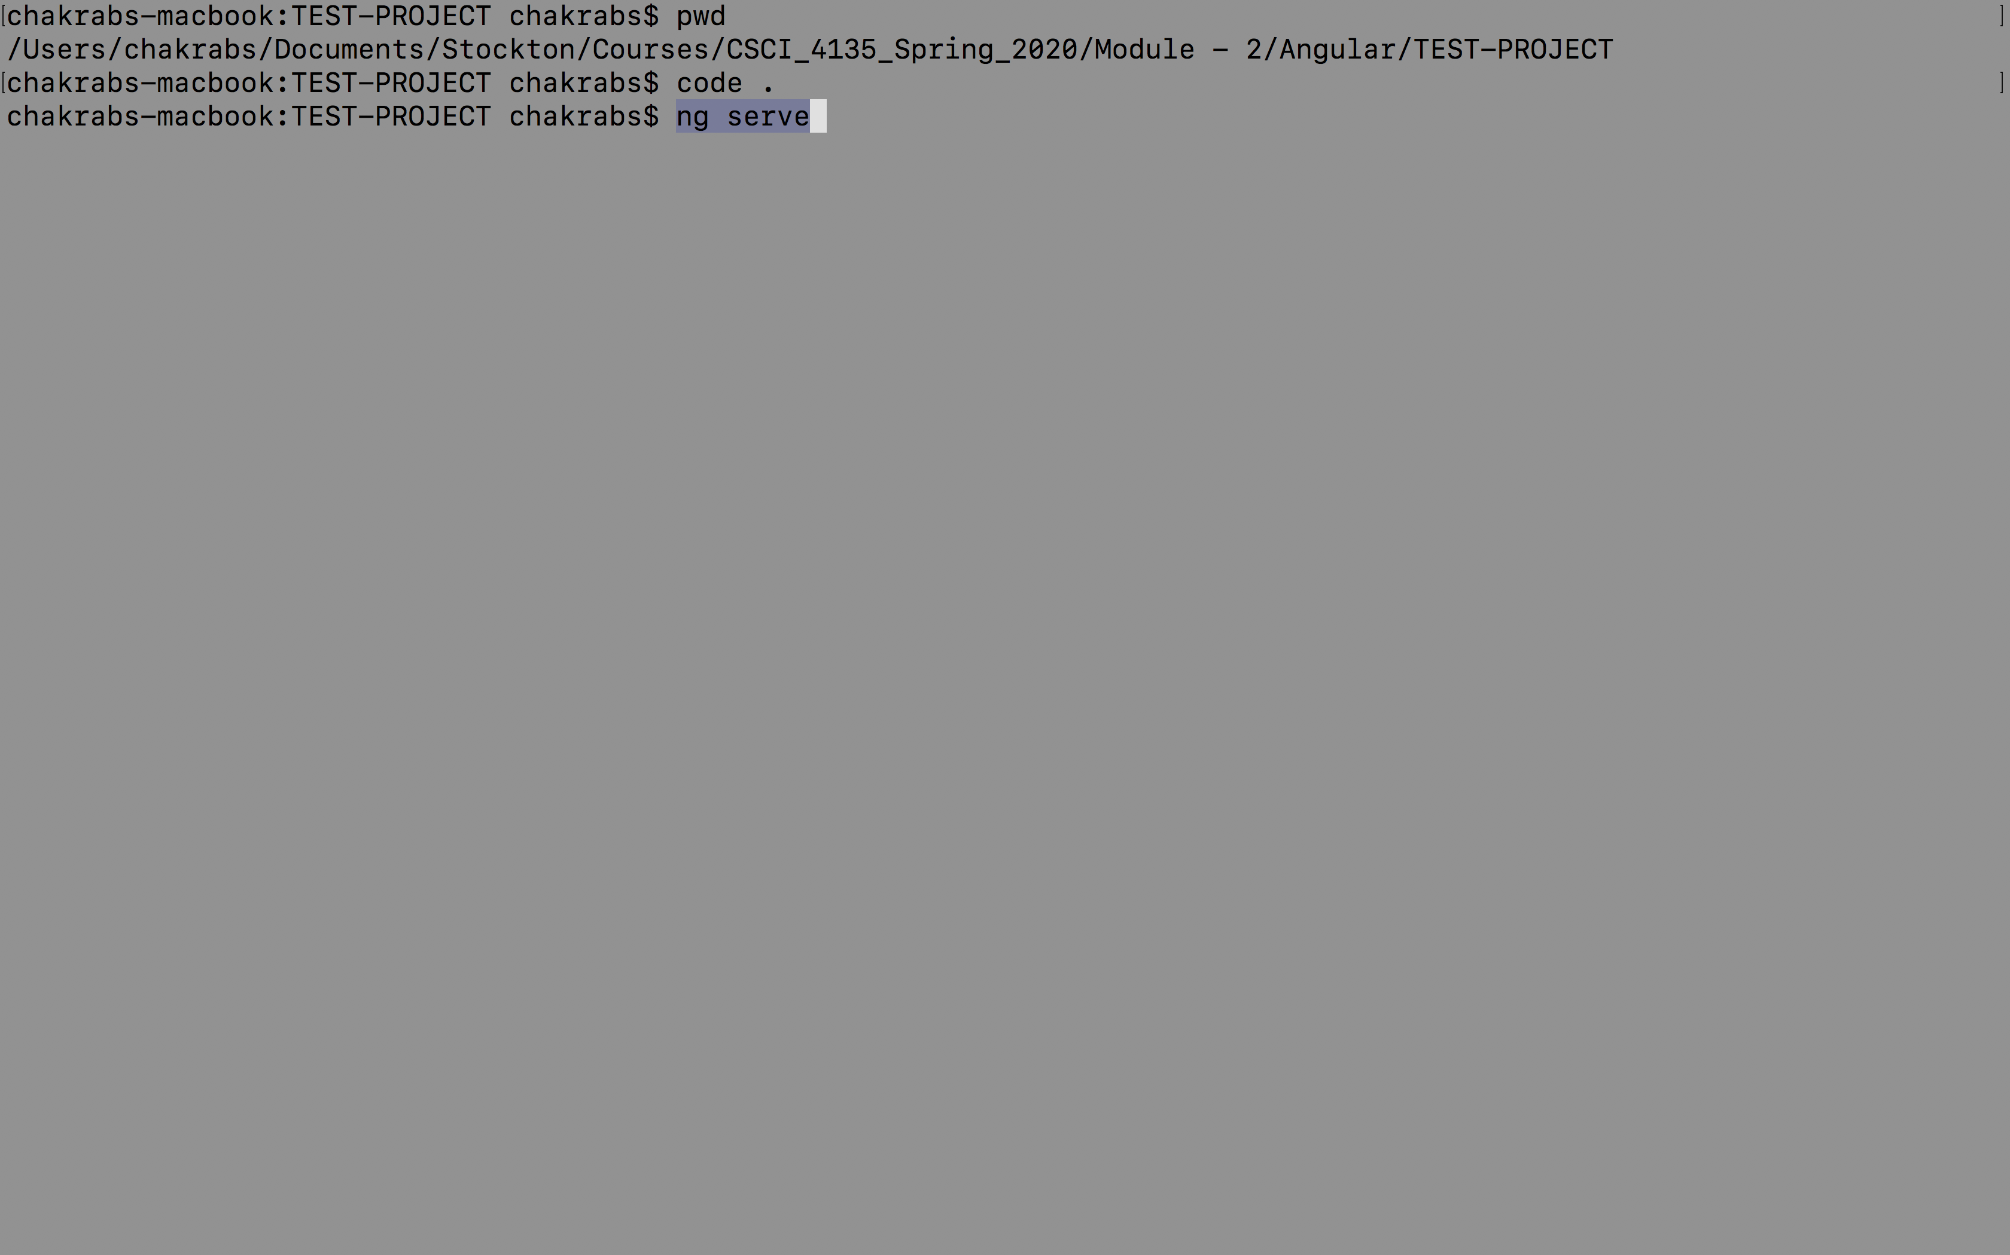
Using the Angular-CLI – cont.

Slide 22
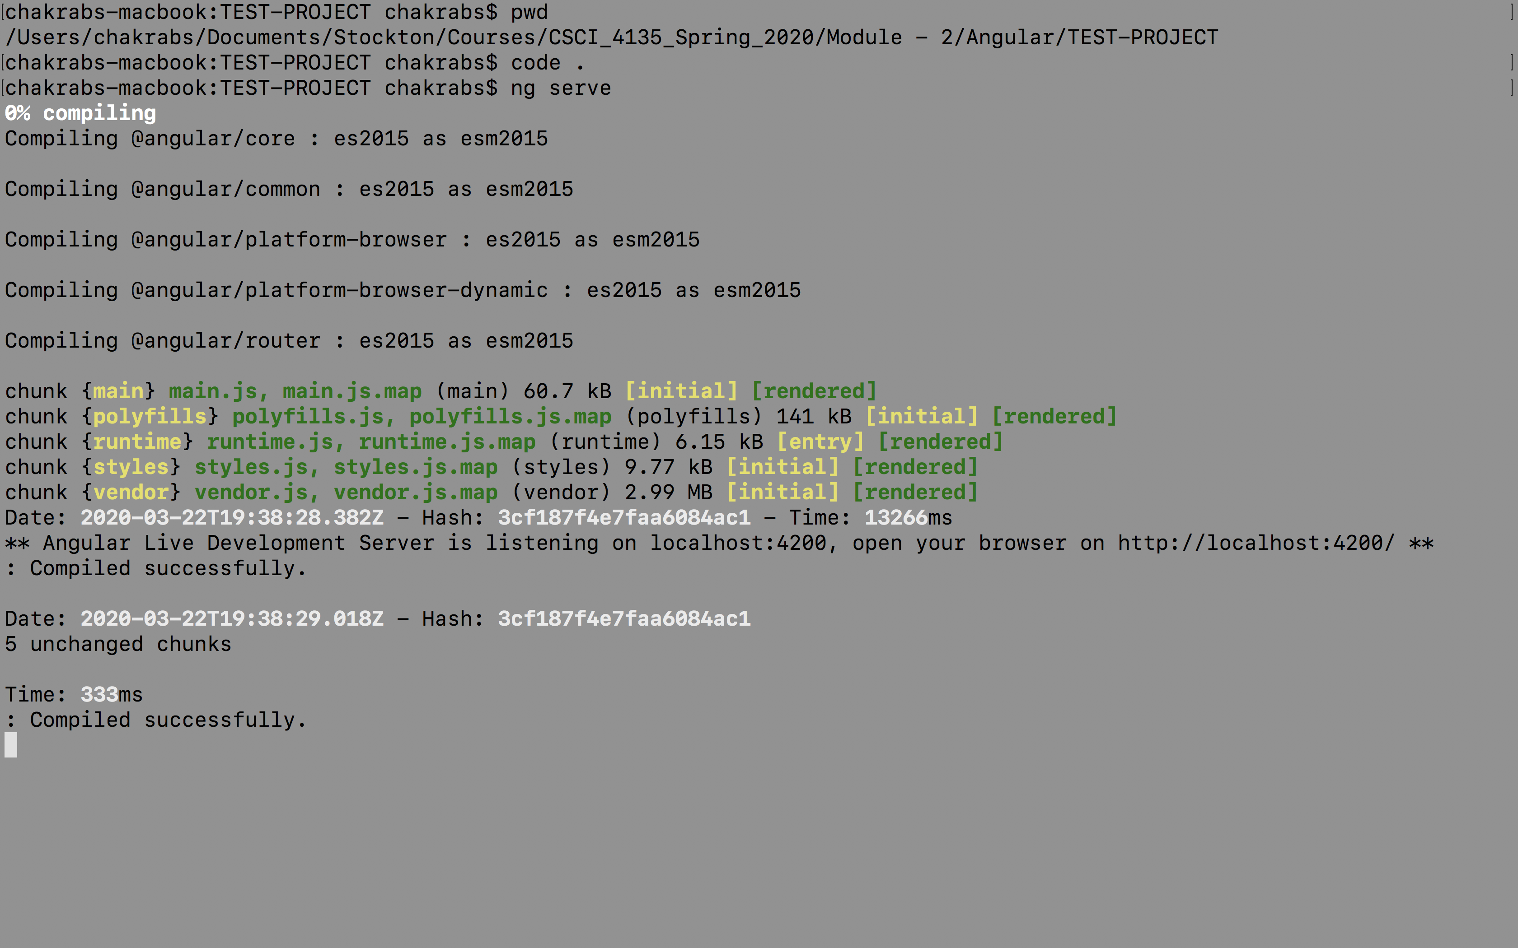
Using the Angular-CLI – cont.

Slide 23
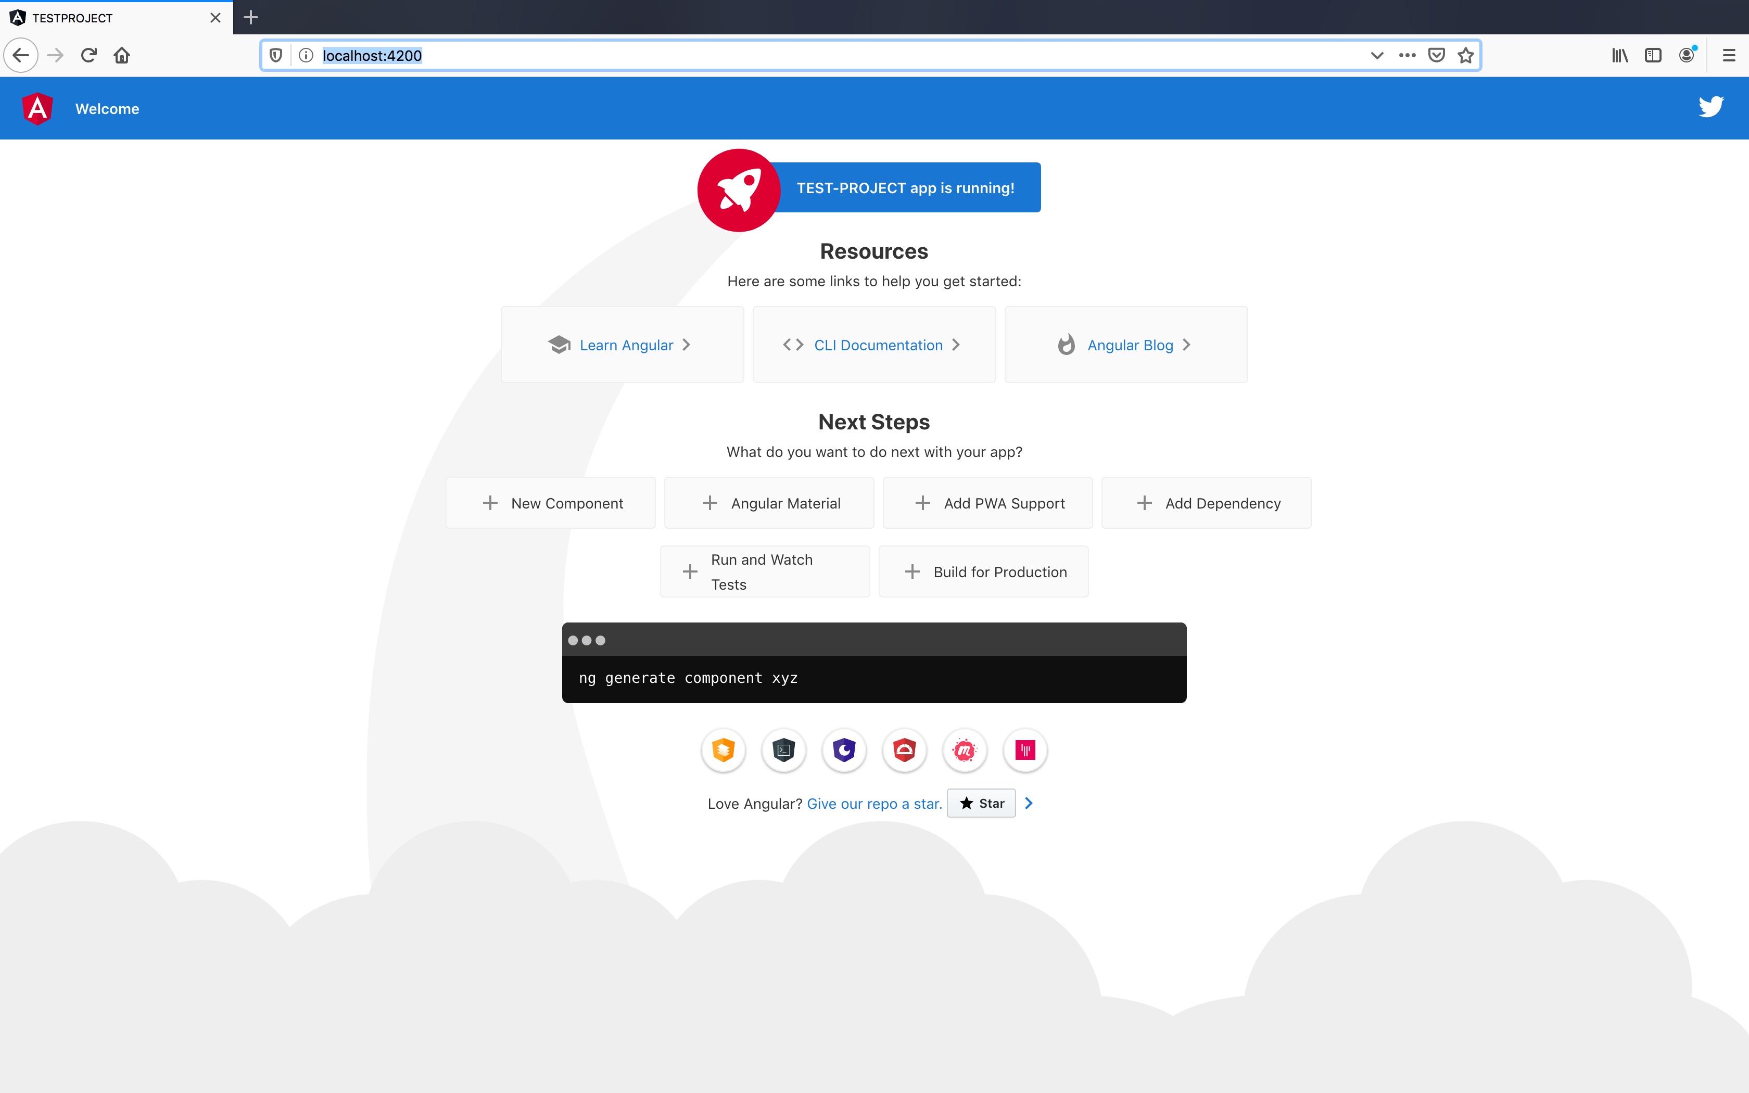
Using the Angular-CLI – cont.

Slide 24
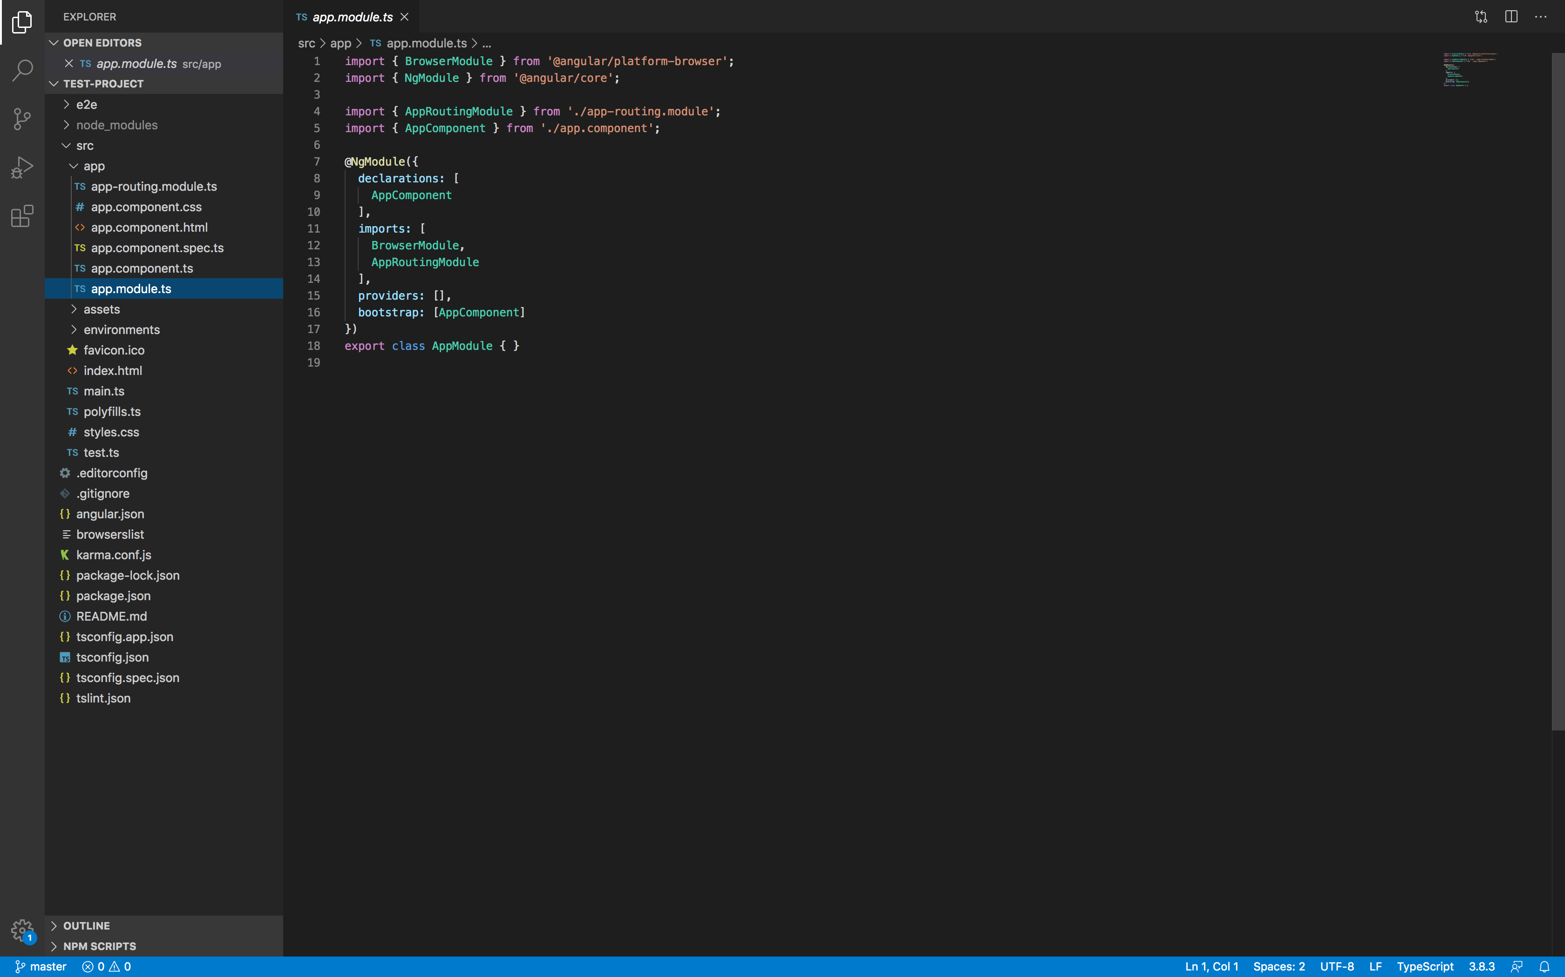
The anatomy of Angular
The import statements here are importing the respective packages.
Each of these packages have modules which we might want to consume in our applications.
Angular is very component-driven.
A component in an application has some
specific functionality (might have a template/
view/styles associated with it).
An angular application is about creating various components and assembling them together.

Slide 25
The anatomy of Angular – cont.
An Angular app has to have a root module which bootstraps the application, which is the file app.module.ts.
Angular also offers decorators starting with ‘@’, to decorate a class or a property.
They give us a way to modify the behavior of a class or property.
The decorator needs to be placed just before the class or property that we want to alter.
All components need to be included in within the declarations.
import { BrowserModule } from '@angular/platform-browser';
import { NgModule } from '@angular/core';
import { AppRoutingModule } from './app-routing.module';
import { AppComponent } from './app.component';
@NgModule({
declarations: [
AppComponent
],
imports: [
BrowserModule,
AppRoutingModule
],
providers: [],
bootstrap: [AppComponent]
})
export class AppModule { }

Slide 26
The anatomy of Angular – cont.
Declarations are used to specify the components of the application.
Imports: Tells which modules we need to import for our application.
Providers: An array of injectable services that we create for our application.
Bootstrap: We need to specify which component is the top-level component.
Any other component that we create will be the child component of the top-level component.
import { BrowserModule } from '@angular/platform-browser';
import { NgModule } from '@angular/core';
import { AppRoutingModule } from './app-routing.module';
import { AppComponent } from './app.component';
@NgModule({
declarations: [
AppComponent
],
imports: [
BrowserModule,
AppRoutingModule
],
providers: [],
bootstrap: [AppComponent]
})
export class AppModule { }

Slide 27
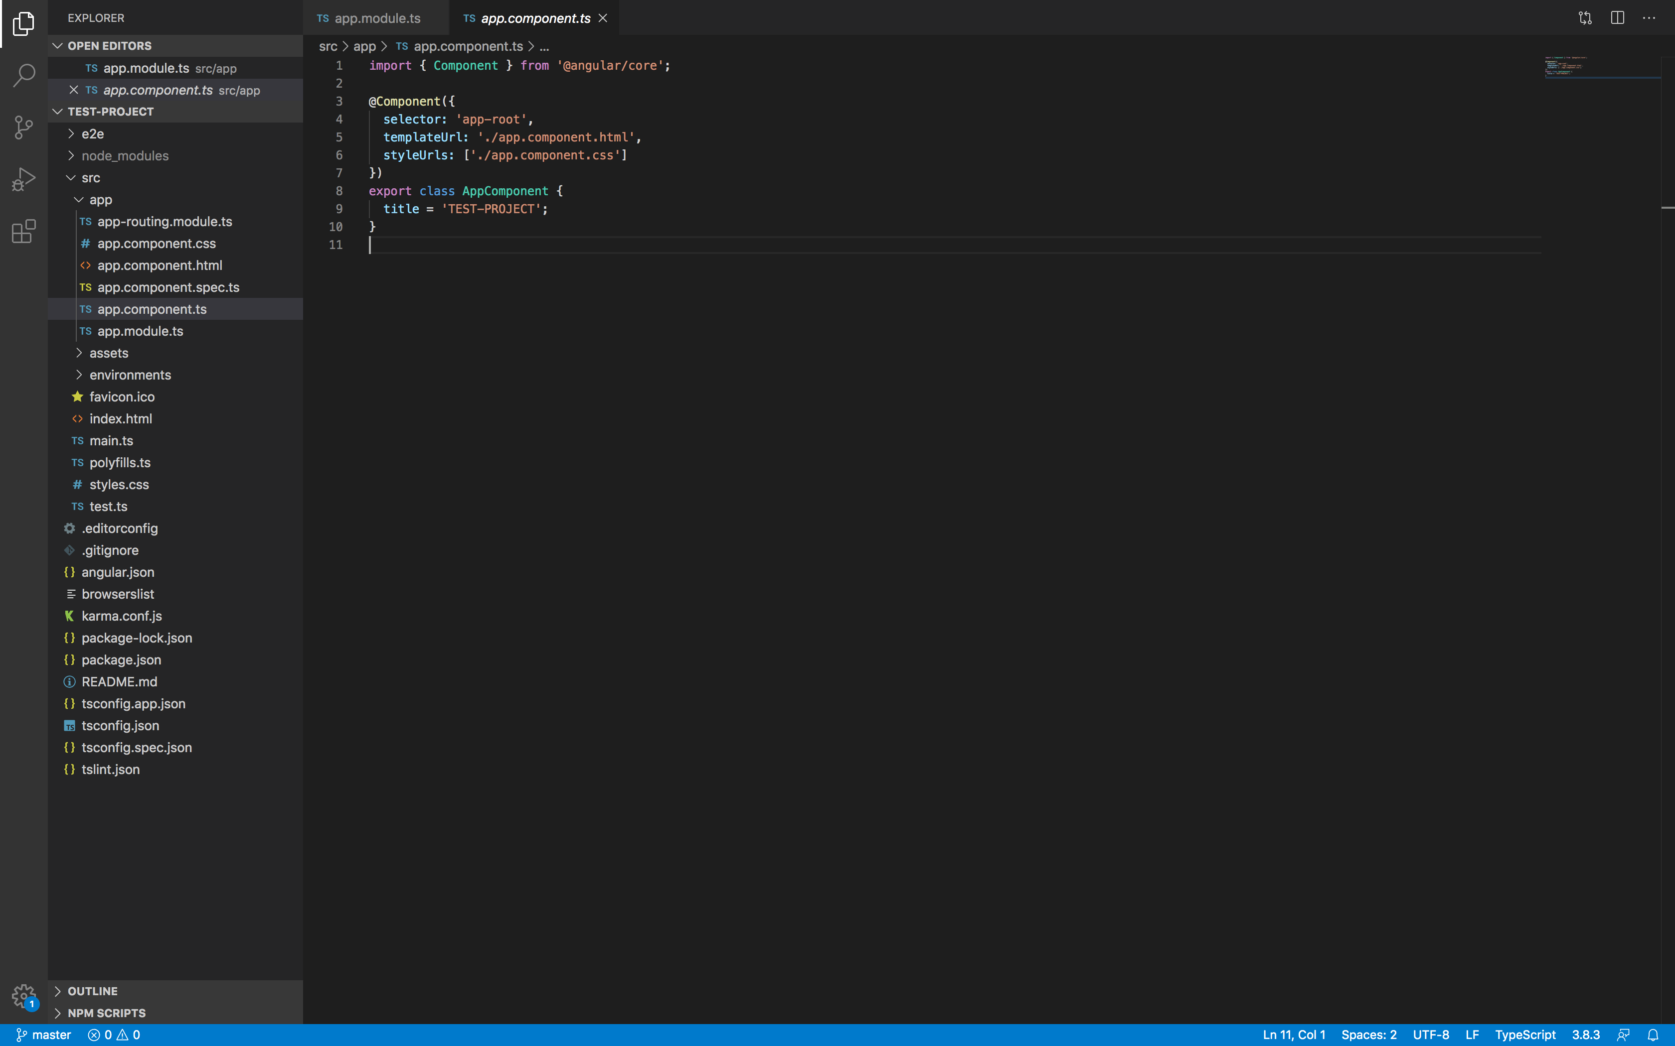
The anatomy of Angular – cont.
At the app.component.ts, there is another decorator which is @Component.
The selector here is ‘app-root’.
The file that gets loaded when the application starts is the file index.html.
In index.html, we have the tag <app-root>, so the component app-root is called from there.
We can use a template that we specify through templateUrl.
Similarly, we also specify a styleUrl.

Slide 28
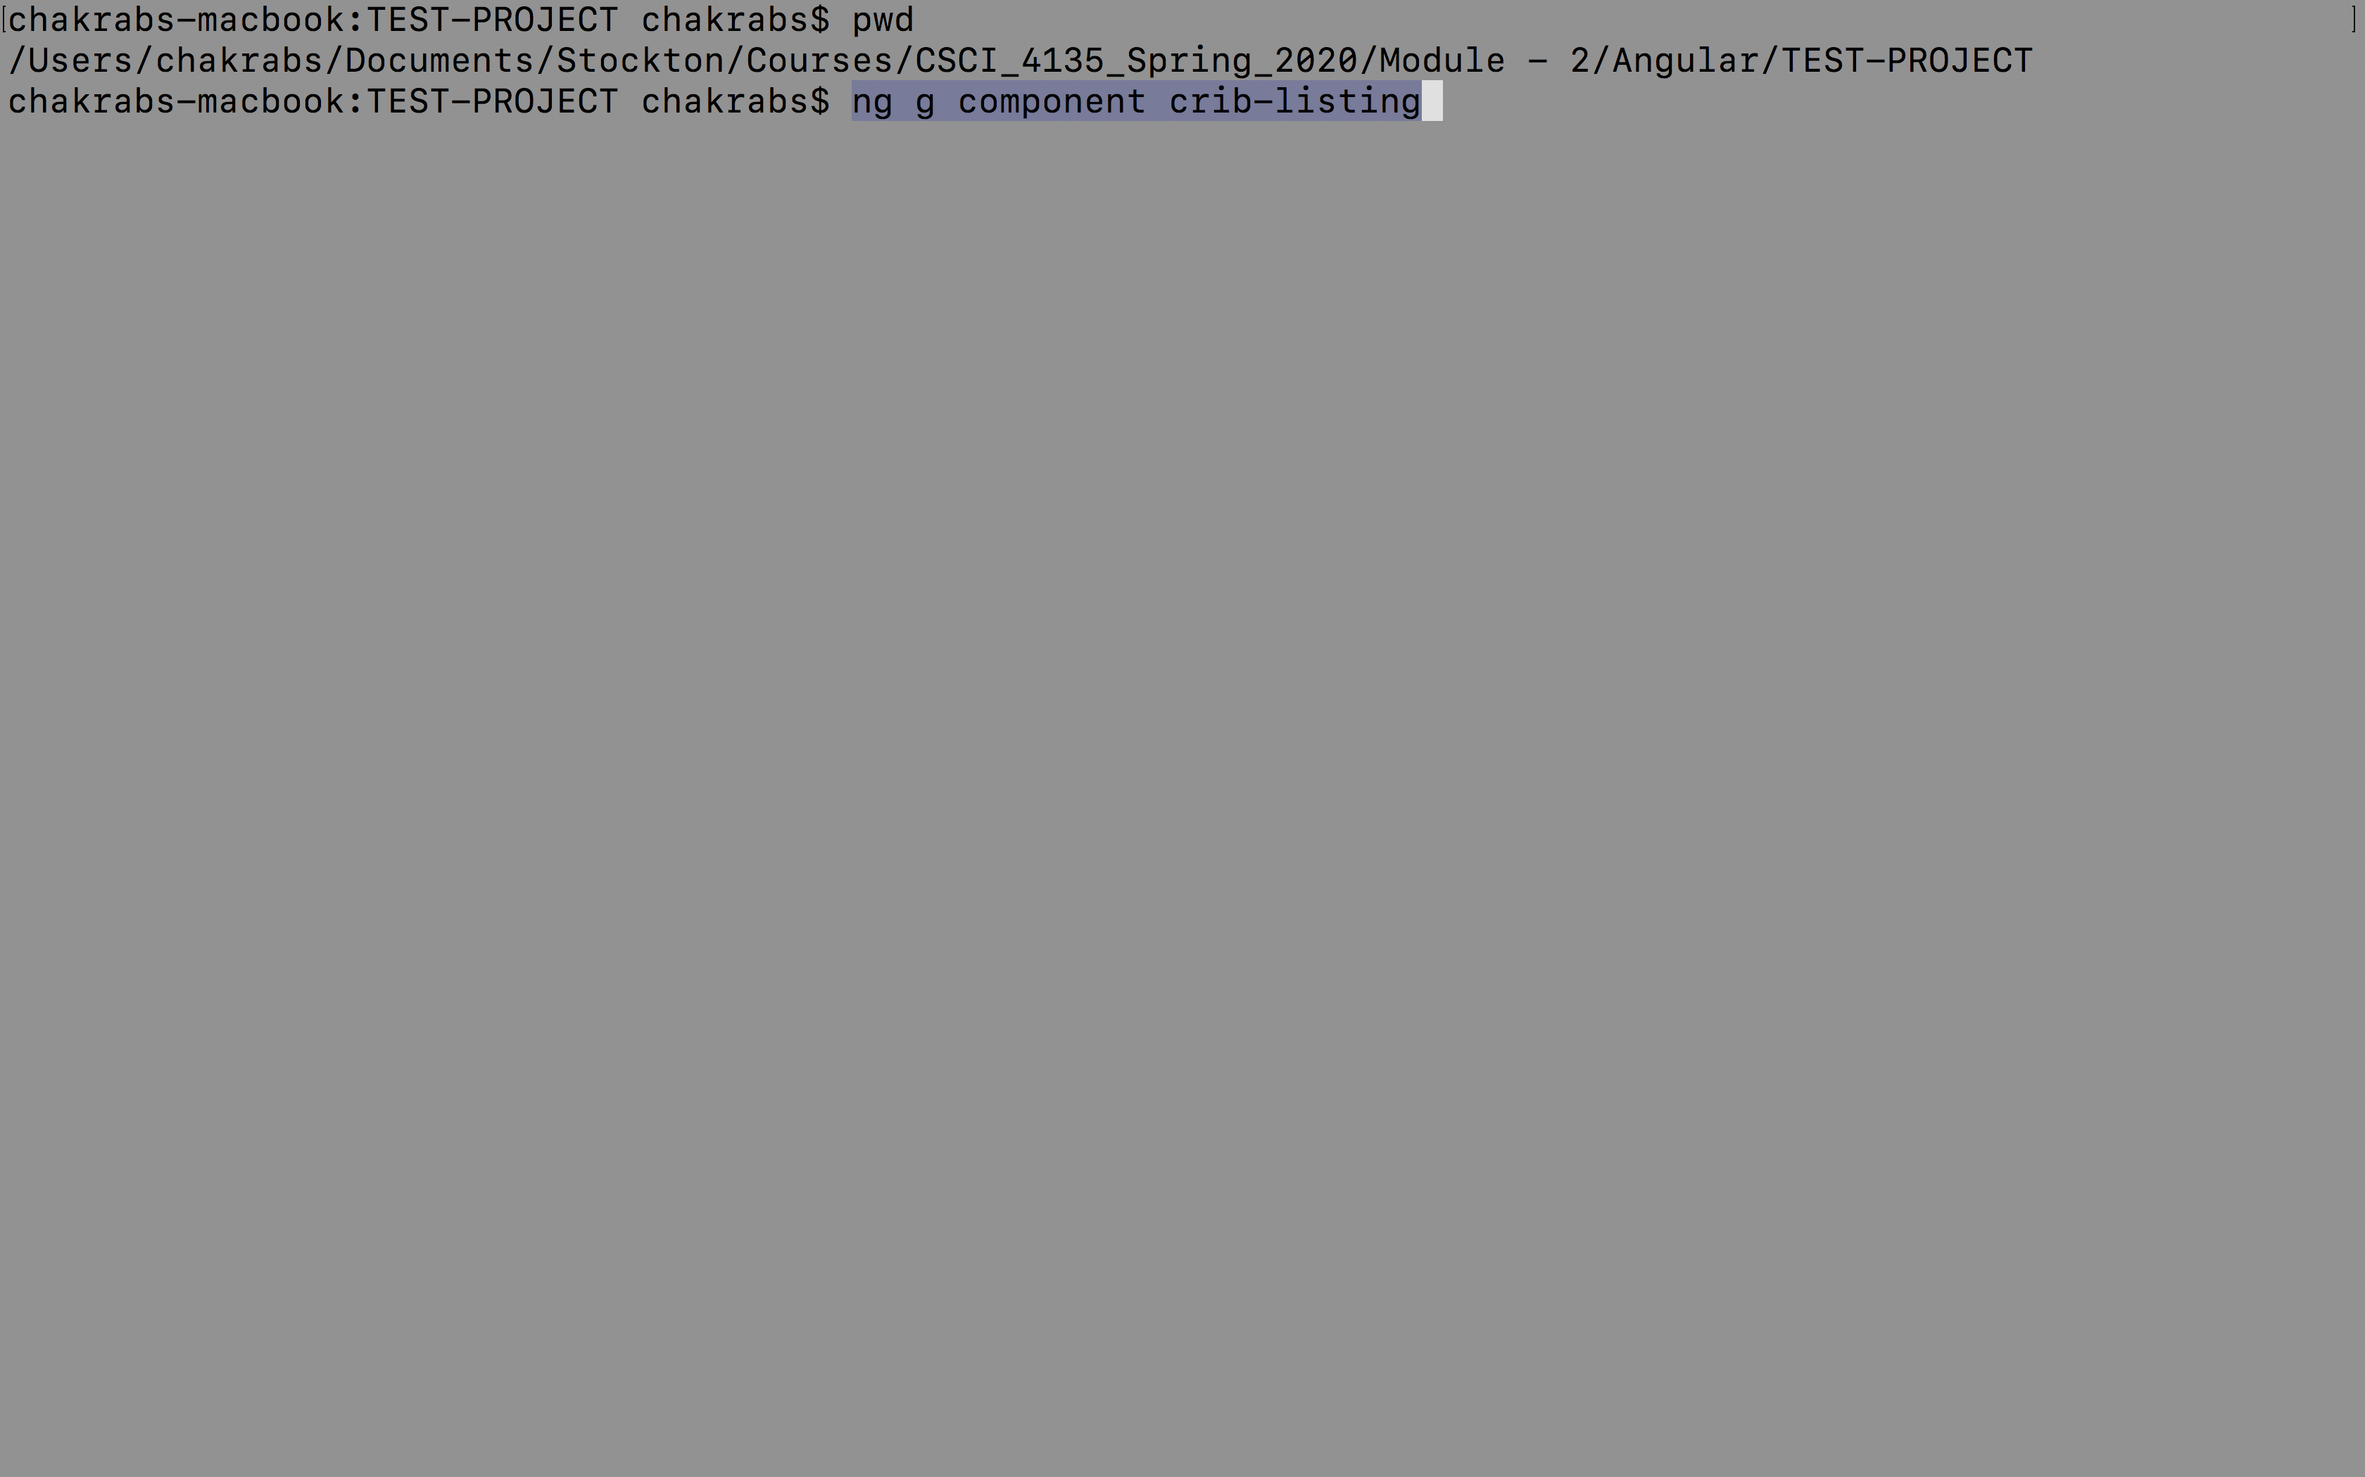
Creating a new component

Slide 29
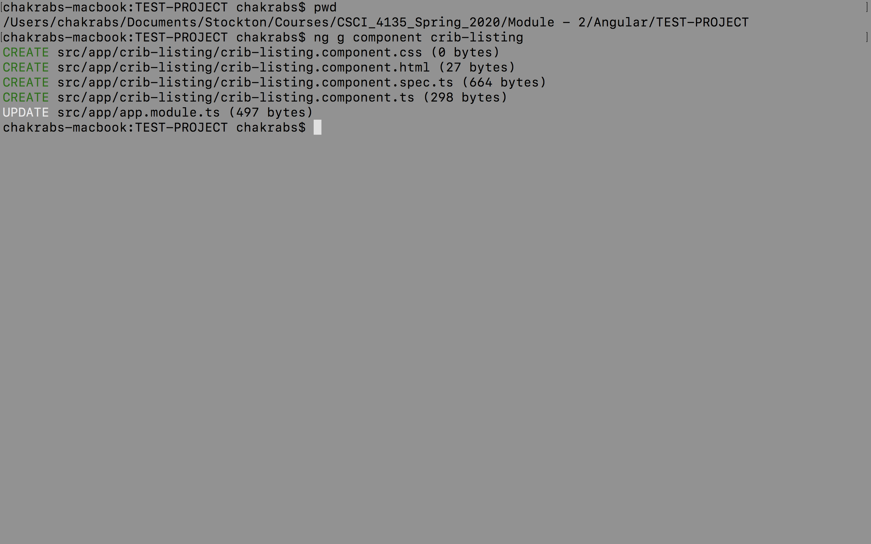
Creating a new component – cont.

Slide 30
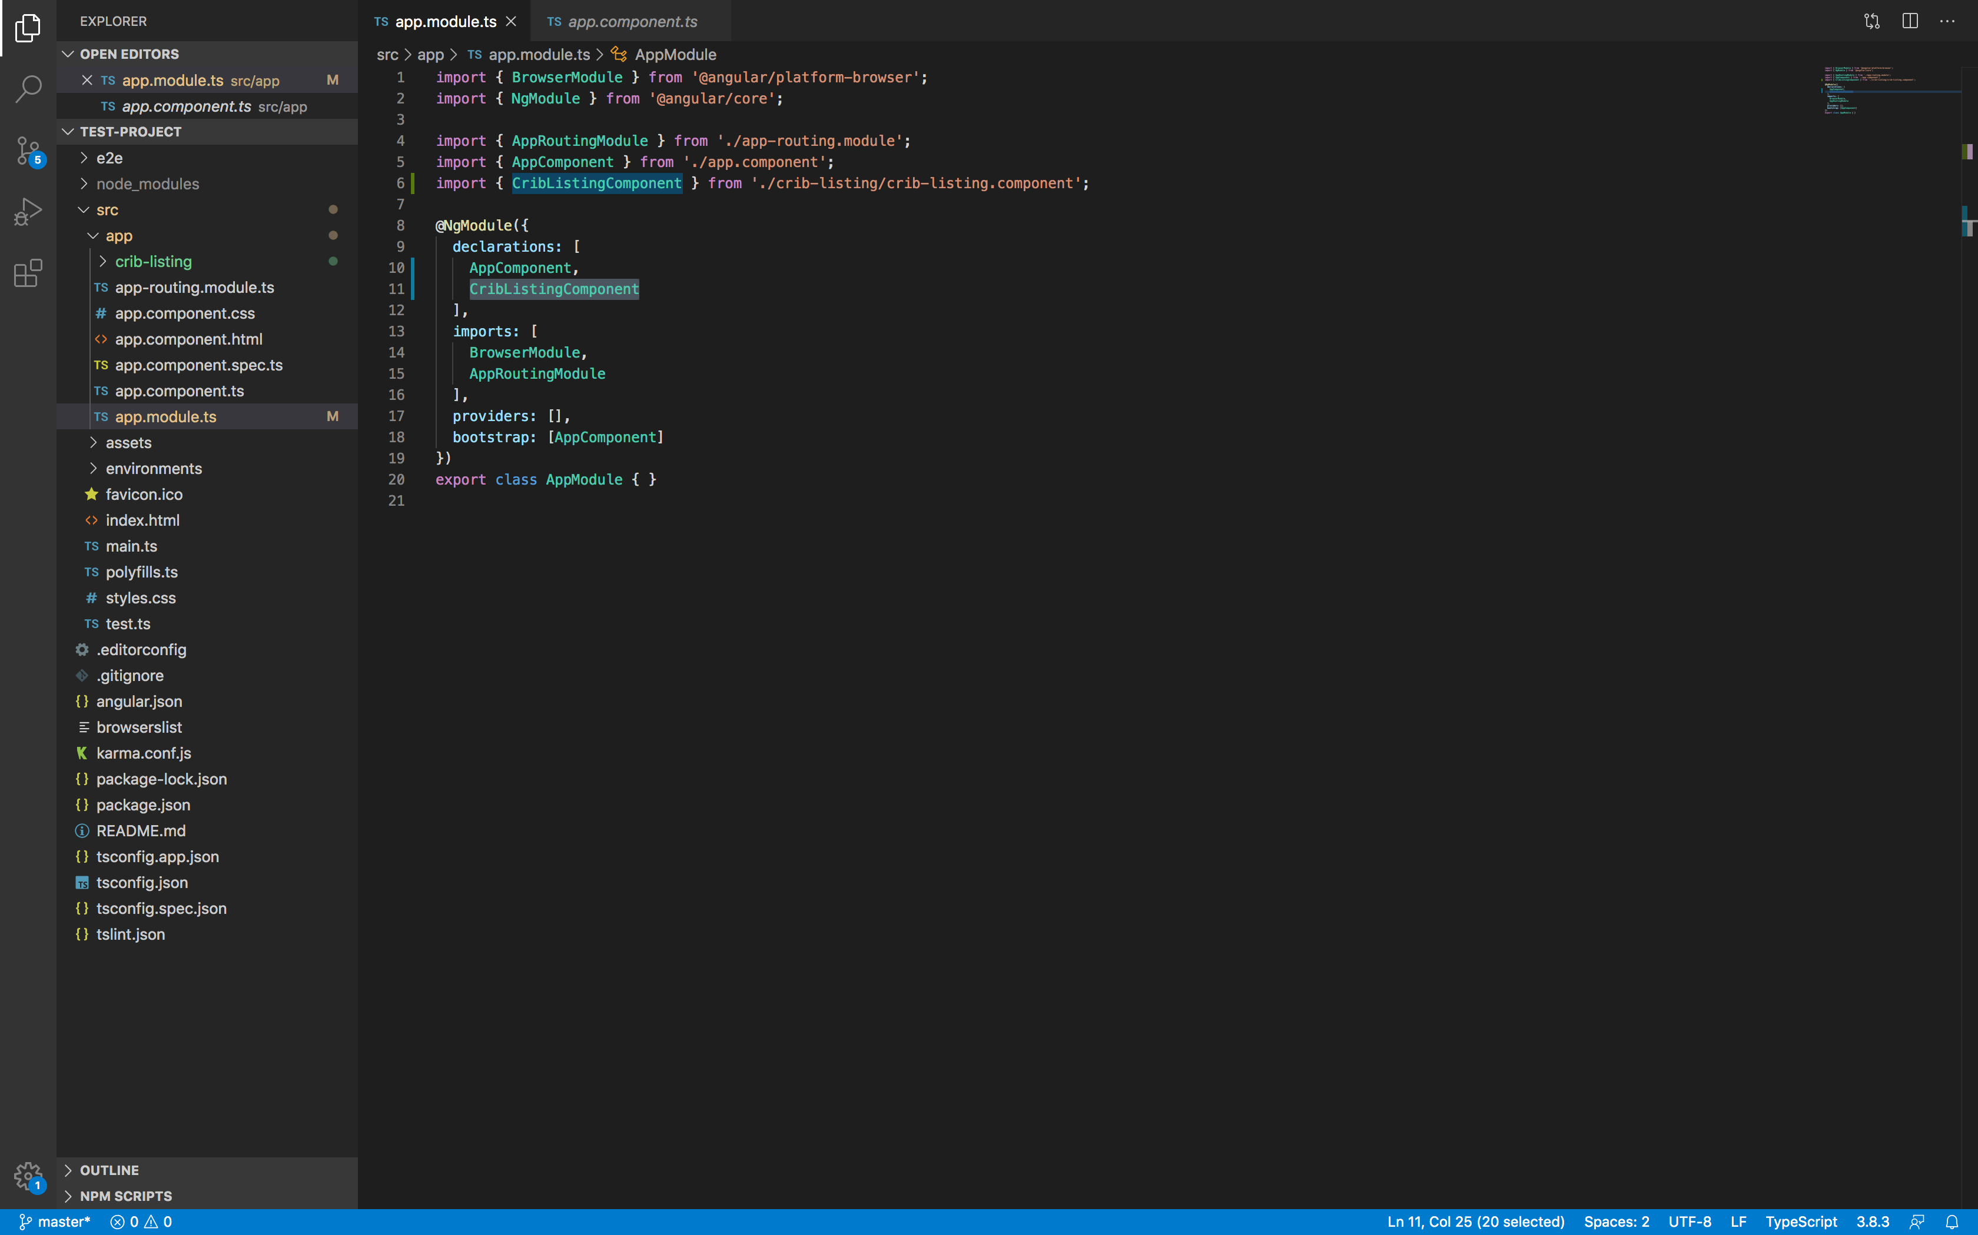
Creating a new component – cont.

Slide 31
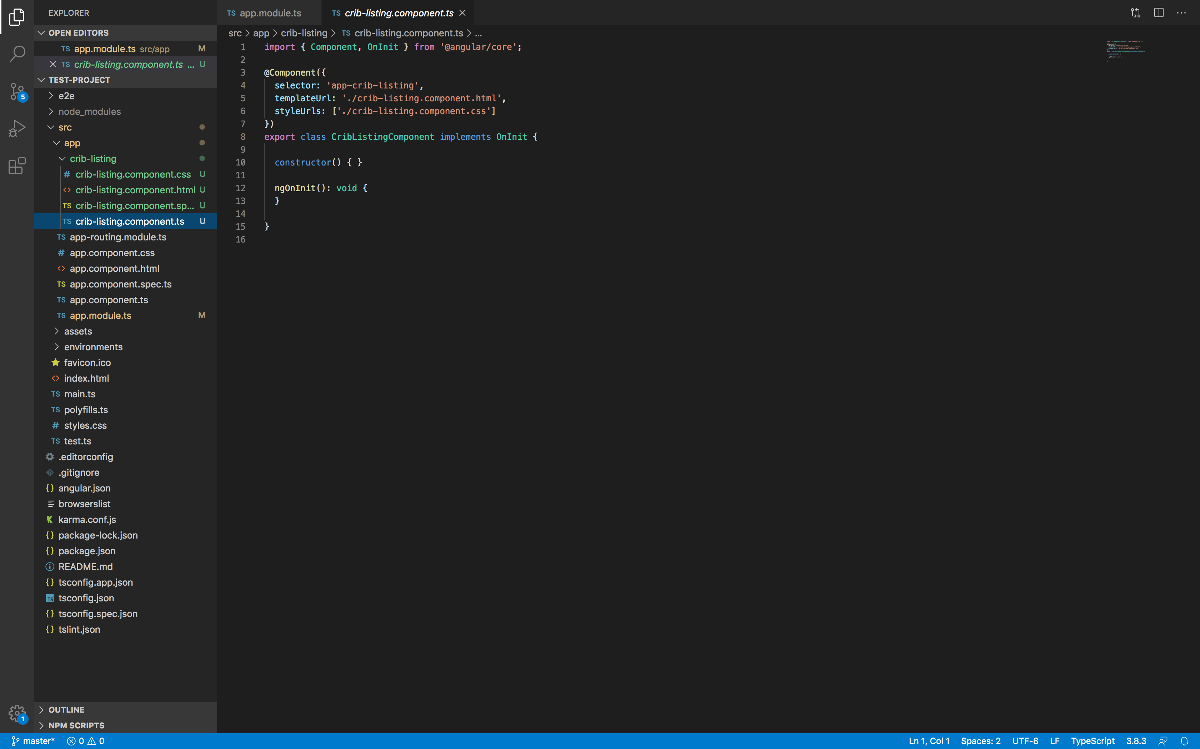
Creating a new component – cont.

Slide 32
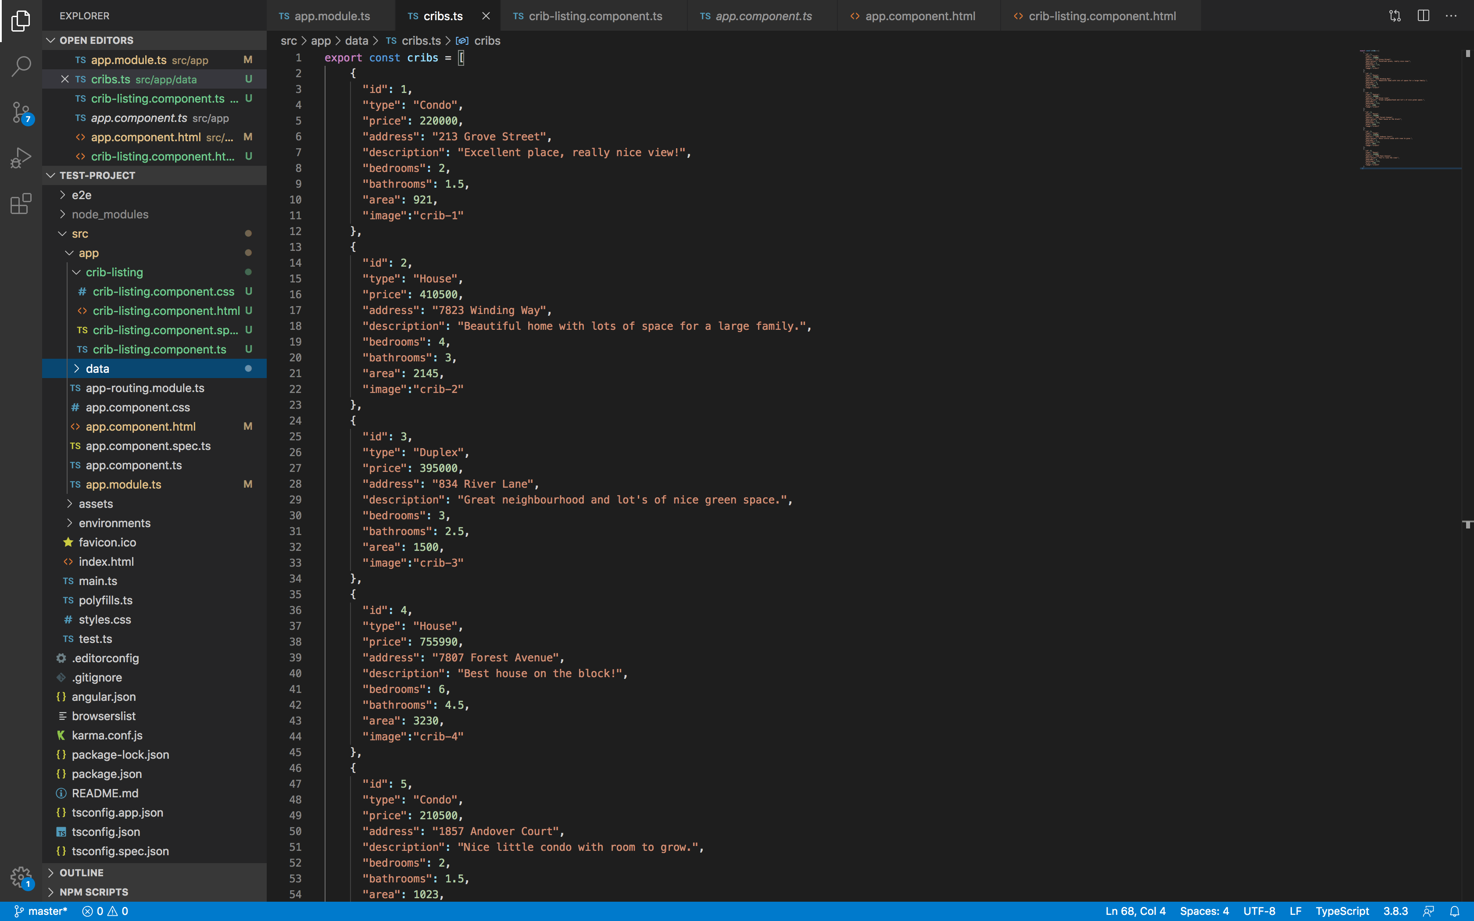
Repeating over data
As a first step, let’s get some data to be displayed on the screen when we execute our application.
For that, we need some data to work with.
Let us create a folder “data” under the “app” folder in our project TEST-PROJECT.
We create a file cribs.ts which has an export statement for exporting the data.

Slide 33
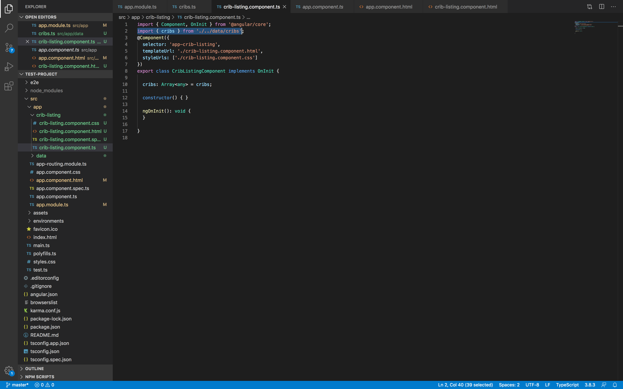
Repeating over data – cont.
Let’s come to the crib-listing component.
Since we are exporting the cribs data, we can import it in our component.
We add the highlighted import statement.
Notice that we need not specify the .ts extension in the import statement.
We also need to create a member in the class CribListingComponent, which is an array in this case.
The type is set to <any> and the imported data is assigned to it.

Slide 34
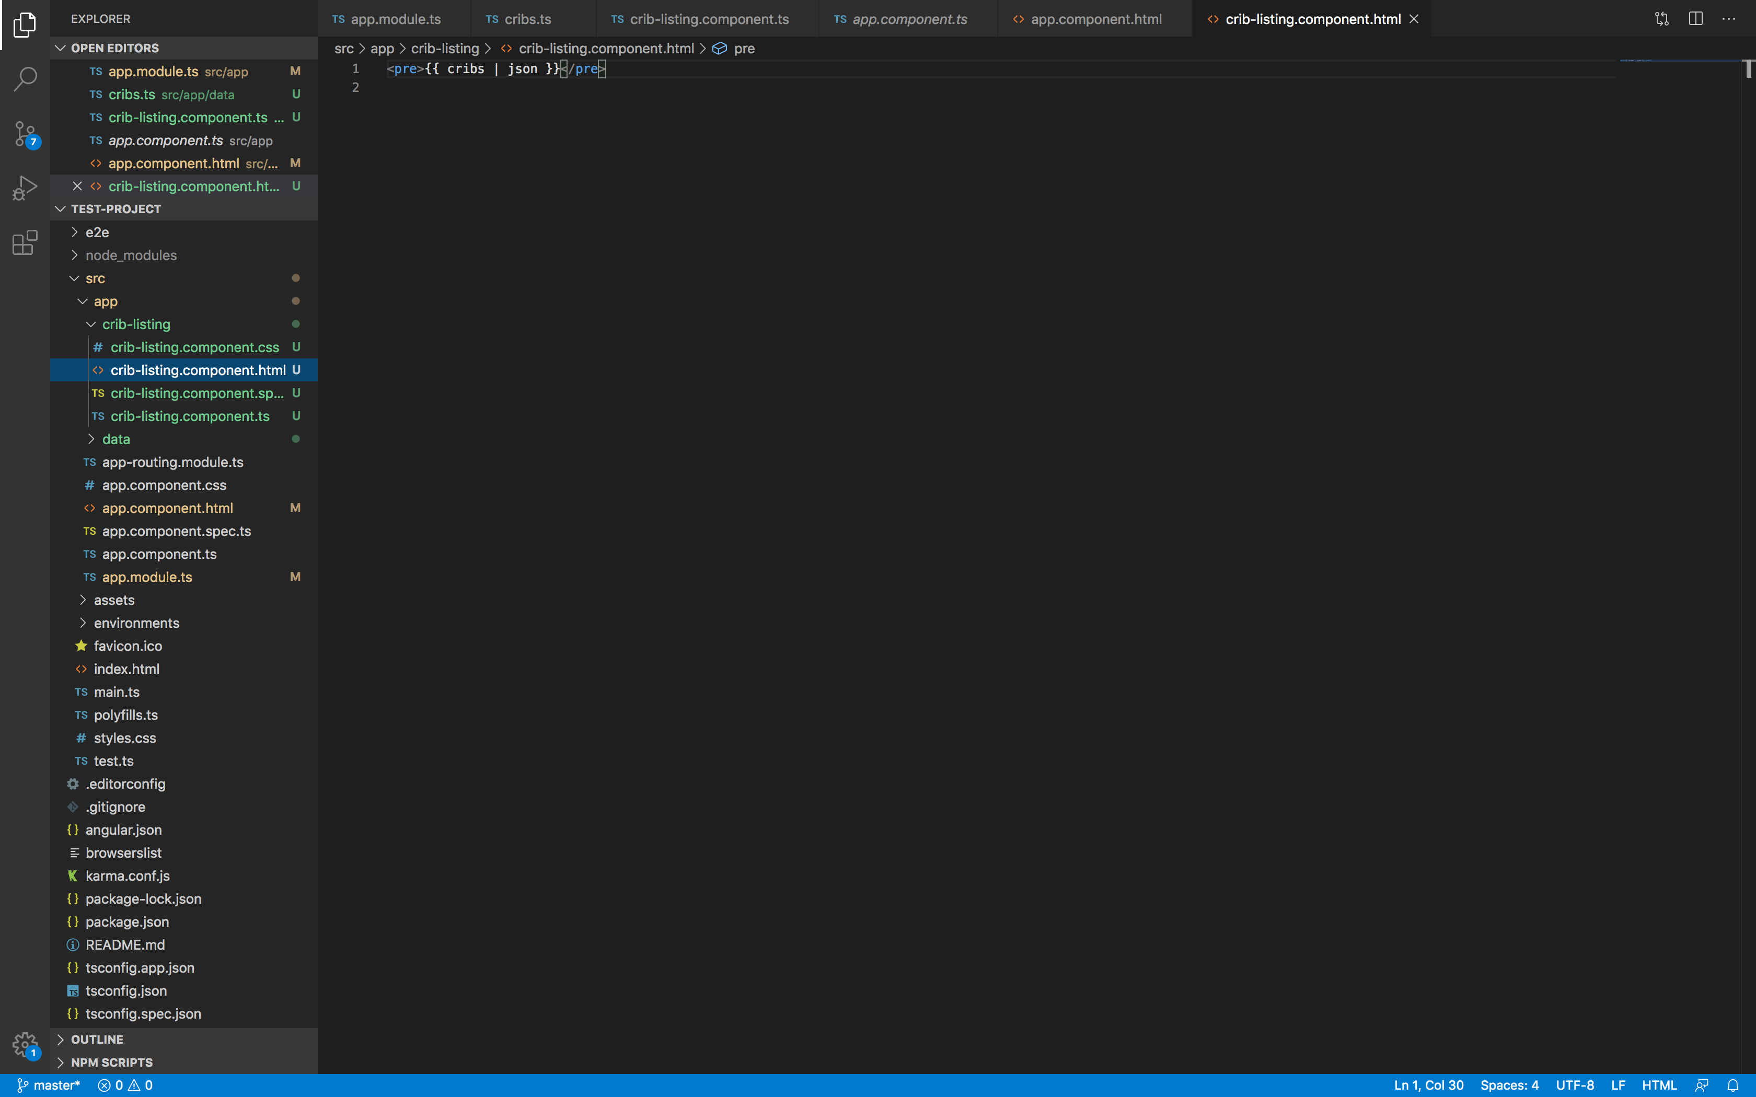
Repeating over data – cont.
Let’s open the crib-listing component html and add a <pre> tag as shown in the screenshot.
We template out the data and specify that we wish to view it as a json file.
To view the data, we need to use the component.
We look at the selector which lists the tag corresponding to the component.
The component is a child of the top-level component.

Slide 35
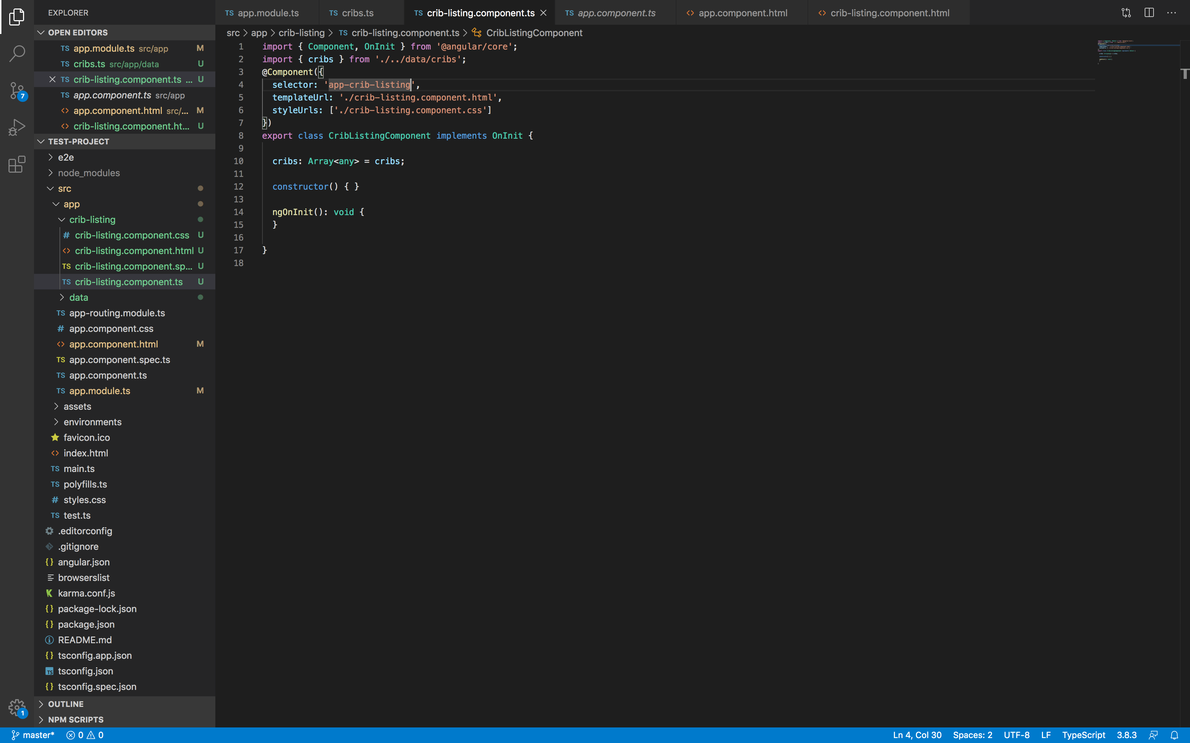
Repeating over data – cont.
The selector for this component is app-crab-listing.
We need to put that in the app.component.html file (refer to the screenshot in the next slide):
<app-crib-listing></app-crib-listing>
Next, run the application and view it on the browser (execute “ng serve” in the CLI).

Slide 36
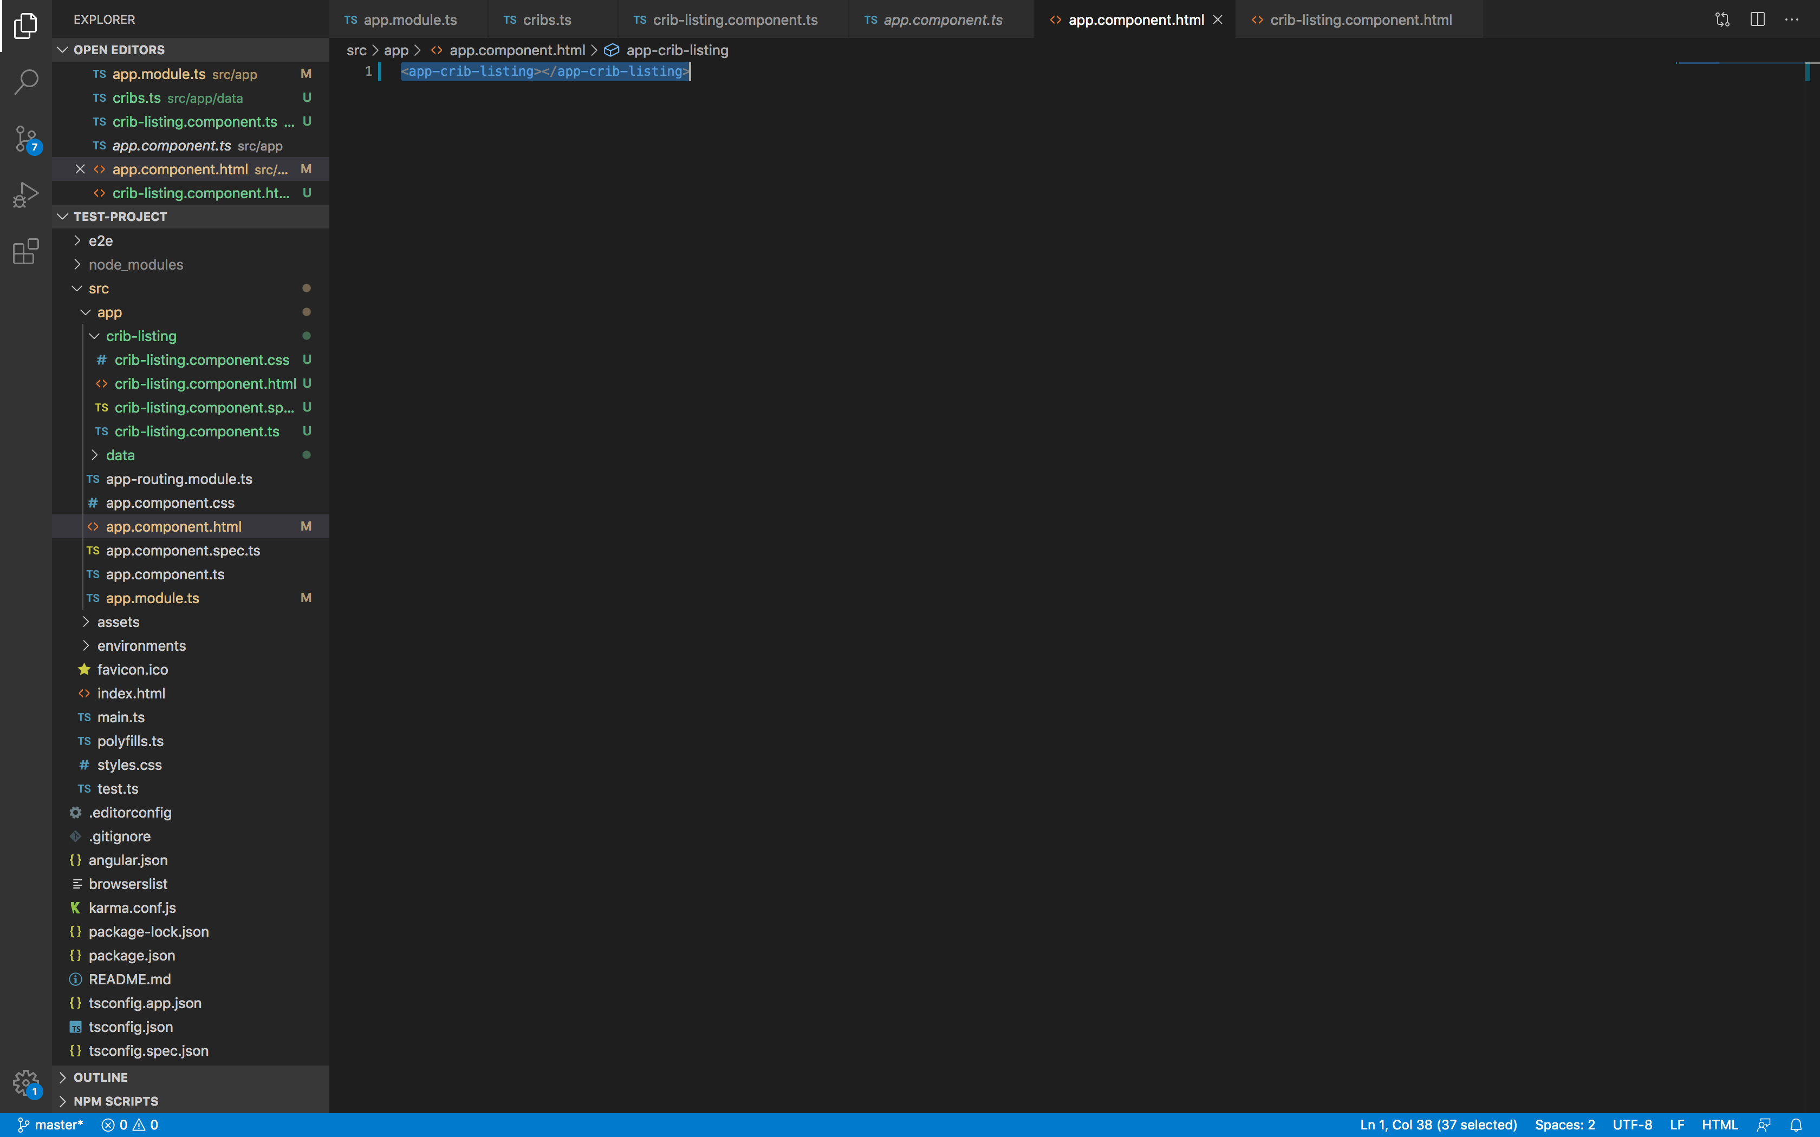
Repeating over data – cont.

Slide 37
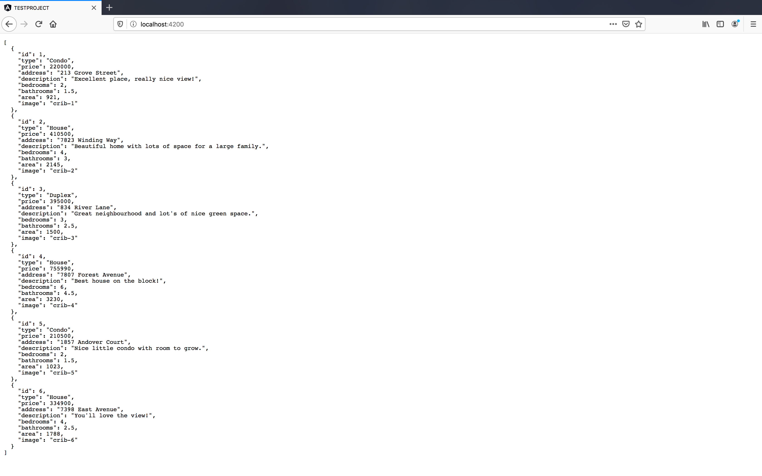
Repeating over data – cont.

Slide 38
Repeating over data – cont.
However, this really isn’t the way we want to display the listing data.
We want to have a lot more control over how we can manipulate the data on screen.
We want to display it in some fashion such as: an unordered listing, having some card for each item in the collection etc.
We want to provide a single template for that (one html that would be re-used for all items in the collection).
We do that with a directive called ngFor (Angular’s repeater implementation).

Slide 39
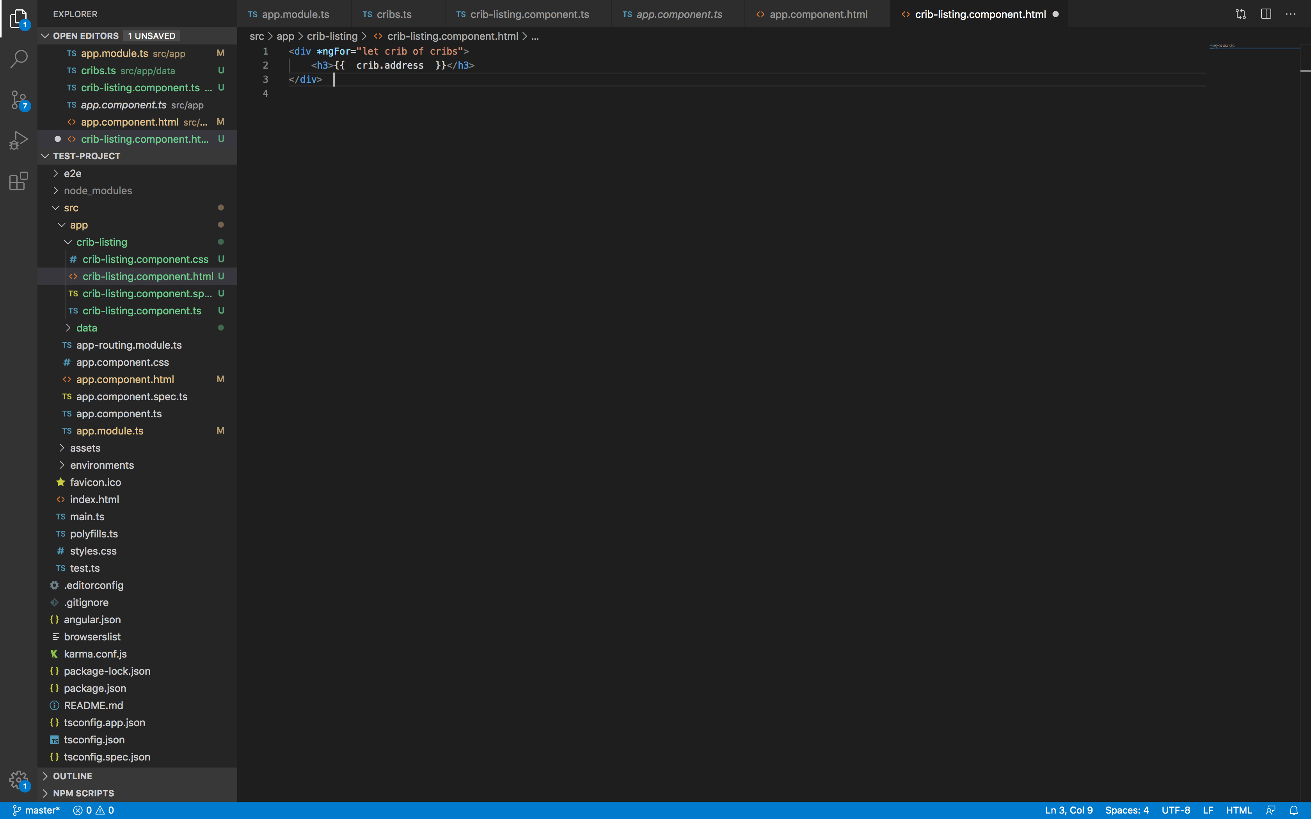
Repeating over data – cont.

Slide 40
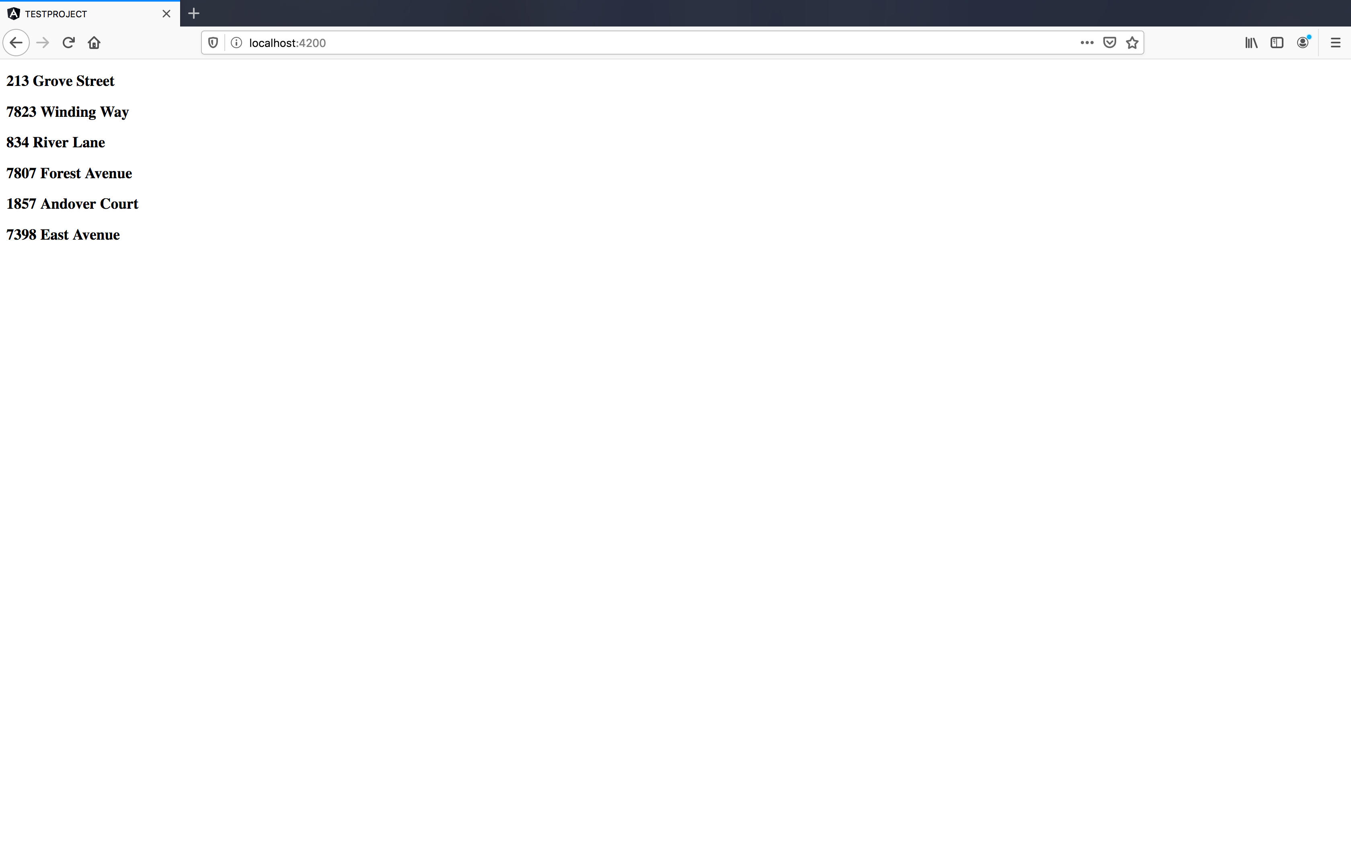
Repeating over data – cont.

Slide 41
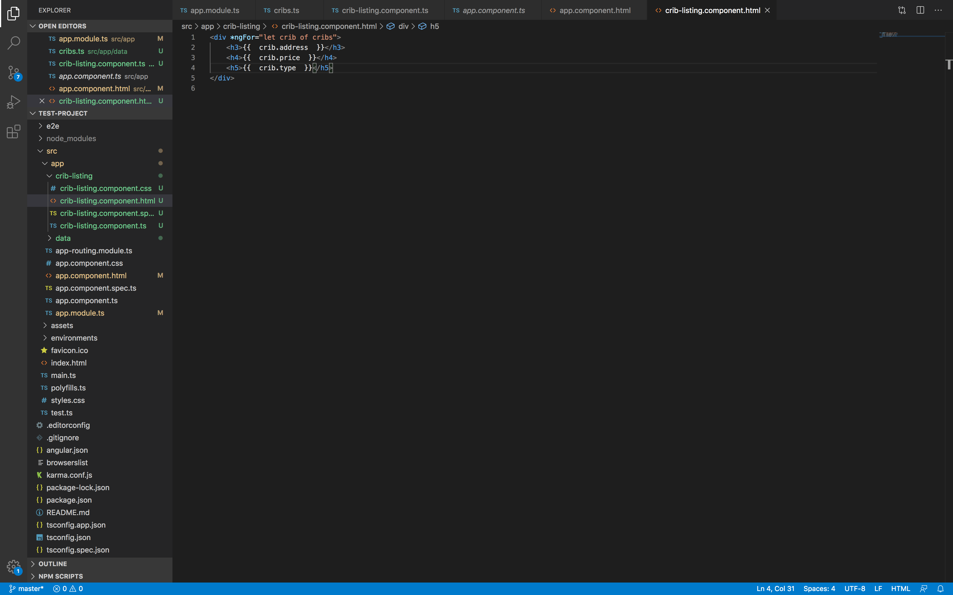
Repeating over data – cont.

Slide 42
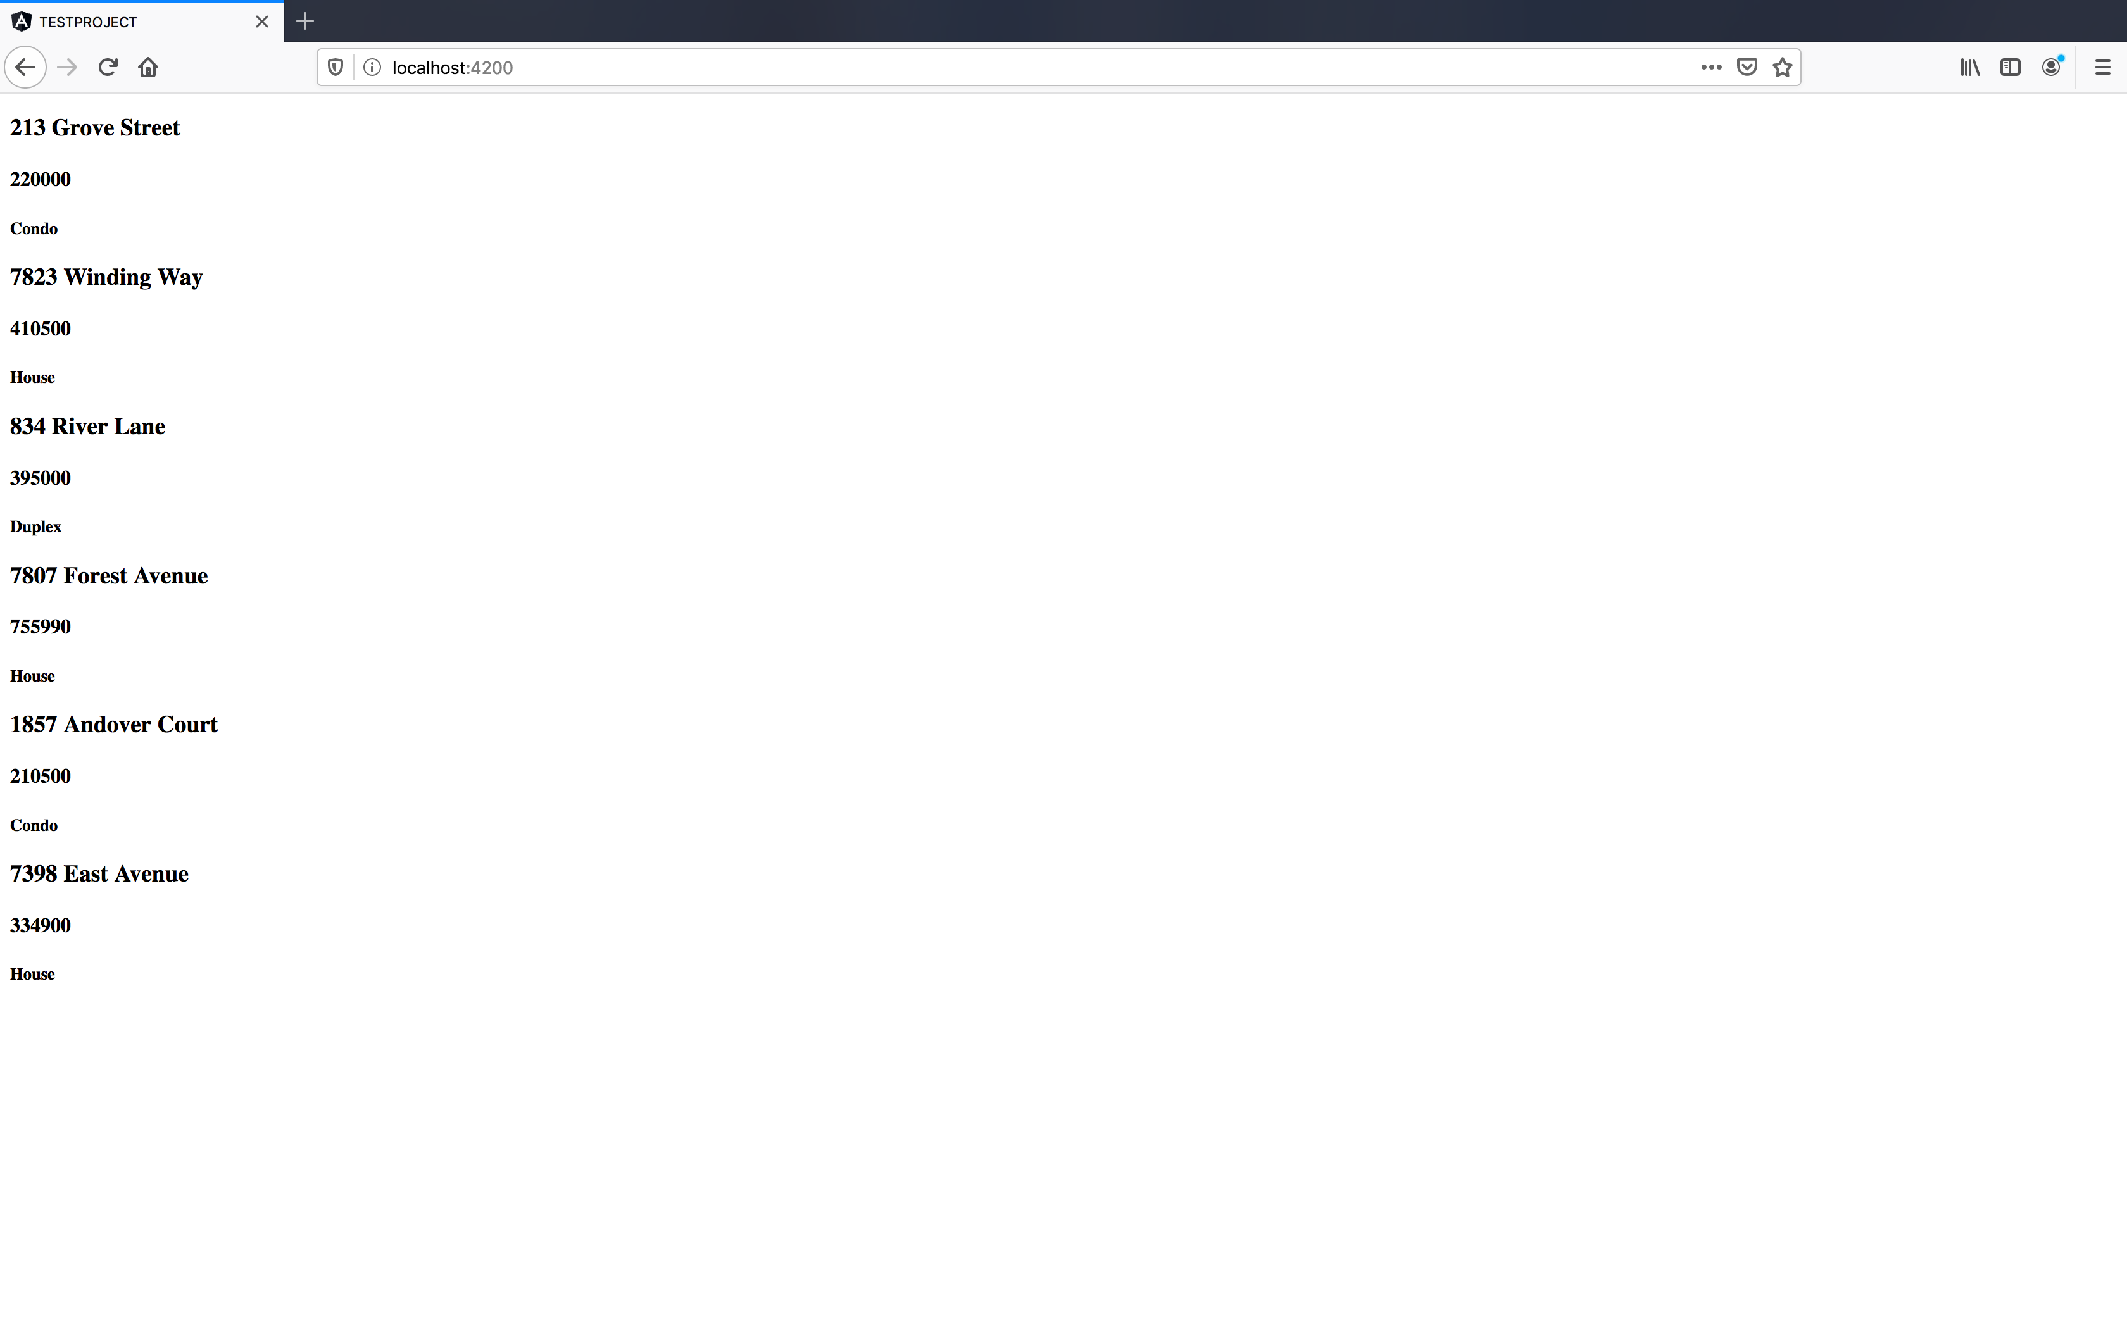
Repeating over data – cont.

Slide 43
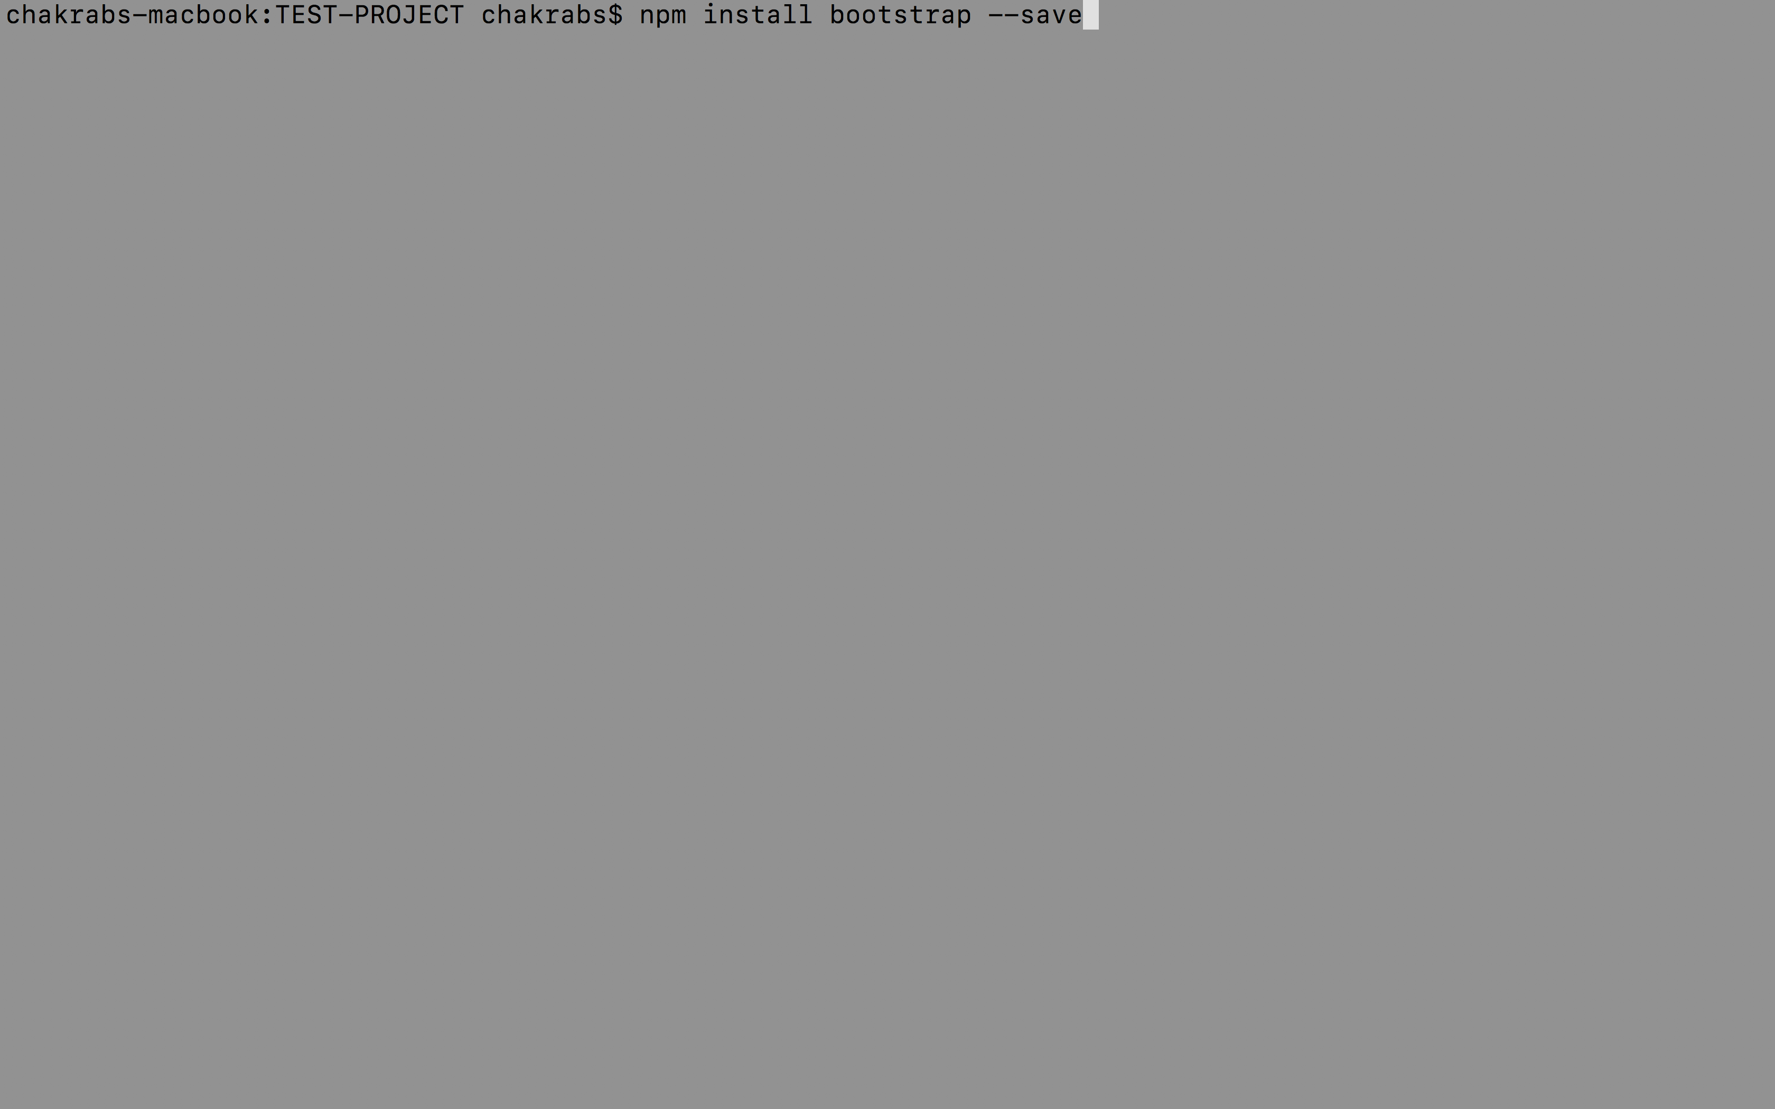
Repeating over data – cont.
This still doesn’t really look like our final application.
Get the CSS for bootstrap so that we have some styling.
Next, register it in our angular-cli configuration.

Slide 44
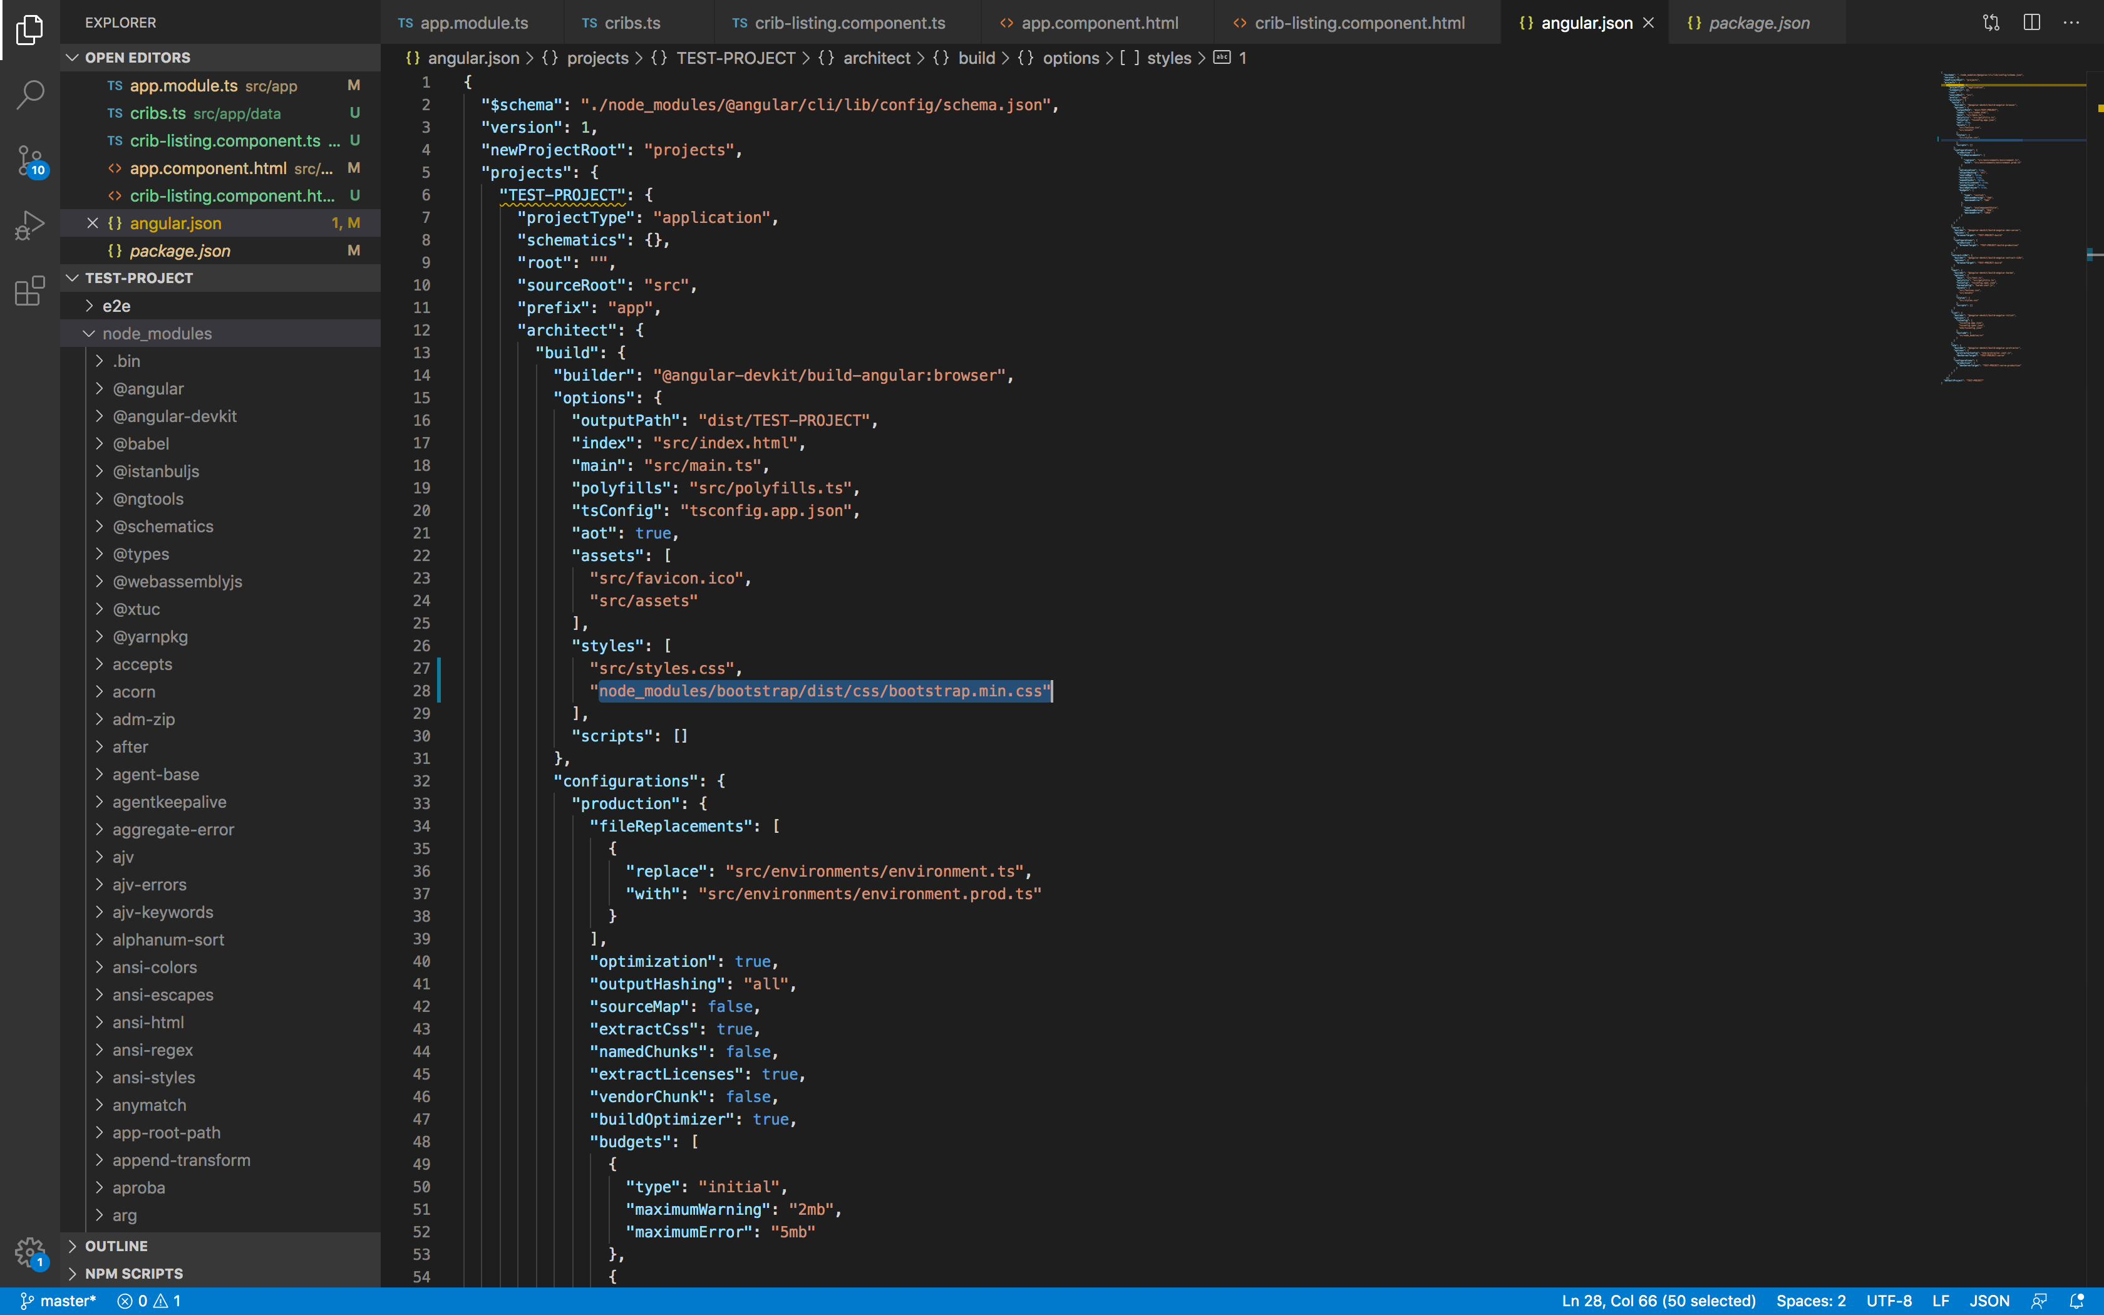
Repeating over data – cont.

Slide 45
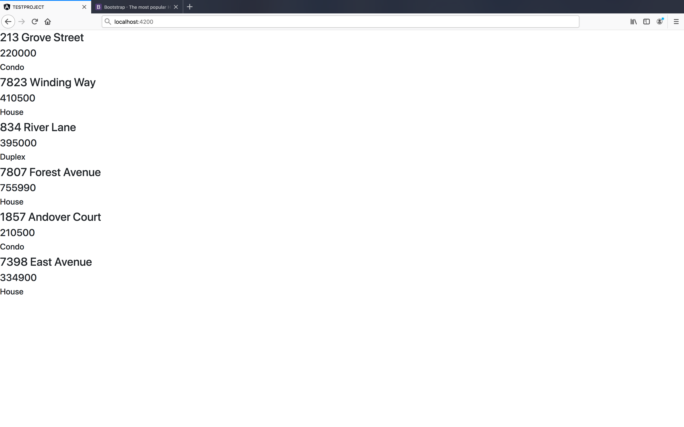
Repeating over data – cont.

Slide 46
Improving the display
We’ll add a navigation bar at the top.
Also, we will display the data in a different way (in a series of cards).
Each of the properties would get its own card, to display data for that property listing.
We want the data to be displayed in the central part in some container.

Slide 47
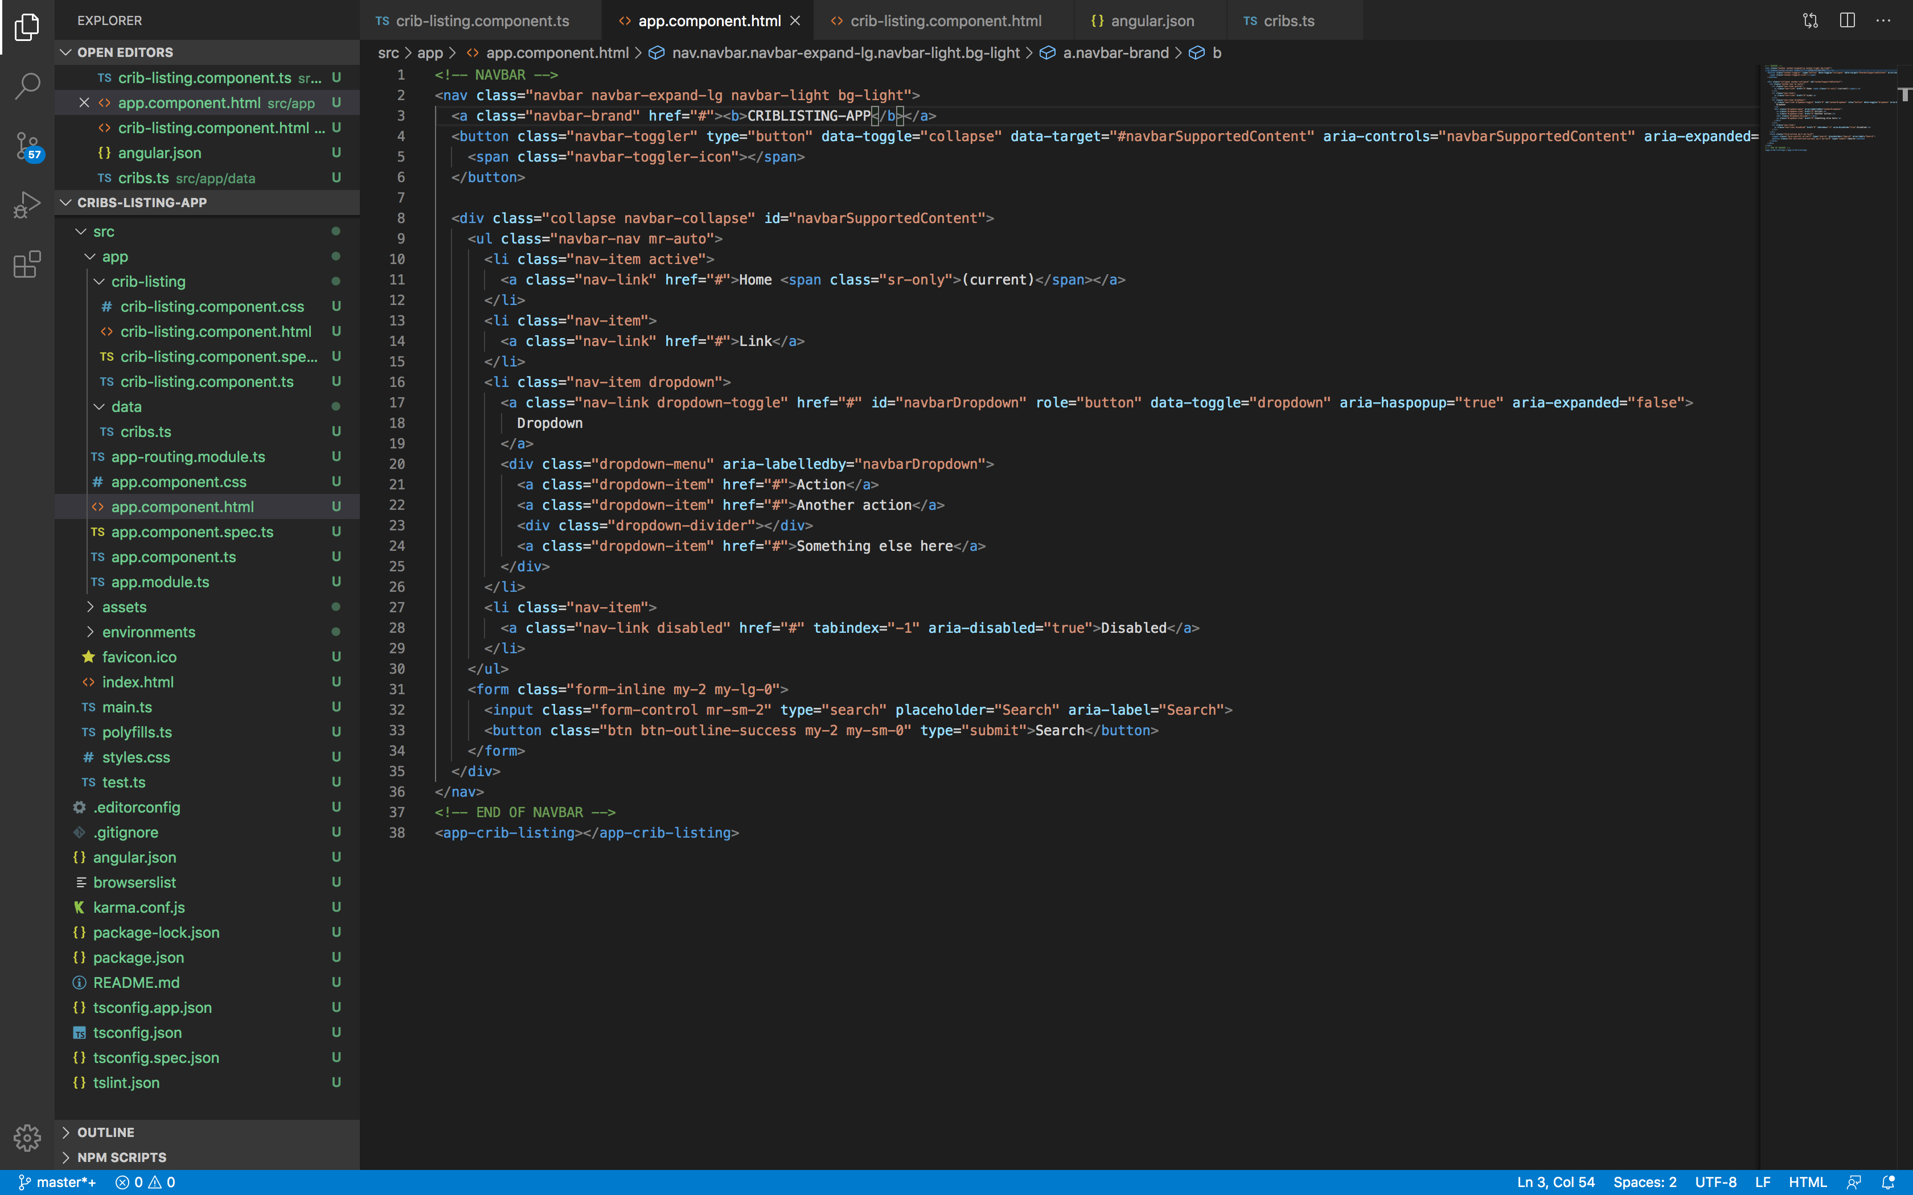
Improving the display – cont.
We get the template of the navbar from https://getbootstrap.com/docs/4.6/components/navbar/:

Slide 48
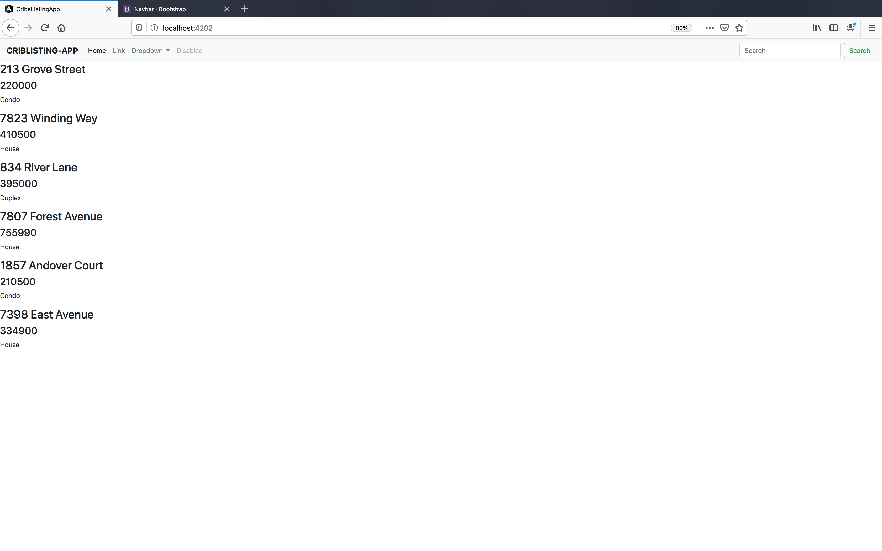
Improving the display – cont.

Slide 49
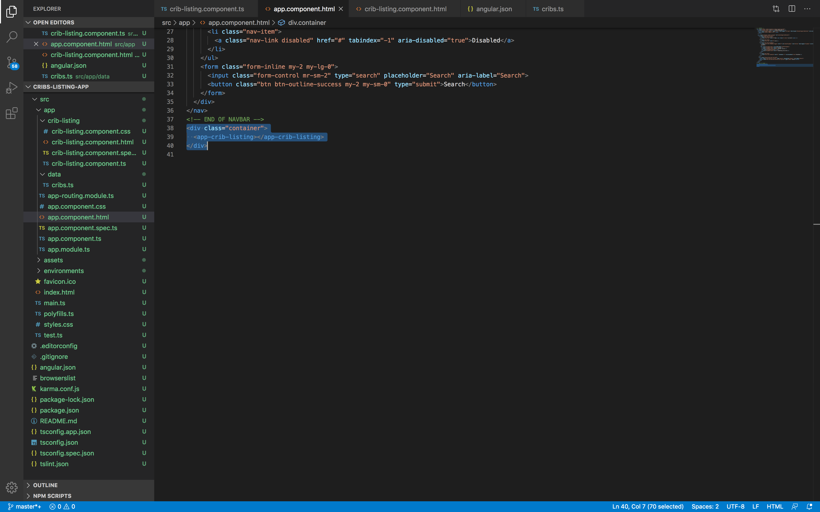
Improving the display – cont.
We add a container div so that the data appears in the middle of the screen:

Slide 50
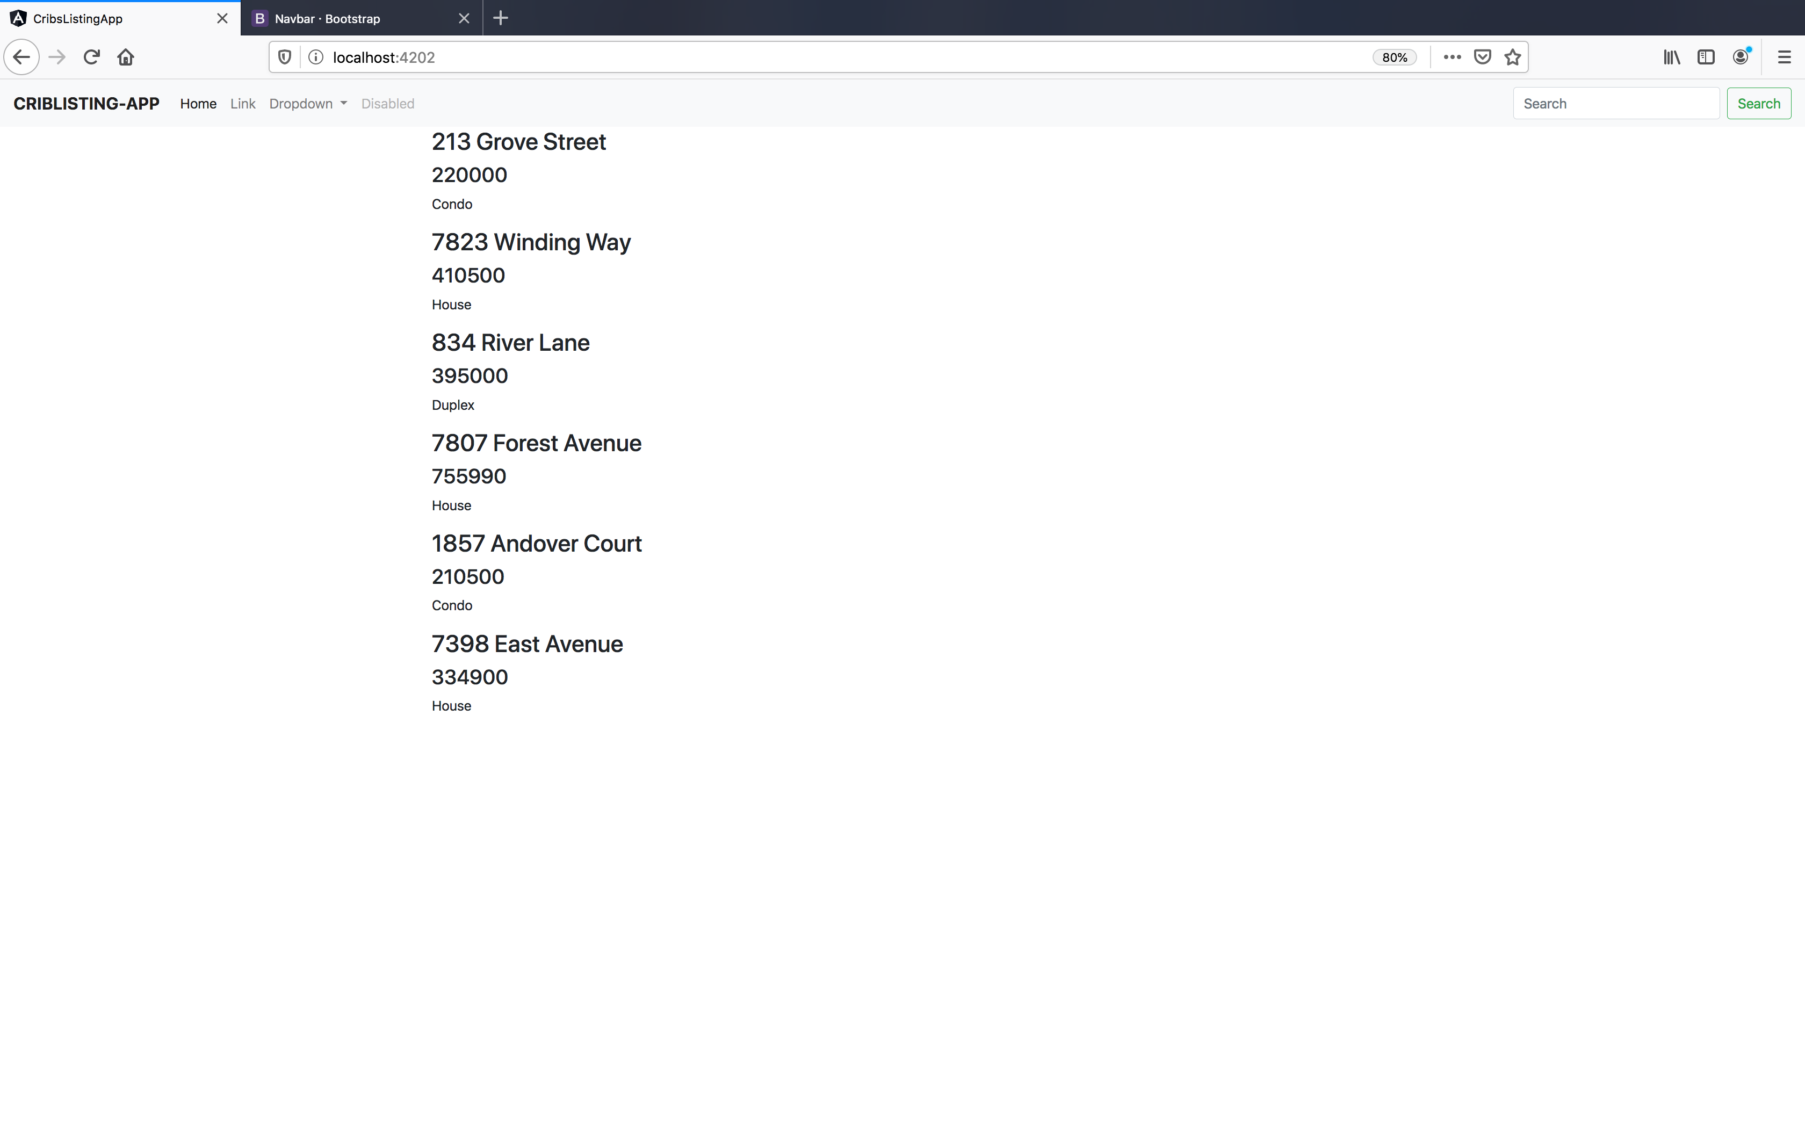
Improving the display – cont.

Slide 51
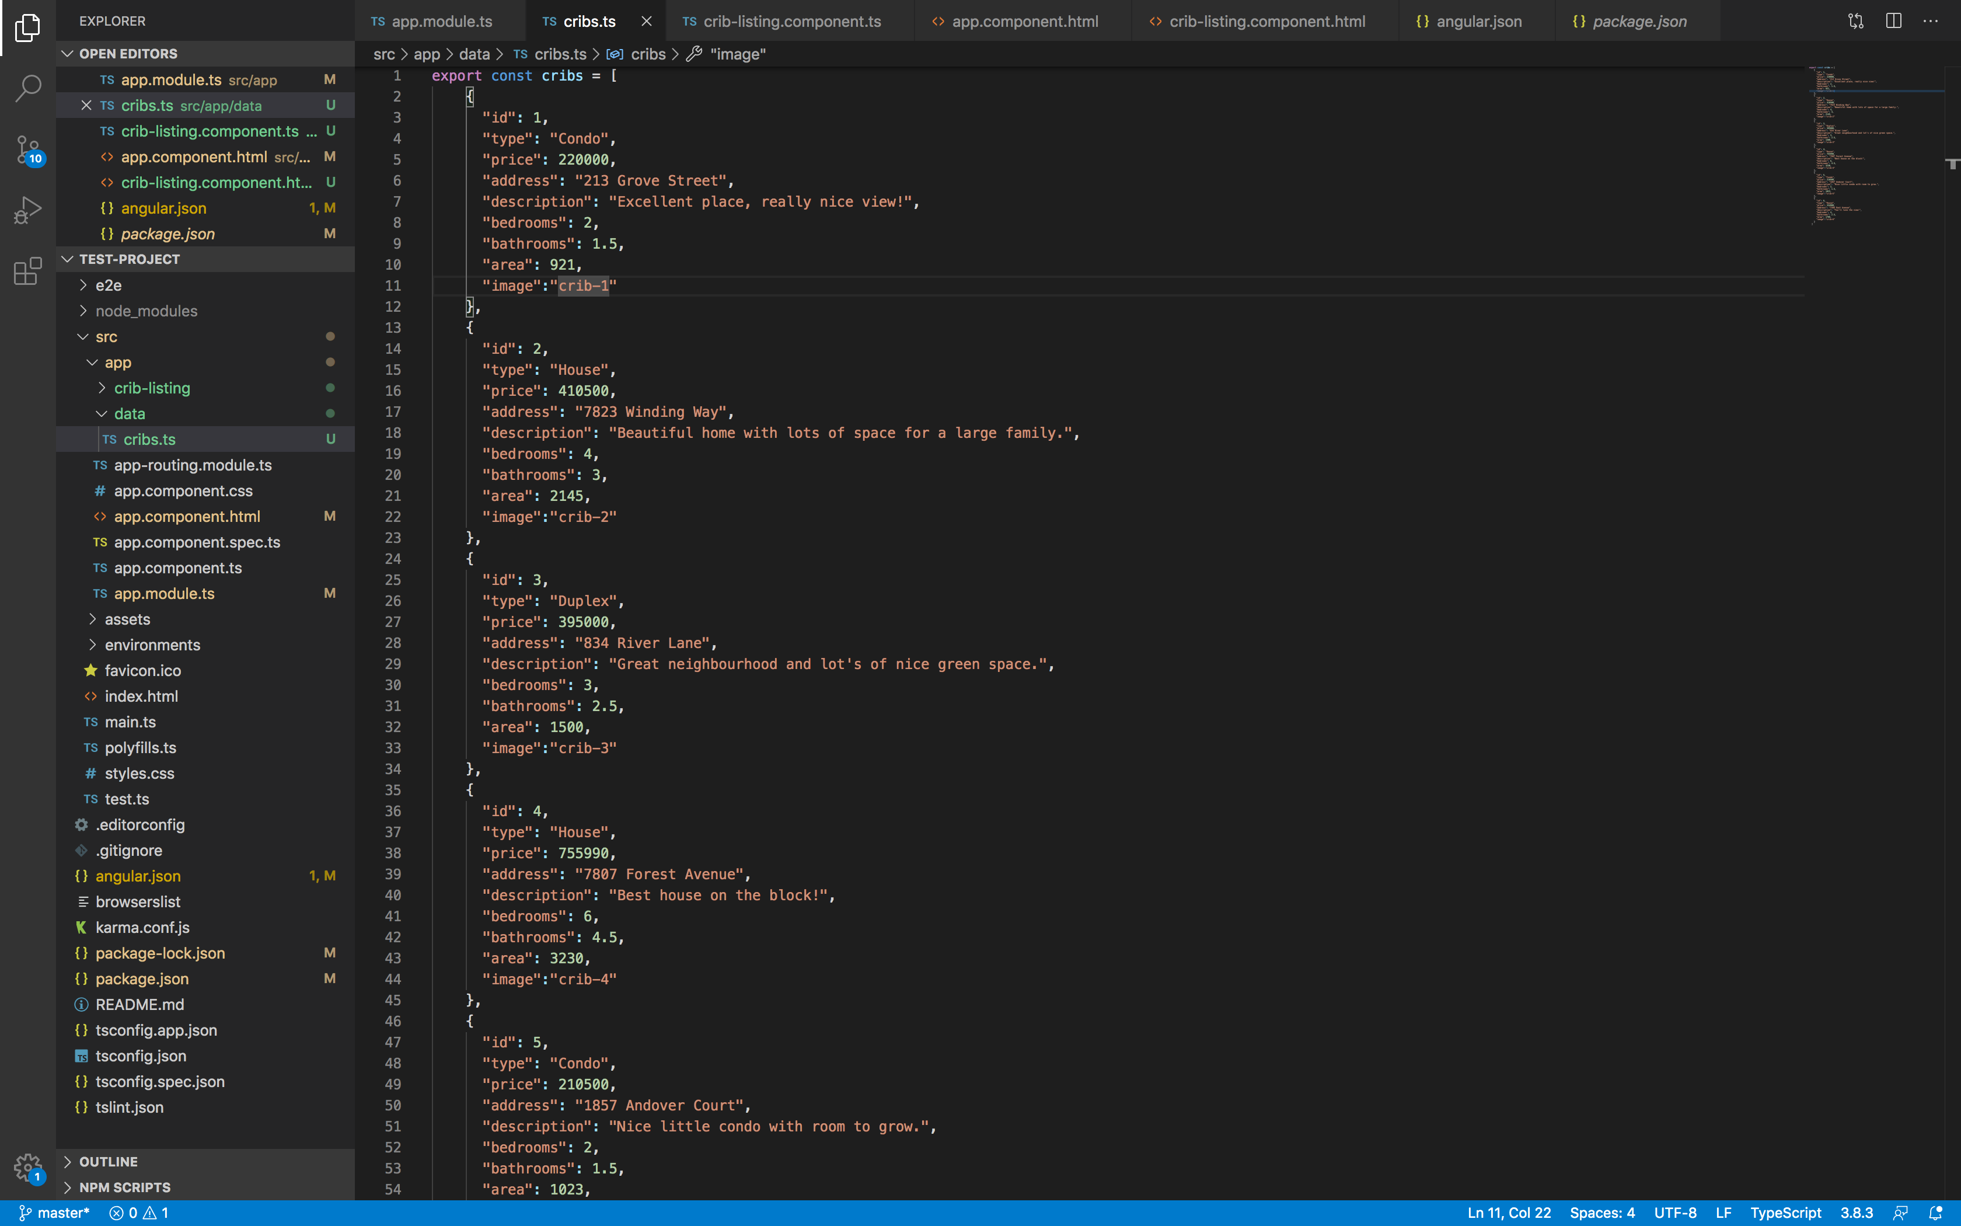
Improving the display – cont.
Now, we need to put the cards.
Each listing has an image associated with it (refer to the screenshot).
In the repository, we have images for all the listings.
Copy the images to the folder src/assets/images under your project folder.

Slide 52
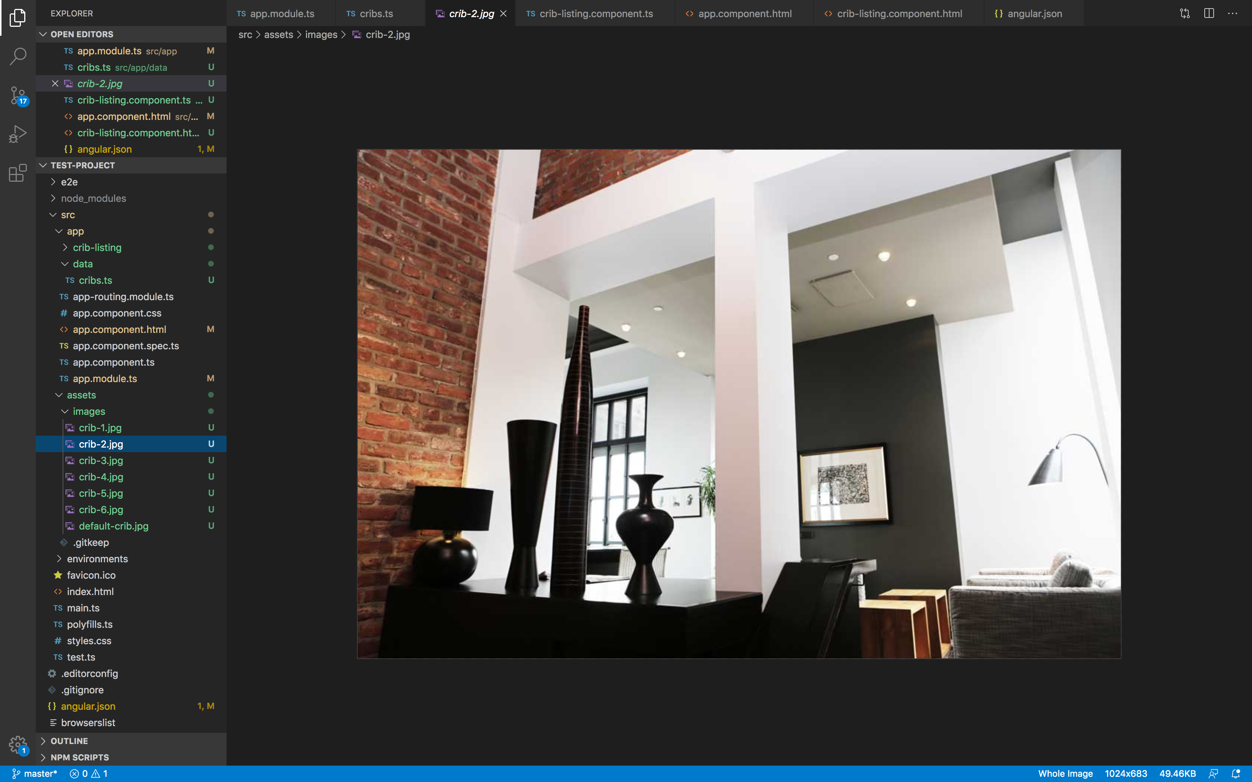
Improving the display – cont.

Slide 53
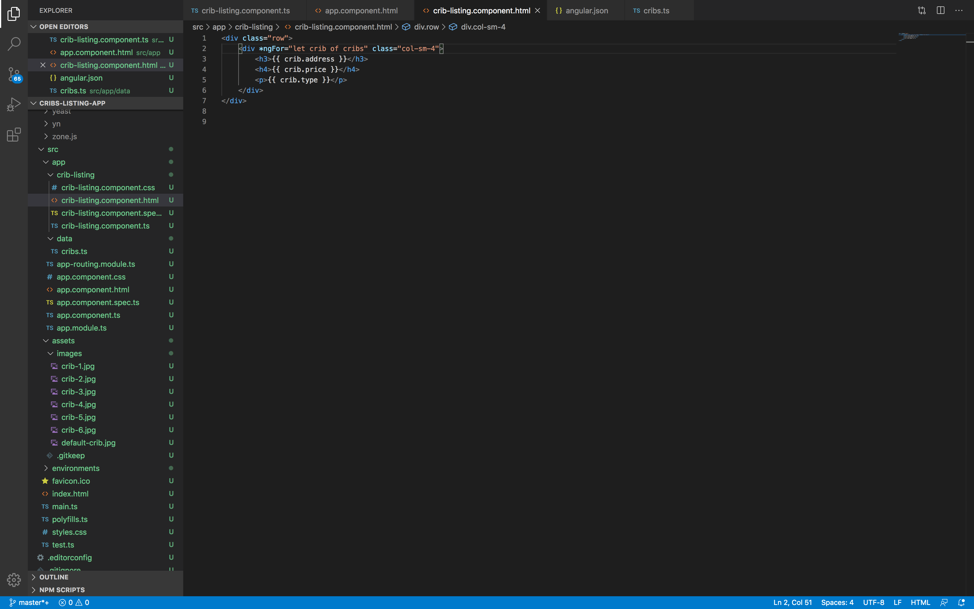
Improving the display – cont.

Slide 54
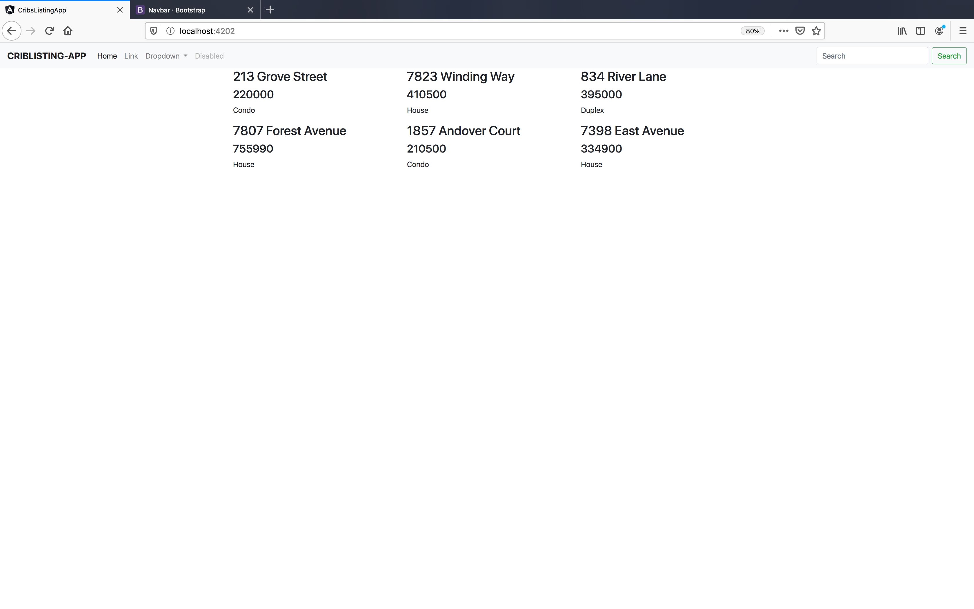
Improving the display – cont.

Slide 55
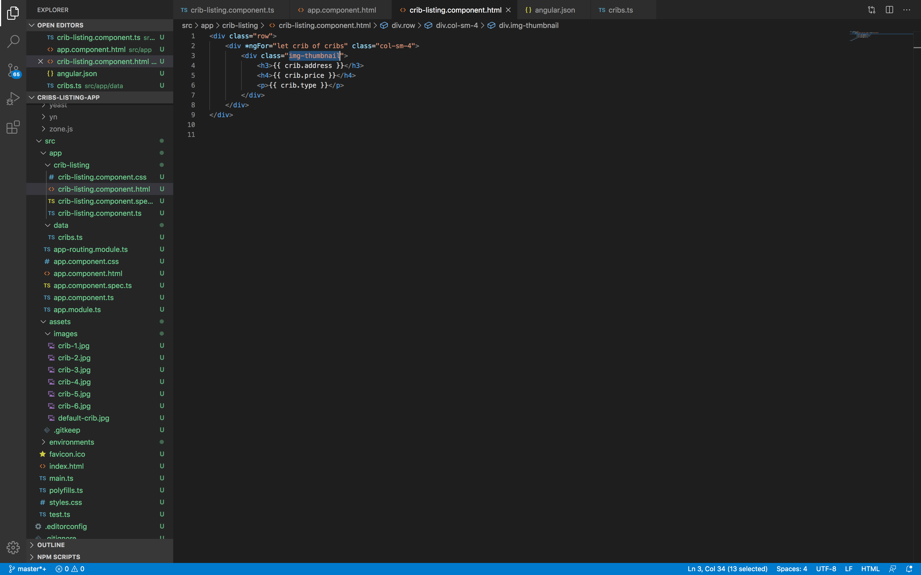
Improving the display – cont.

Slide 56
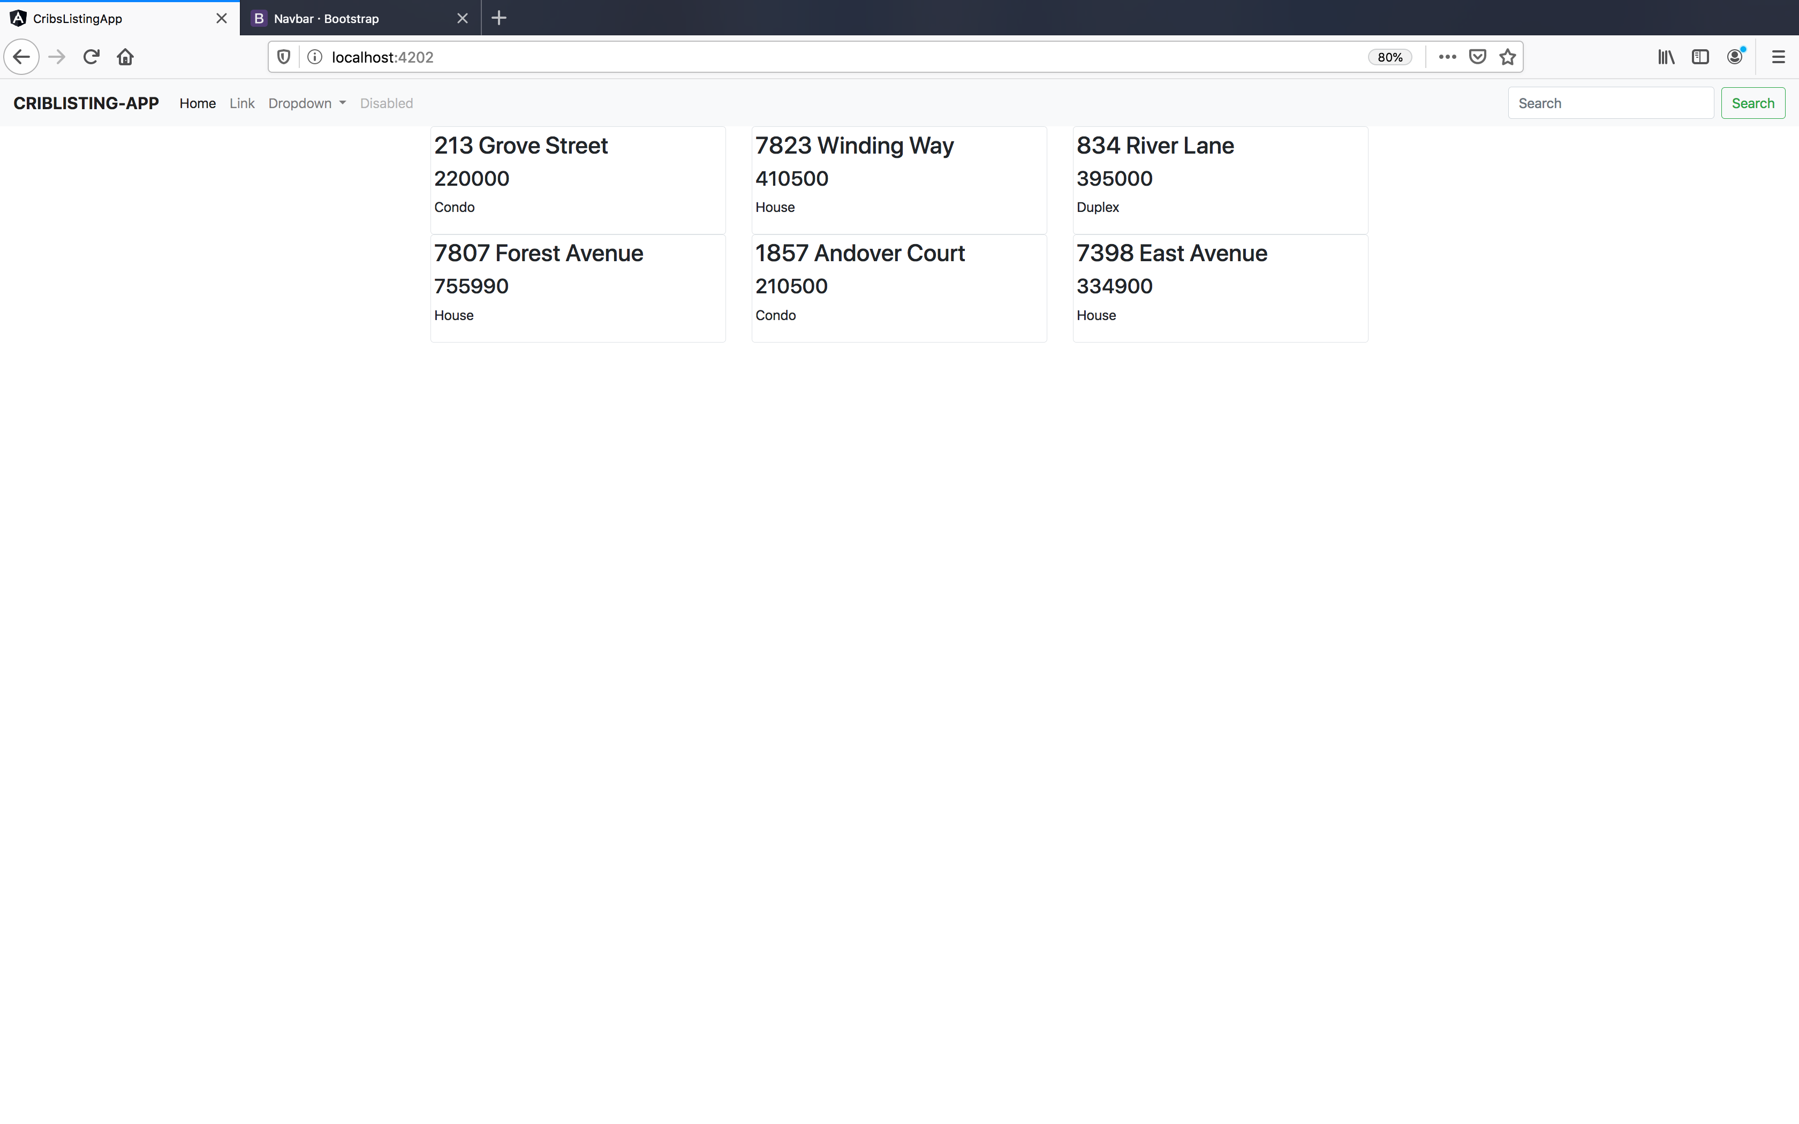
Improving the display – cont.

Slide 57
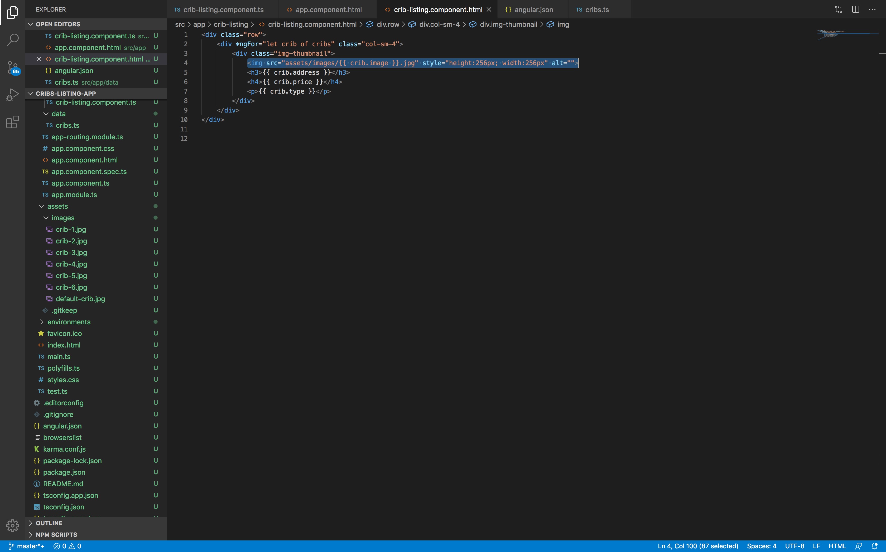
Improving the display – cont.

Slide 58
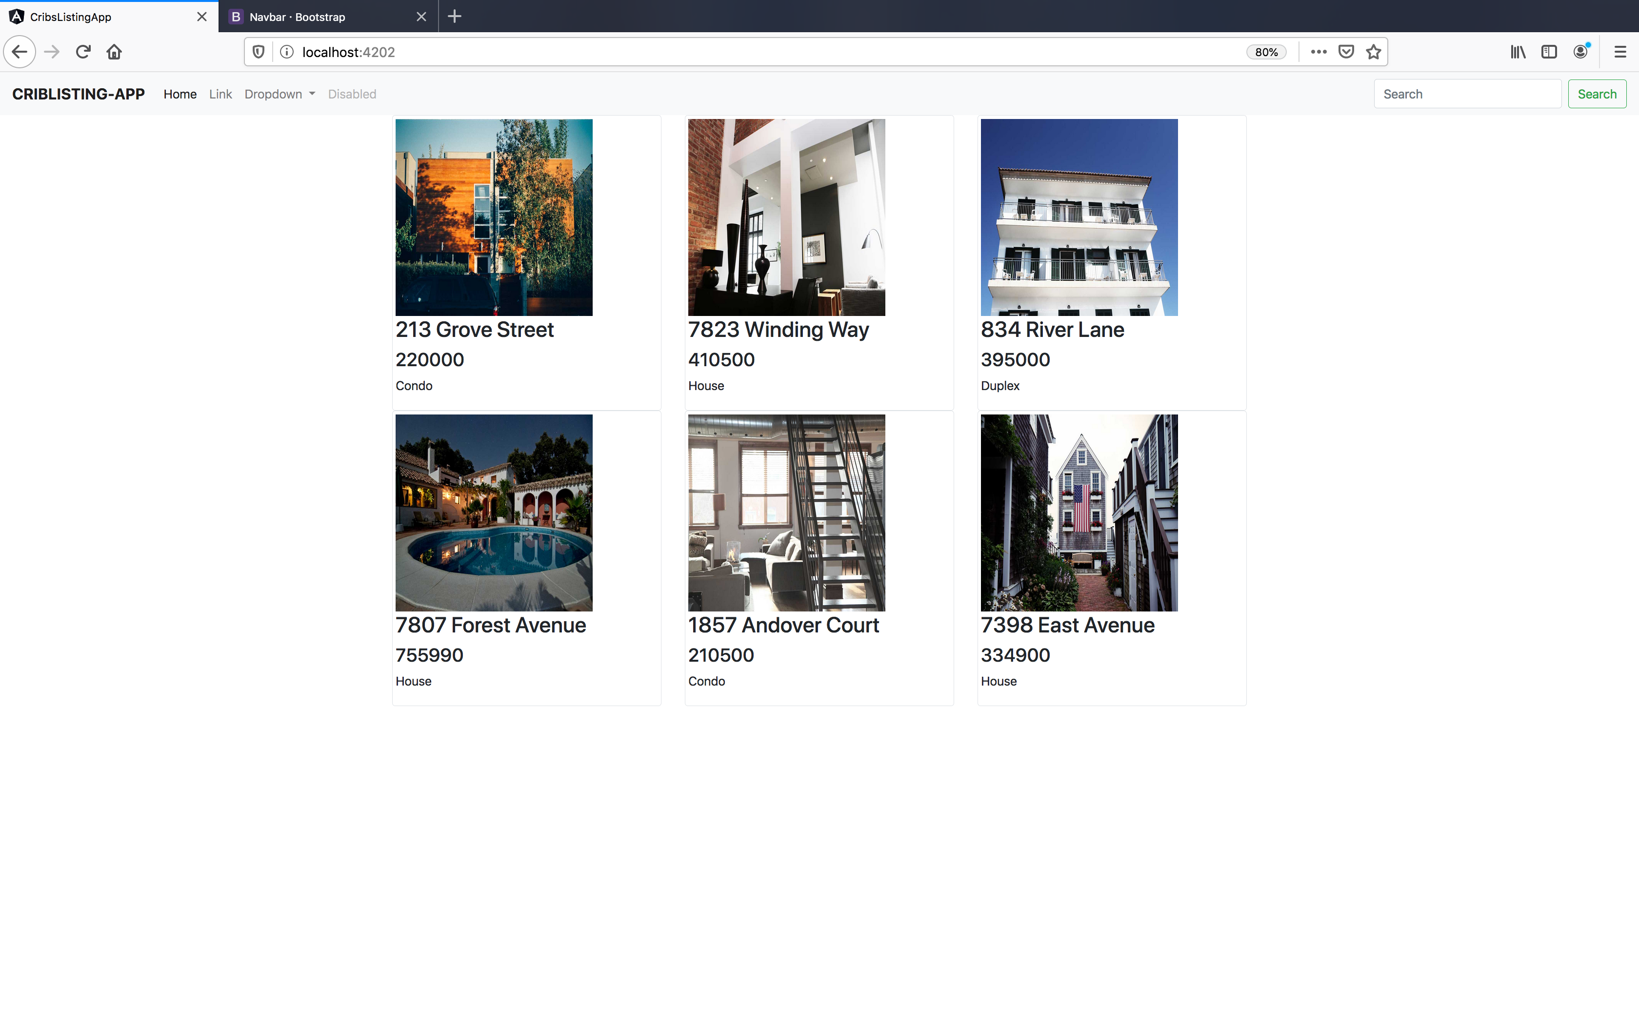
Improving the display – cont.

Slide 59
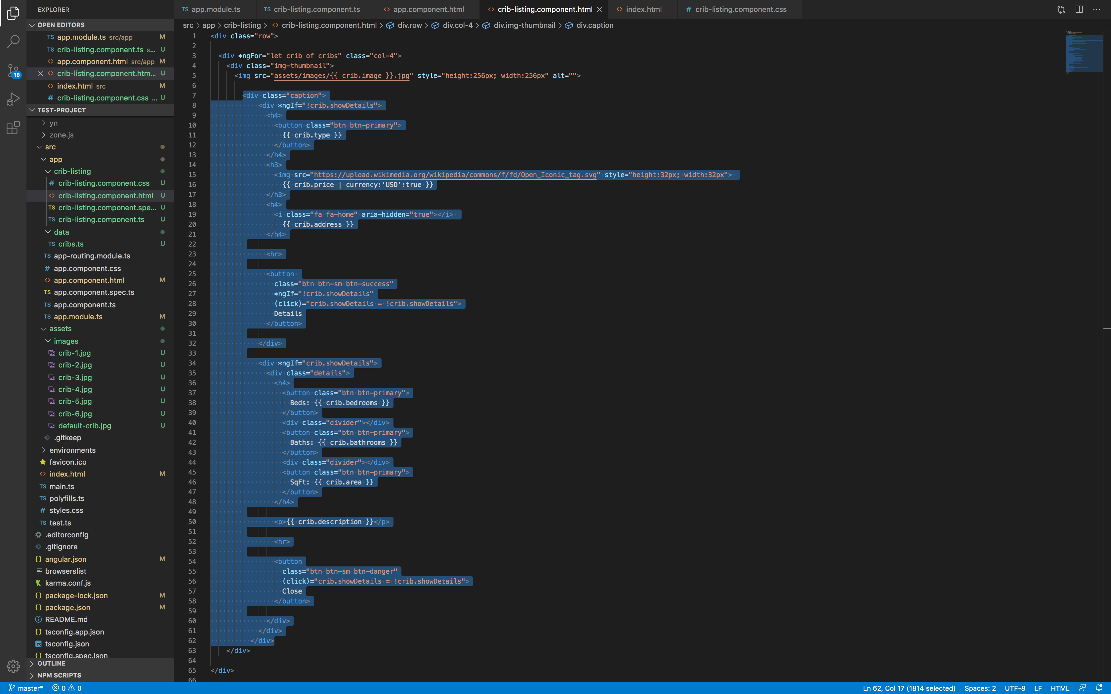
Improving the display – cont.
Next we clean up the area below the images and make it look nicer:

Slide 60
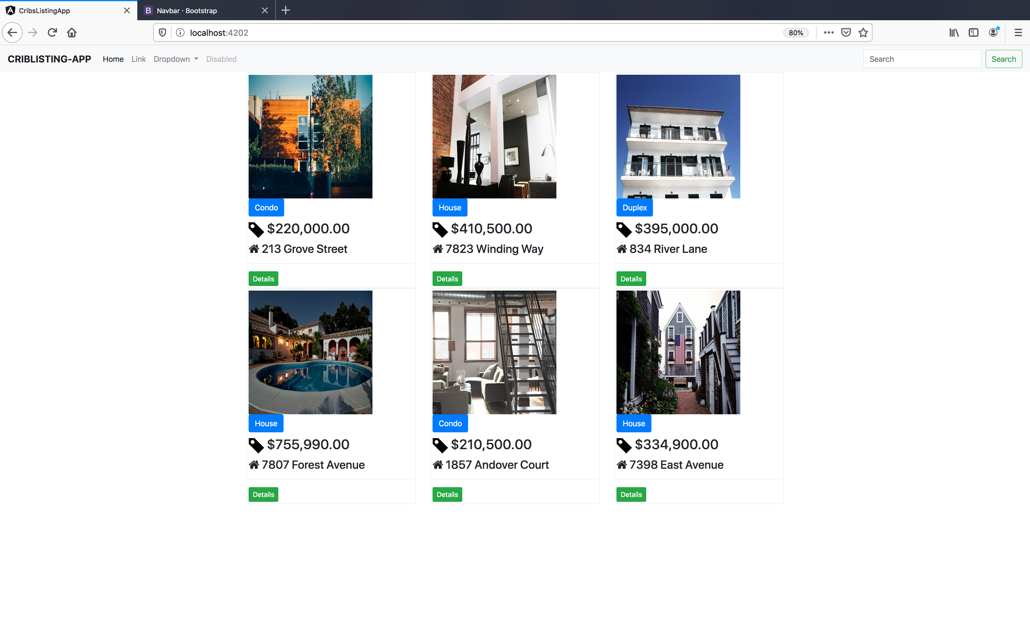
Improving the display – cont.

Slide 61
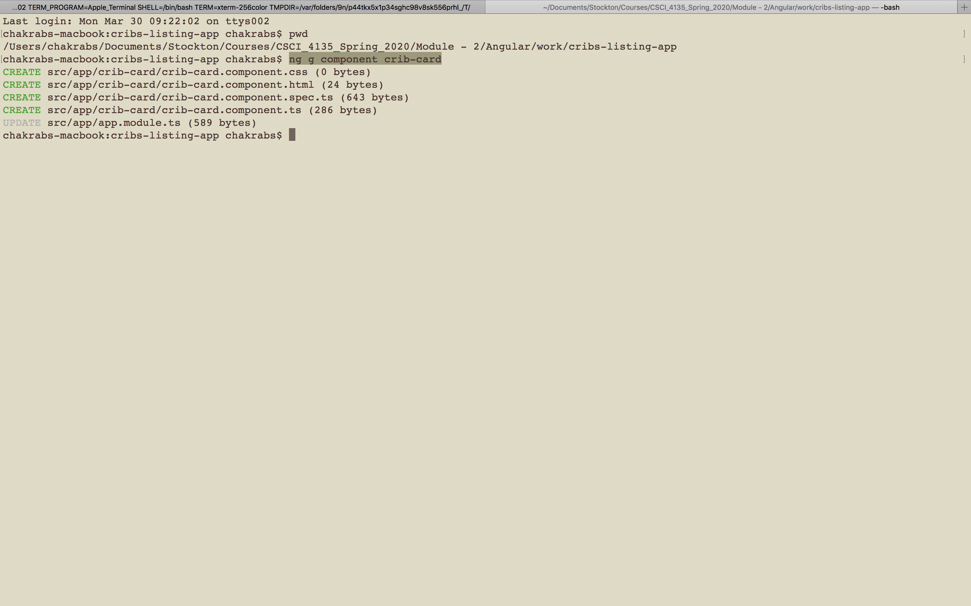
Creating a new component

Slide 62
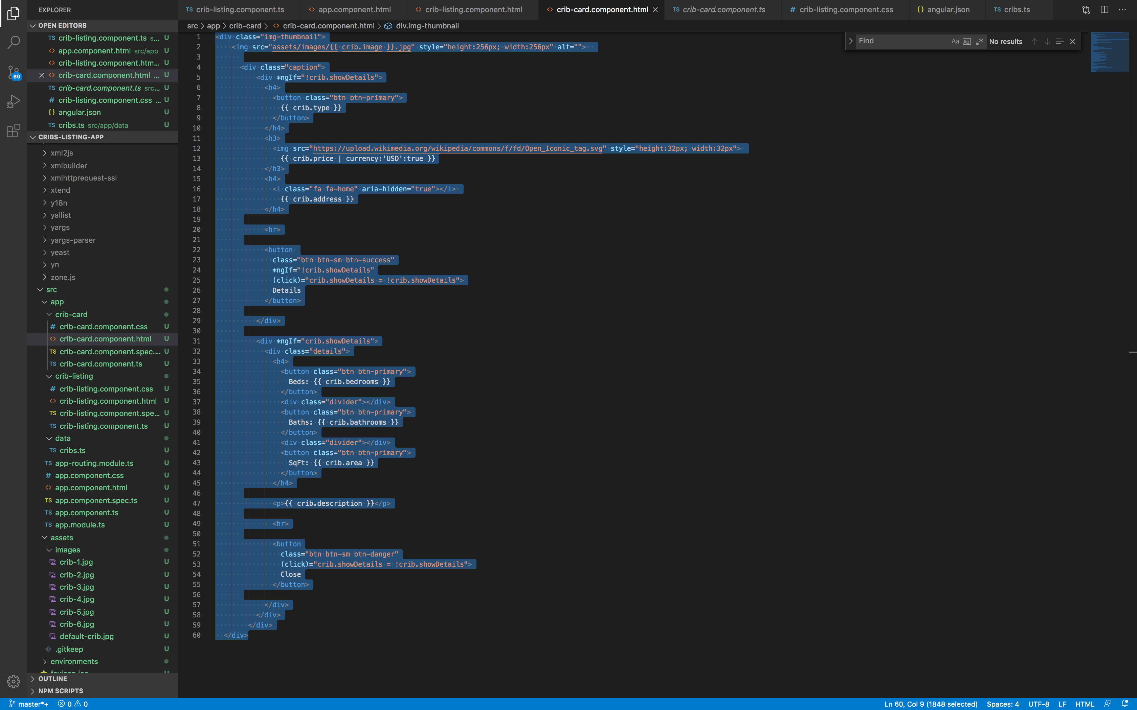
Improving the display – cont.
We move the highlighted code to crib-card.component.html from crib-listing.component.html.
Next we take the selector from the crib-card.component.ts.
We paste it to crib-listing.component.html
(Refer to screenshot in the next page).

Slide 63
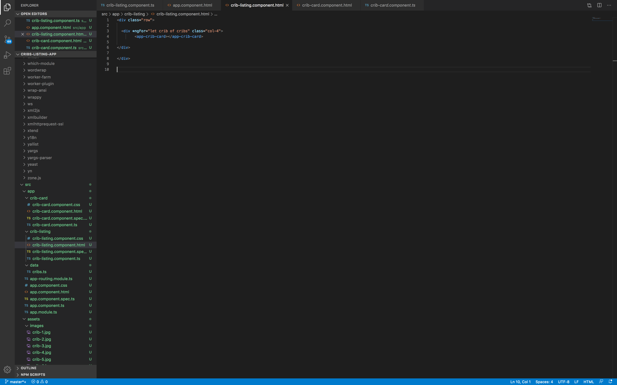
Improving the display – cont.

Slide 64
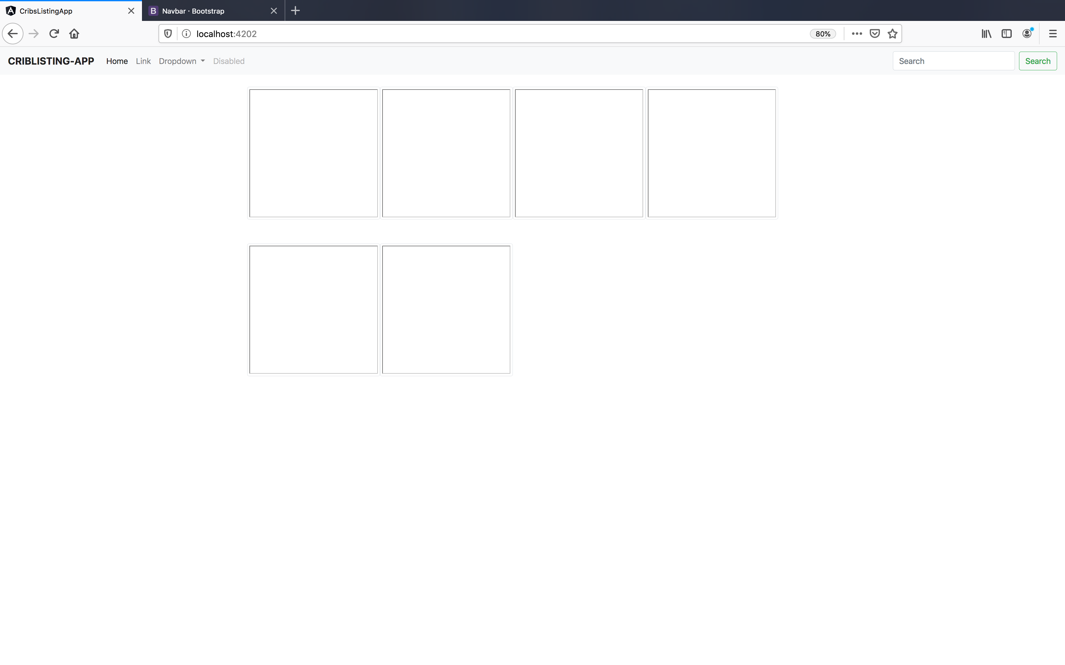
Improving the display – cont.
Currently we just have an empty structure, with no data to display:
<div class="row">
<div *ngFor="let crib of cribs" class="col-4">
<app-crib-card></app-crib-card>
</div>
</div>
We fix it with property binding.

Slide 65

Improving the display – cont.

Slide 66

Improving the display – cont.

Slide 67

Improving the display – cont.
Next, move the style from crib-listing.component.css to crib-card.component.css.
Now we can reuse our new crib-card component.

Slide 68

Improving the display – cont.

Slide 69

Implementing an interface

Slide 70

Implementing an interface – cont.
We can explicitly specify what kind of data should exist on the “crib” property.
We do that with an interface.
An interface is a class that describes how something should be shaped/what kind of keys or values it should contain.

Slide 71

Implementing an interface – cont.

Slide 72

Implementing an interface – cont.

Slide 73

Implementing an interface – cont.

Slide 74

Implementing an interface – cont.
This also allows you to see what are the available fields for the property:

